Slide 1

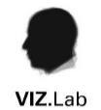
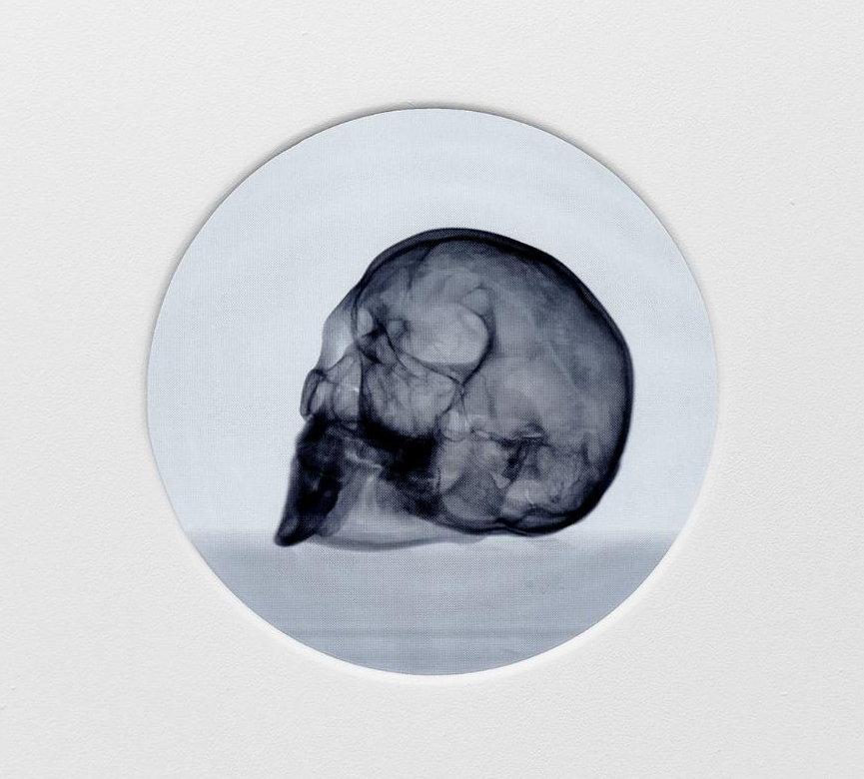
Visualising Personhood cemeteries as archives of the future
SACA 2025 | 25-27 August | Brixton Johannesburg
Prof. KATHRYN SMITH
VIZ.Lab / Department of Visual Arts
Stellenbosch University, South Africa
kathryns@sun.ac.za
Kathryn Smith, The Phantom Interlocutor (2023). Digital animation of 2802 micro-CT slices of a human skull. Infinite loop. A4 Arts Foundation

Slide 2
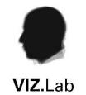
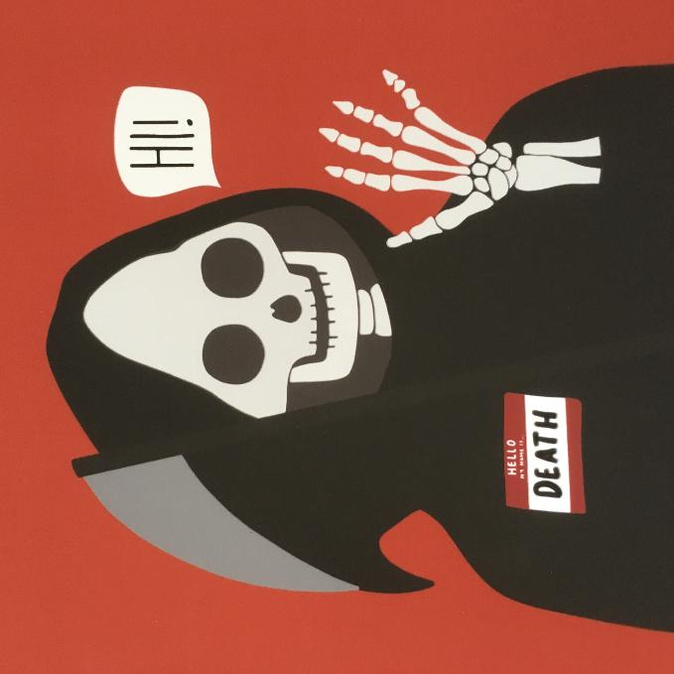
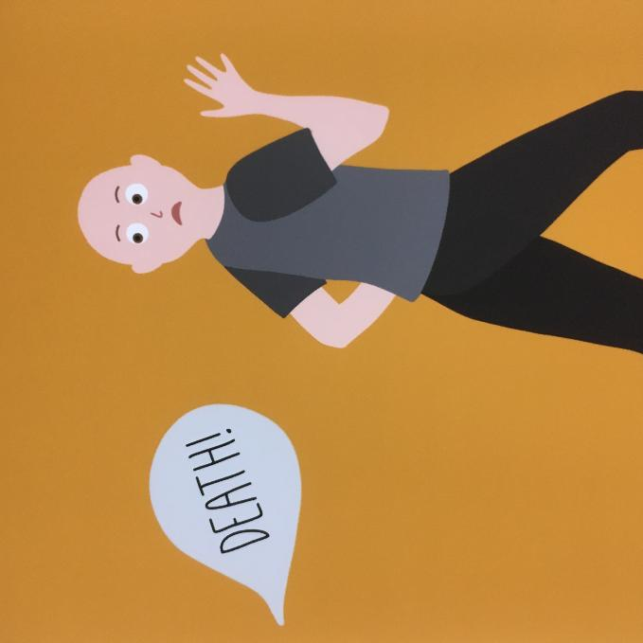
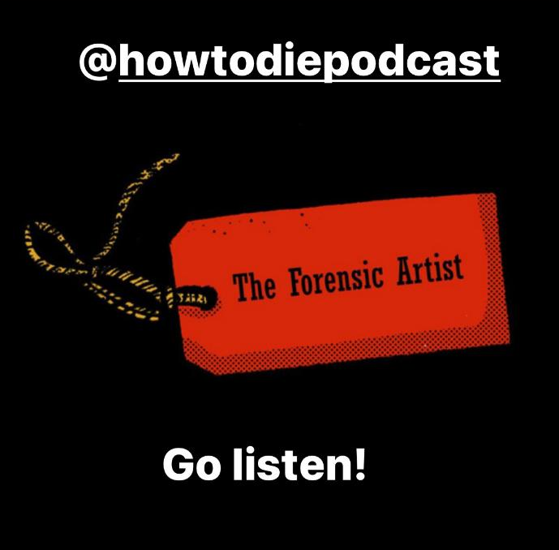
Death is scary… for some!
Illustrations by Jessica Irwin. See Irwin, J., Roughley, M. & Smith, K. 2020. ‘To donate or not to donate? that is the question!’: an organ and body donation comic. Journal of Visual Communication in Medicine. 43(3):103–118. DOI: 10.1080/17453054.2020.1770059.
How to Die podcast by Sean O'Connor, episode 18.

Slide 3

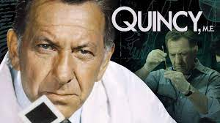

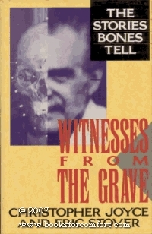
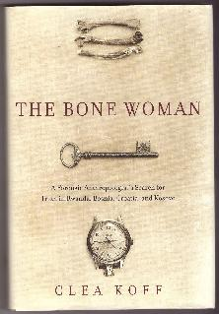
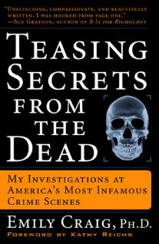
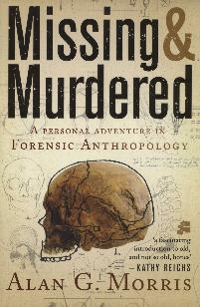
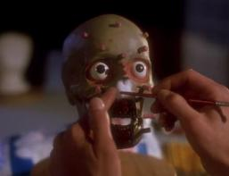
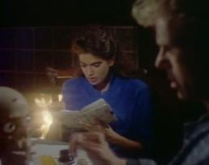
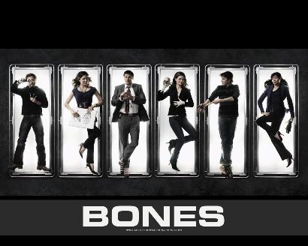
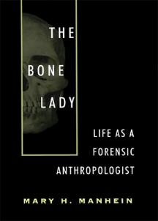
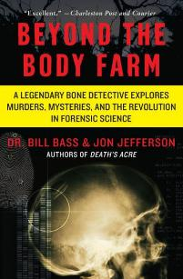
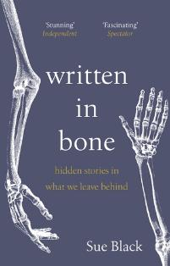
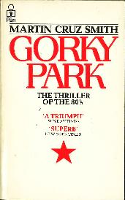
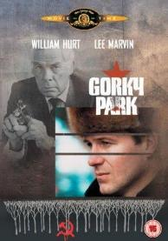
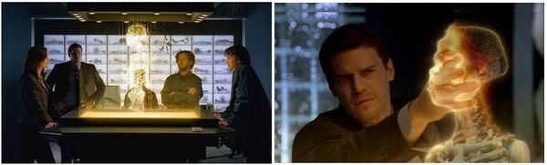
The forensic imaginary

Slide 4

THE PRACADEMIC (Posner, 2009)
CHARACTERISTICS OF AN EFFECTIVE PRACADEMIC
  Familiar with addressing multiple audiences with different interests and communication styles - “boundary-spanners”
  Have unique skills which enable communication across linguistic, social and cultural contexts i.e. mediation, interpretation, translation of knowledge across contexts e.g. art and science, or research and community
  Fostering trust across sectors is a fundamental skill; creates legitimacy
Pracademics contribute to higher social welfare through mediating explicit and tacit knowledge via a network model informed by the Japanese concept of ba (how knowledge is produced relative to sites of work)
TRANSDISCIPLINARY RESEARCH INVOLVES THE END-USER IN THE DESIGN AND THE PROCESS!

Slide 5
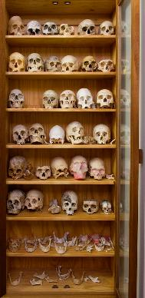
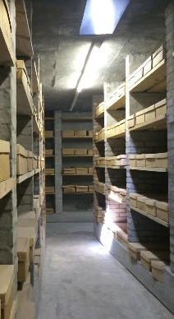
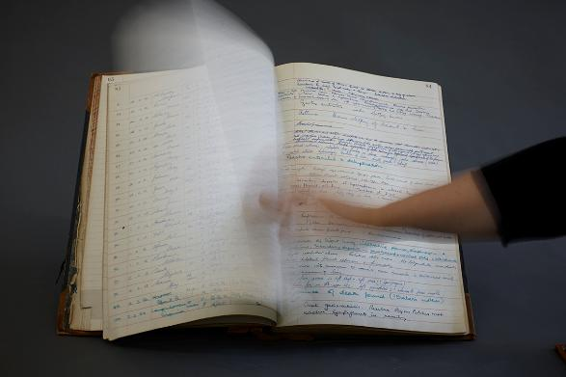
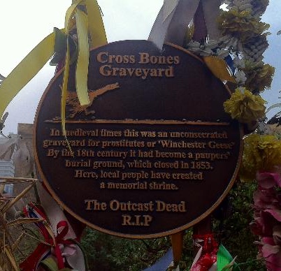
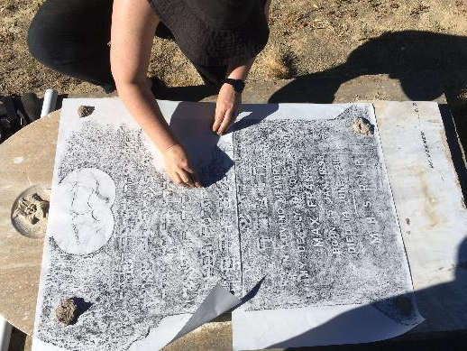
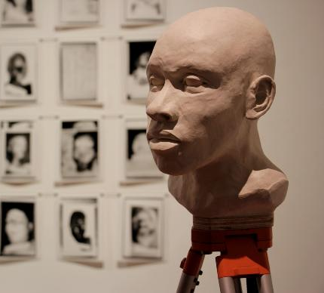
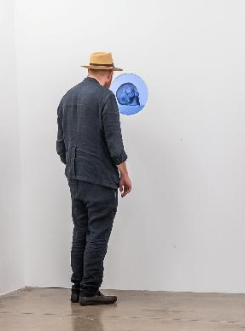
Cemeteries as archives of the future
FOCUS the vital work of pracademic collaboration in forensic & heritage work
Rethinking cemeteries (in the broadest sense) as essential archives by which we can know ourselves in more profound ways
for appreciating & understanding human attitudes to life and death across time and diverse cultures. What we know about the human journey is largely as a result of how we have treated our dead
for reinvestigating unresolved deaths

Slide 6
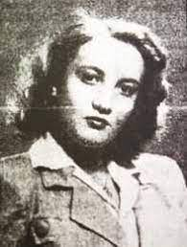
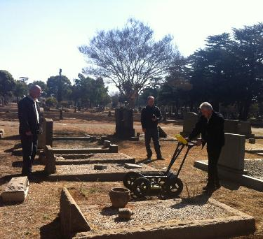
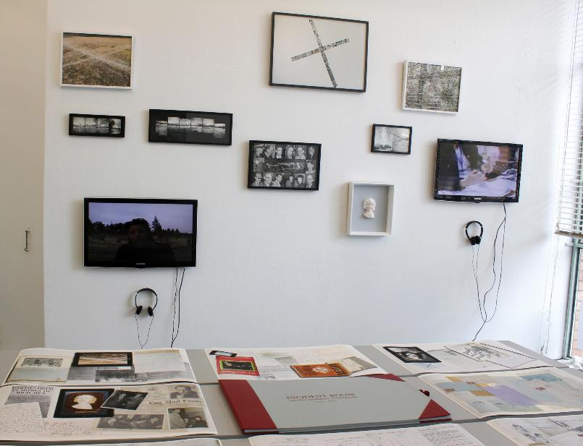
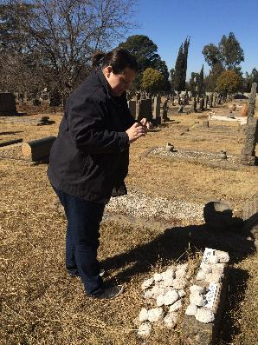
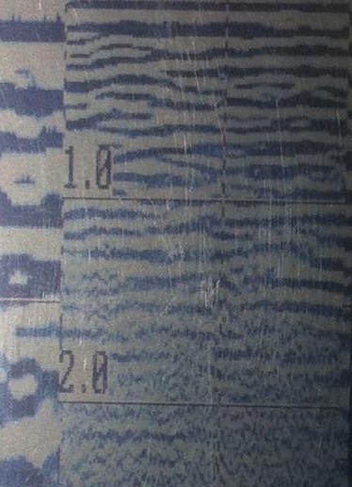
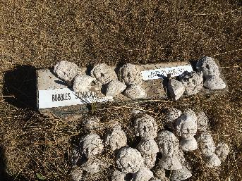
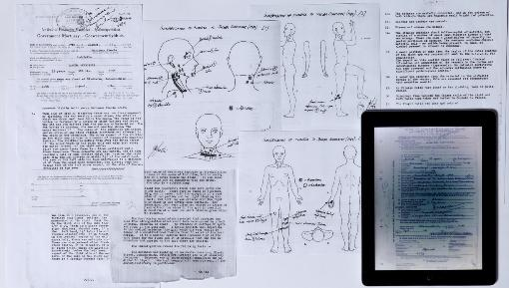
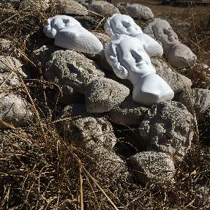
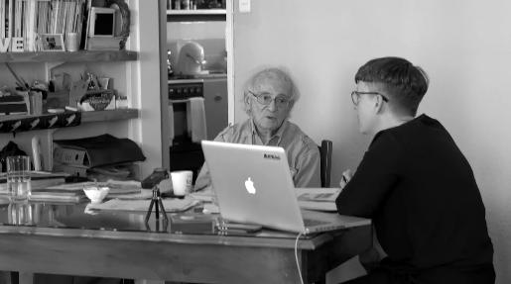
Incident Room (2012)
Jacoba ‘Bubbles’ Schroeder
1931-1949

Slide 7
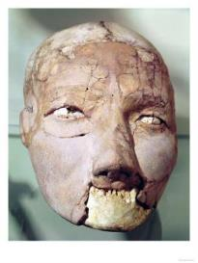
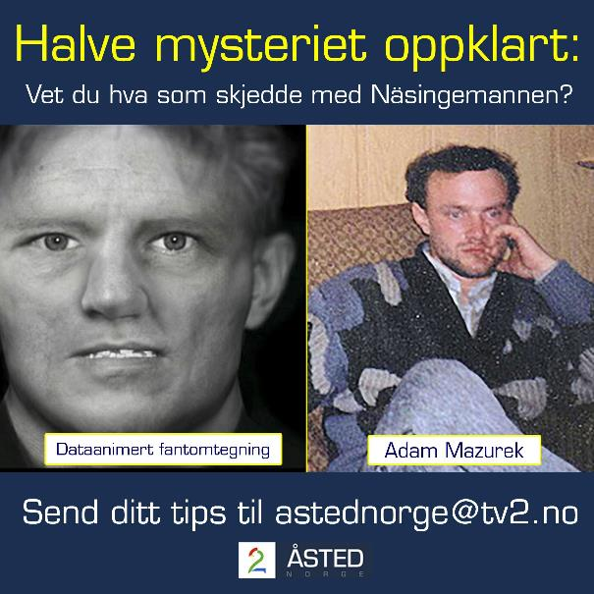
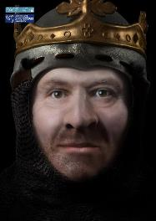
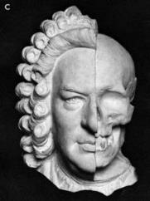
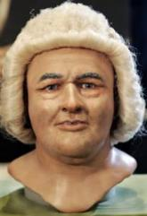
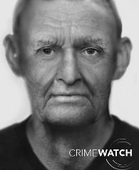
Why depict the dead?
What might anatomical reconstruction afford?
Humanization of remains
Crafting ‘personhood’, individuality
Examining cognitive bias, appearance vs perception
Ritual
practices
Jericho head, c. 7000-6000 BC
Historical
interest
Robert the Bruce, Face Lab 2016
Forensic
identification
Earliest anatomical reconstruction
J.S Bach by His & Seffner (1895)
Caroline Wilkinson & Janice Aitkin (2008)
Unidentified person reconstructed from skull, Face Lab
Notes:
What do we make of multiple depictions of the same individual?

Slide 8
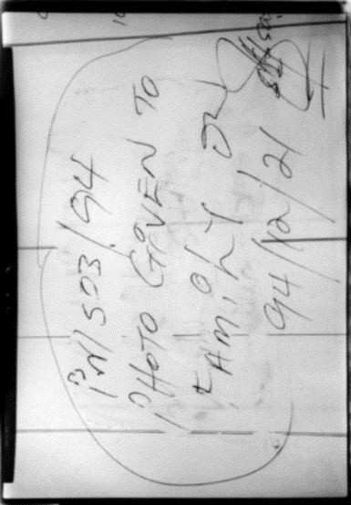
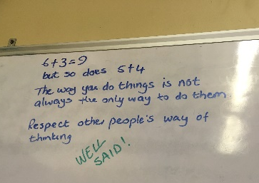
Two Images, Twenty Years Apart
Kathryn Smith, Detail from ID/Inventory, multimedia installation (dimensions variable), 1998-1999. Silver gelatin print on 8” x 10” gloss resin-coated paper
Kathryn Smith, Whiteboard wisdom, Salt River medico-legal mortuary, 2018. iPhone photograph

Slide 9
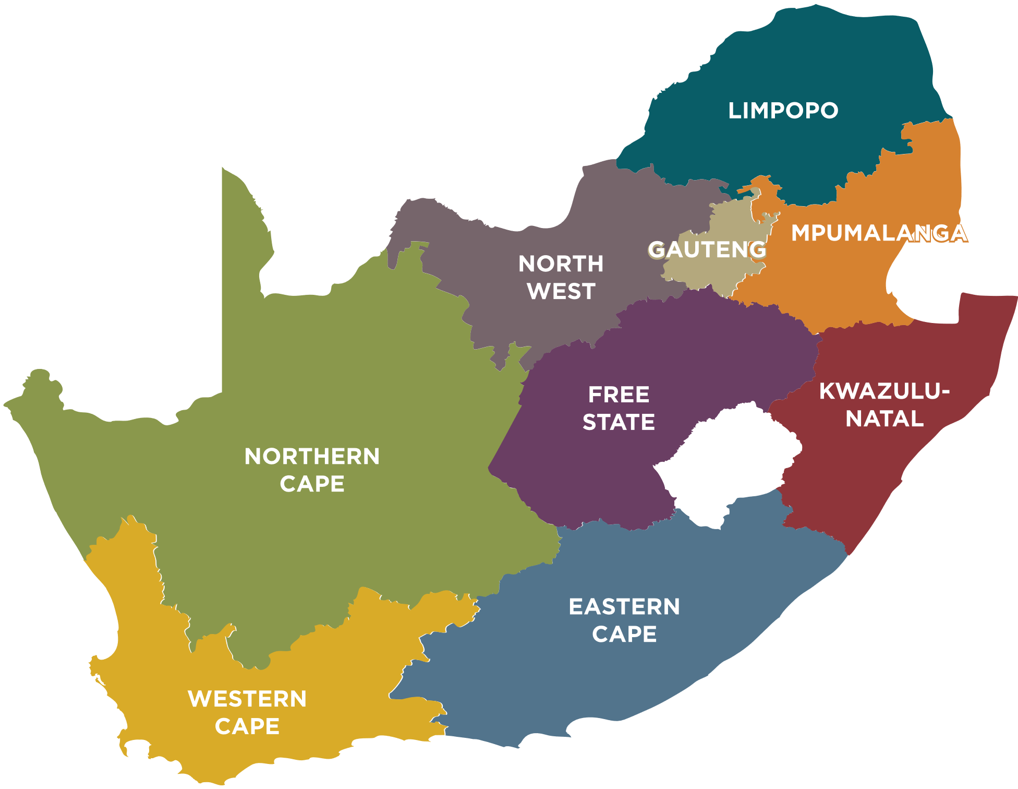


Salt River Study (2018-2019)
± 8000 cases of unnatural death are admitted annually between FPS Salt River and Tygerberg; 9% remain unidentified (Reid et al. 2019; 2020).
Records review of 1010 Unclaimed cases from FPS Salt River over an 8.5 year period, scored for facial condition and quality of facial photo
71% were admitted in a suitable condition for a PM depiction (digital photo enhancement) (Smith, 2020) but only possible for 30.3% cases due to poor photography






  


Slide 10
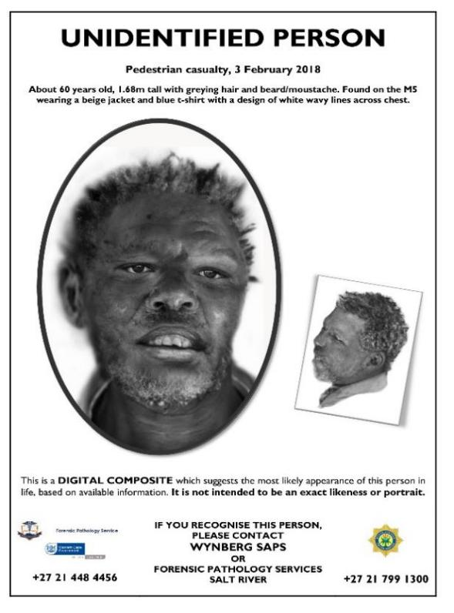
FINDINGS
Difficulties in separating Unclaimed from Unidentified cases
FPS may legally pauper after 30 days, however this is insufficient time to adequately process cases, leading to storage issues
Interventions needed in operational workflows and policy
STANDARDISATION OF POST-MORTEM FACIAL PHOTOGRAPHY is most urgent primary intervention to avoid error at admission & future facial comparison/depiction opportunities
20 cases tracked through the system
10 depictions and template posters produced
Unidentified Person public appeal poster format with active-case depiction (n = 10)

Slide 11
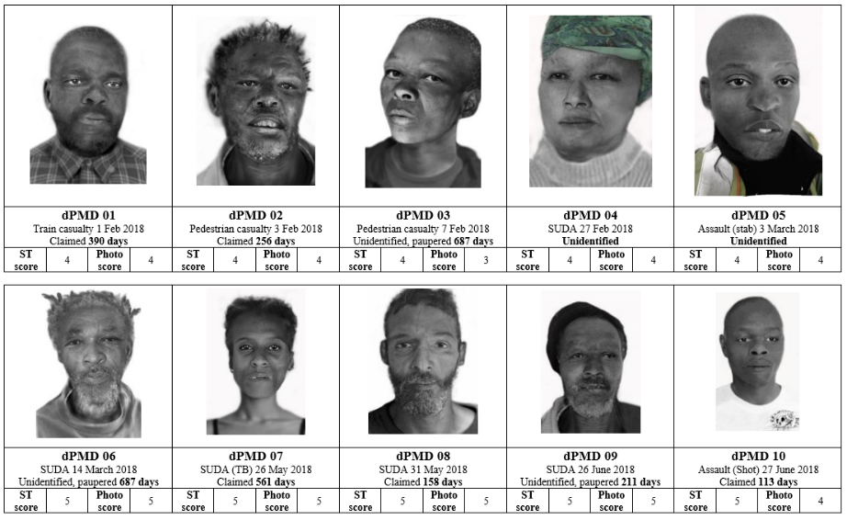
Salt River Study (2018-2019)
Min/max number of days from admission to identification: 80 – 399
Max. number of days from admission to release without identification: 687
Average number of days from admission to release (identified and/or paupered): 383.5
Smith, 2020

Slide 12
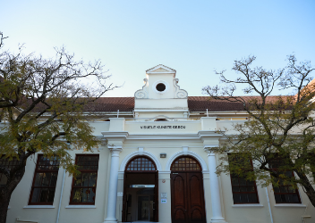
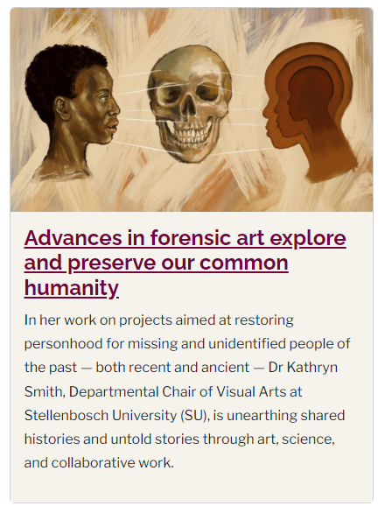
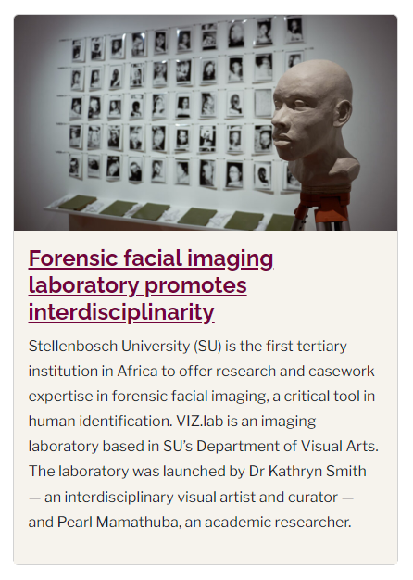








ENGAGING THE VISUAL IN VIZ.Lab
Est. 2021
Research, training and service
Pracademic, ‘networked research’
Entirely digital and virtual workflow for forensic facial imaging
Numerous projects in forensic and heritage sectors

Slide 13


Makerspace, SU Library
https://libguides.sun.ac.za/makerspace/home
Skull digitization and replication for forensic training
Digital studio extension: Jewellery 3 CAD class, 2023

Slide 14

VIRTUAL HAPTIC SCULPTURE
3D SYSTEMS FREEFORM WITH PHANTOM TOUCH
Metrically-accurate digital models acquired via 3D surface scan or CT scan
Non-destructive
Requires expert analysis of the skull and feature prediction via anatomically validated methods
Reconstruction of the face shape is accurate for ±70% of the face surface
Texturing is another story!
Notes:
3D digital workflow

Slide 15








THE SUTHERLAND NINE (2018 – )
Saartje; 40-50 years old; 1.35m tall; Died c.1880
A story is like a wind blowing from afar and you feel it…it floats to your ear
||Kabbo, |Xam storyteller
Gibbon VE, Feris L, Gretzinger J, Smith K, Hall S, Penn N, et al. 2023. PLoS ONE 18(5): e0284785. https://doi.org/10.1371/journal.pone.0284785

Slide 16







W4C CHEC-CCT PILOT STUDY (2021-2023)
UCT/SU/FPS Salt River/City of Cape Town collaboration
Research consortium established
n=5 unidentified cases from Salt River Mortuary selected for multifactorial analysis, with all relevant ethics, permissions & materials transfer agreements
New analysis included forensic DNA and isotope analysis
Focus on contextual information and facial depictions for public release by SAPS
Produced outputs unanticipated and extraneous to original grant but recognized as critical interventions
“The W4C workshops brought a new outlook”
FPS facility manager
Notes:
Identify gaps and areas of improved communication between stakeholders, methods and reporting.
Create documents, policies, knowledge-sharing and skills development opportunities to address gaps.
Establish a plan and protocol with relevant stakeholders for dissemination of the generated facial depictions

Slide 17

W4C CHEC-CCT PILOT STUDY (2021-2023)
UCT/SU/FPS Salt River/City of Cape Town collaboration
trained approx. 100 undertakers and forensic officers in basic fingerprinting and facial photography in 1 week
Introduced concept of ‘forensic care’ (M’Charek and Casartelli, 2019)
Framing PM ID as ‘forensic humanitarian action’ can drive policy change and possibly open other funding avenues & partnerships
Recommendations to revise SAPS 55a and 55b forms
Notes:
Identify gaps and areas of improved communication between stakeholders, methods and reporting.
Create documents, policies, knowledge-sharing and skills development opportunities to address gaps.
Establish a plan and protocol with relevant stakeholders for dissemination of the generated facial depictions

Slide 18



WHY ‘SCIENCE FOR JUSTICE’?
A ‘silent mass disaster’ of the missing and unidentified in South Africa and elsewhere
Legal identification is social and criminal justice issue (recognising personhood)
‘Ambiguous loss’ (Boss, 2009), is a public health issue
No single database to compare data related to the missing or unidentified in SA
Supporting awareness and capacity-building in other African nations
Complex contexts require novel methods of identification (secondary identifiers)
SA could lead on global ‘complex identification’ contexts (cf. Amexican border zone; Mediterranean)
Scarce skills globally – SU is only academic institution in Africa with forensic facial imaging skills and relevant technology - How do we build training and capacitation ‘at home’?
What are the most cost-effective interventions for the greatest impact?

Slide 19




SCIENCE FOR JUSTICE (S4J)
Institutional initiative to foster collaborative and inter- and transdisciplinary research at SU
Forum to strengthen complementarity of forensic research areas & applications
Build sector capacity via PG & contract research (ICRC)
Pracademic support to improve service delivery in non-forensic contexts
ICRC equipment donations to SU & Tygerberg FPS

Slide 20




Our silent teachers

Slide 21





Finding life in death

Slide 22
REFERENCES
Buti L, Gruppioni G, Benazzi S. 2015. Facial Reconstruction of Famous Historical Figures: Between Science and Art. In Studies in Forensic Biohistory: Anthropological Perspectives edited by C Stojanowski and WN Duncan. Cambridge: Cambridge University Press.
Del Pilar Blanco M and Peeren E. 2013. The spectralities reader: ghosts and haunting in contemporary cultural theory. New York/London: Bloomsbury Publishing USA.
Gibbon VE, Feris L, Gretzinger J, Smith K, Hall S, Penn N, et al. 2023. Confronting historical legacies of biological anthropology in South Africa—Restitution, redress and community-centered science: The Sutherland Nine. PLoS ONE 18(5): e0284785. https://doi.org/10.1371/journal.pone.0284785
Gordon A.F. 2008. Ghostly Matters: Haunting and the Sociological Imagination. London: University of Minnesota Press.
Hartman S. 2008. Venus in Two Acts. Small Axe: A Caribbean Journal of Criticism, 12(2), pp.1-14.
Houlton TMR, and Billings BK. 2017. Blood, Sweat and Plaster Casts: Reviewing the History, Composition, and Scientific Value of the Raymond A. Dart Collection of African Life and Death Masks. HOMO 68, no. 5: 362–77.
Roughley M and Wilkinson C. 2019. The Affordances of 3D and 4D Digital Technologies for Computerized Facial Depiction. In Biomedical Visualisation vol. 2, edited by Paul M. Rea. Cham: Springer International Publishing. https://doi.org/10.1007/978-3-030-14227-8_7.
Roughley M, and Ching Yui JL. 2022. Digital 2D, 2.5D and 3D Methods for Adding Photo-Realistic Textures to 3D Facial Depictions of People from the Past. In Biomedical Visualisation vol.11, edited by Paul M. Rea. Cham: Springer International Publishing. https://doi.org/10.1007/978-3-030-87779-8_11.
Schramm K. 2020. Stuck in the Tearoom: Facial Reconstruction and Postapartheid Headache. American Anthropologist (Special Section) 122, no. 2: 1–14. https://doi.org/10.1111.aman.13384.
Shepherd N. 2007. Archaeology dreaming: post-apartheid urban imaginaries and the bones of the Prestwich Street dead. Journal of social archaeology, 7(1), pp.3-28.
Smith K, Roughley M, Harris S, Wilkinson C, and Palmer, E. 2020. From Ta-Kesh to Ta-Kush: The Affordances of Digital, Haptic Visualisation for Heritage Accessibility. Digital Applications in Archaeology and Cultural Heritage 19: e00159. https://doi.org/10.1016/j.daach.2020.e00159.
Smith K. 2018. Portraits, Likenesses, Composites? Facial Difference in Forensic Art. In Approaches to Facial Difference: Past and Present, edited by Patricia Skinner and Emily Cock. London: Bloomsbury
Smith, K. and Wilkinson, C. How art and technology helped bring faces of the dead to life, in The Conversation, 2 December 2019.
Smith K and Wilkinson C. 2024. The Doppelgänger effect? A comparative study of forensic facial depiction methods. Forensic Science International. 356:111935. DOI: 10.1016/j.forsciint.2024.111935.
Sofaer J. 2012. Touching the body: The living and the dead in osteoarchaeology and the performance art of Marina Abramović. Norwegian Archaeological Review. 45(2):135–150.
Wilkinson C. 2020. Cognitive Bias and Facial Depiction from Skeletal Remains. Bioarchaeology International 4, no. 1. http://dx.doi.org.ez.sun.ac.za/10.5744/bi.2020.1001.
Wilkinson, C., Mackenzie, S. & Smith, K. 2019. Faces of Merseyside: Exploring Cognitive Bias through Facial Averages. Leonardo. 53(5):498–503. DOI: 10.1162/leon_a_01747.

