Slide 1


Slide 2
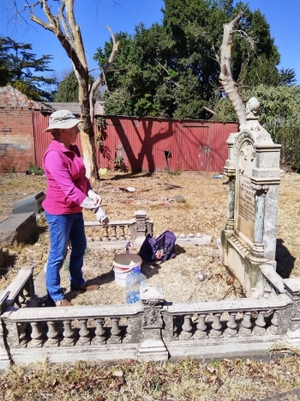
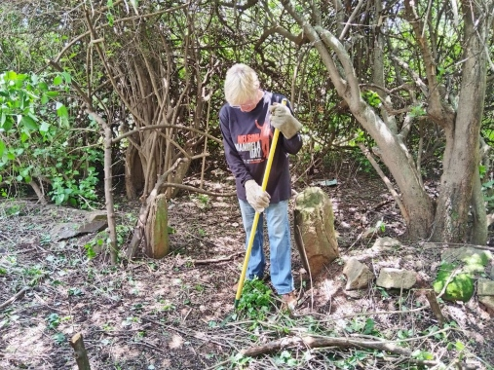

Background
Notes:
Established = 2018
Headed by = Sarah Welham
Reason = Clean & maintain the graves in Brixton & Braamfontein Cemeteries
Municipality responsible between graves.
Families responsible graves themselves.
Most graves no resident or surviving families
Umbrella = Johannesburg Heritage Foundation

Slide 3
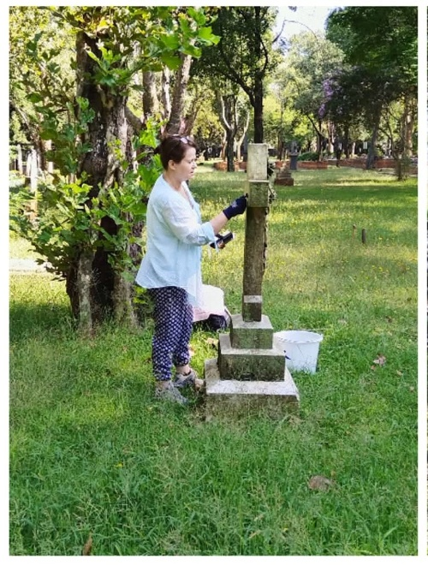
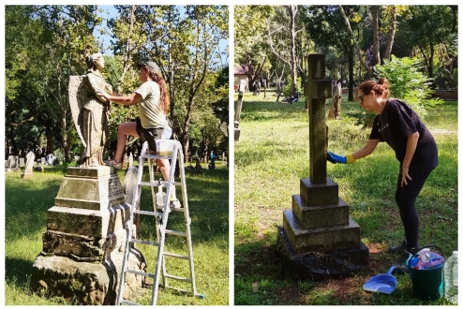
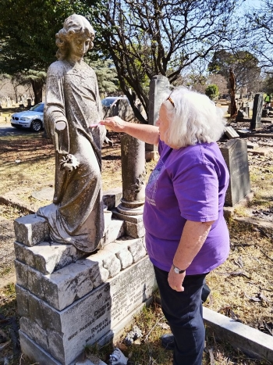
Clean up Days
Notes:
Arrange working days every few months
Clean headstones so inscriptions can be read
Remove ivy, strangling trees & shrubs
Cut back overhanging & intrusive branches

Slide 4
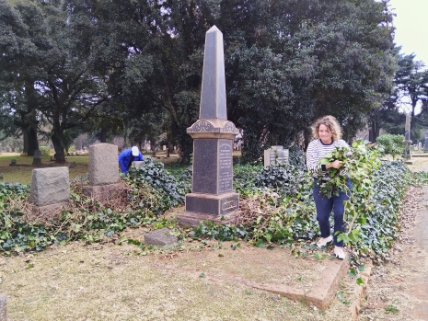
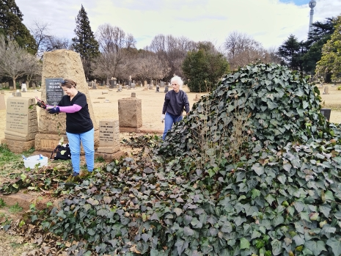
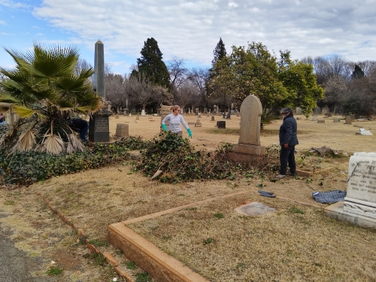
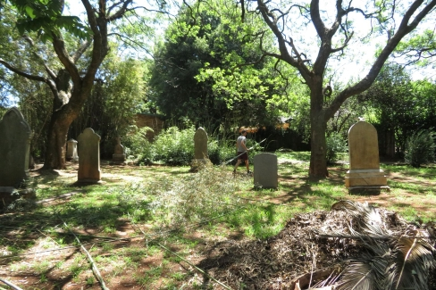
Clean up Days
Notes:
On one clean up day at Braamfontein cleared bamboo forest revealing +_ 10 gravestones dating from before 1900s
Annually arrange special cleaning day in lieu of 67 minutes on Mandela Day 18 July.
Held at Brixton

Slide 5
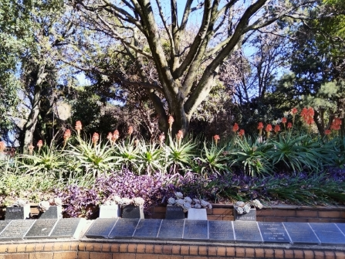
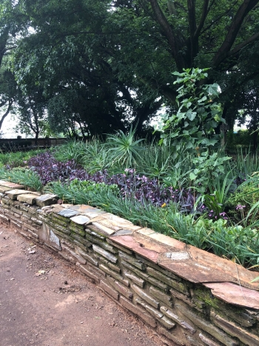
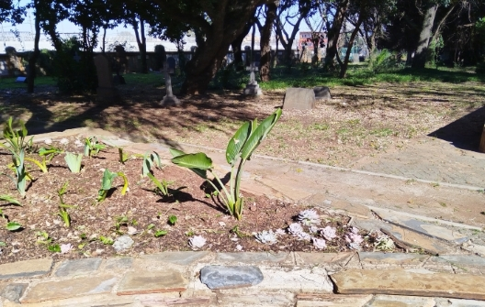
Beautify
Notes:
At Braamfontein Cemetery some of the Friends plant and maintain flowerbeds around the Crematorium

Slide 6
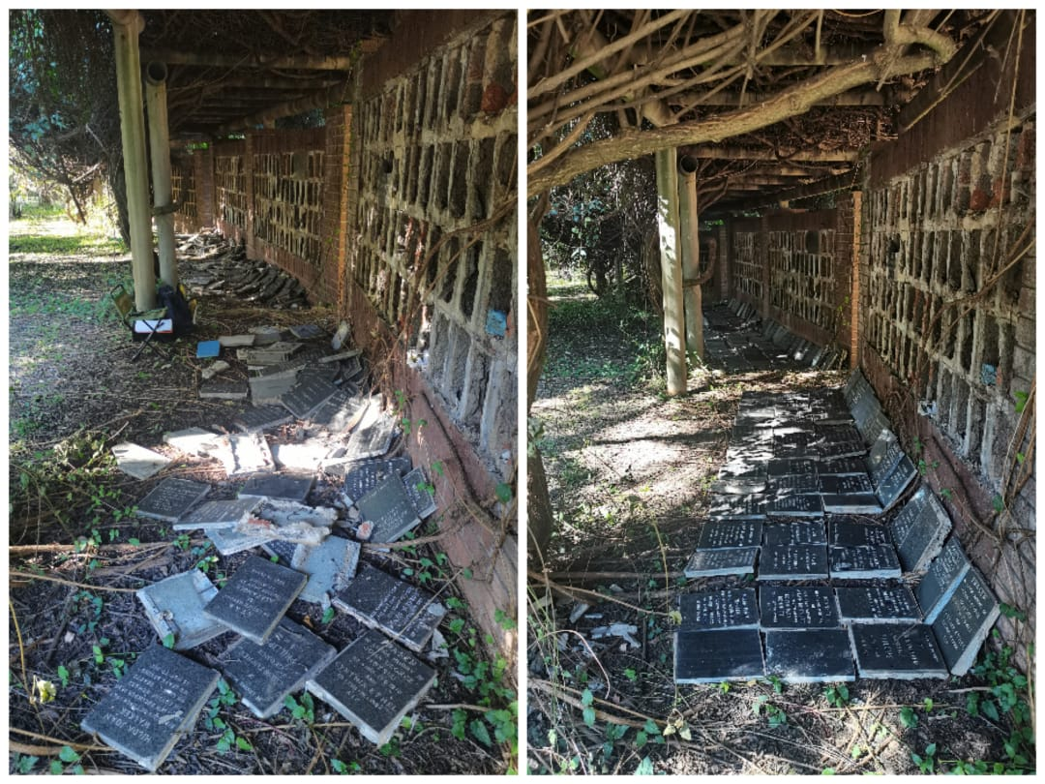
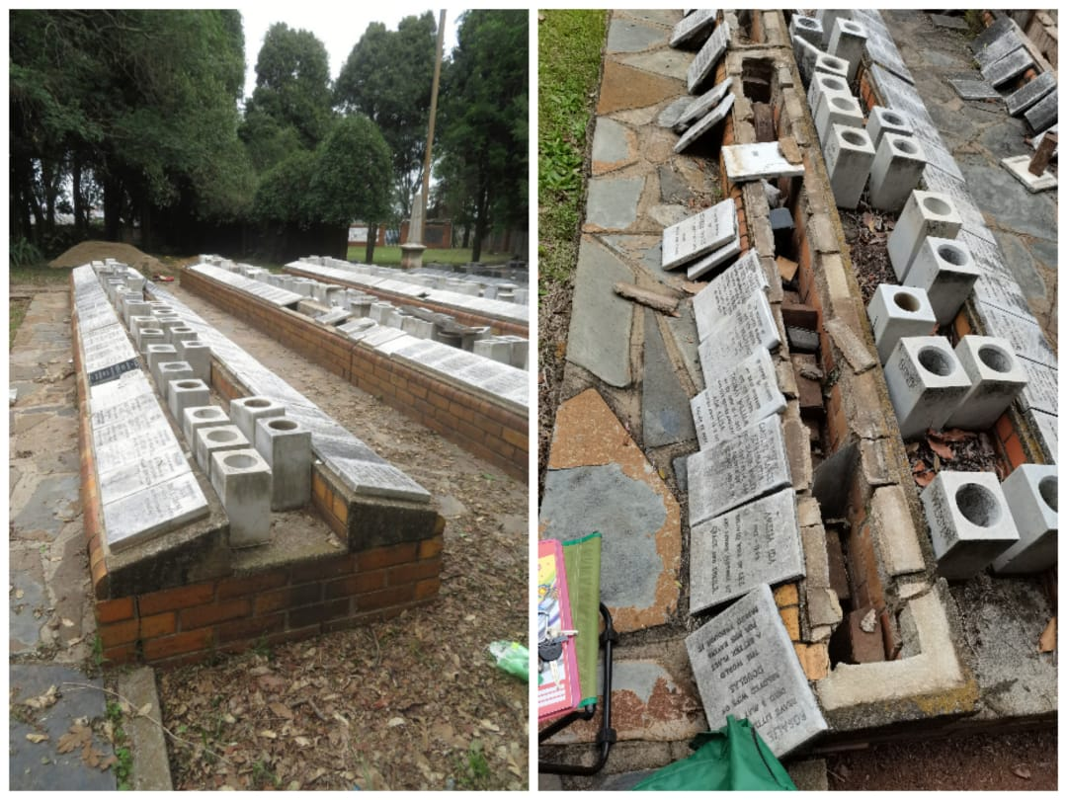
Record and Restore
Notes:
2021 thousands of ash niches at Braamfontein vandalised
FoJC with JCPZ record and restore nearly 5000 niches
Restoration conducted by various groups of volunteers
Record plaques and clear vegetation for access to walls

Slide 7
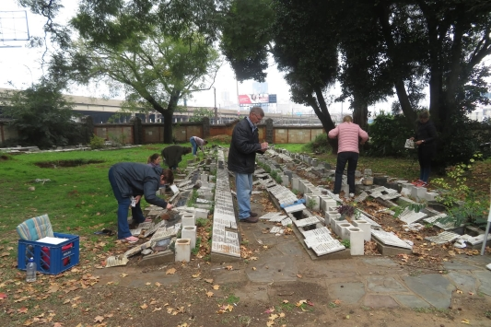
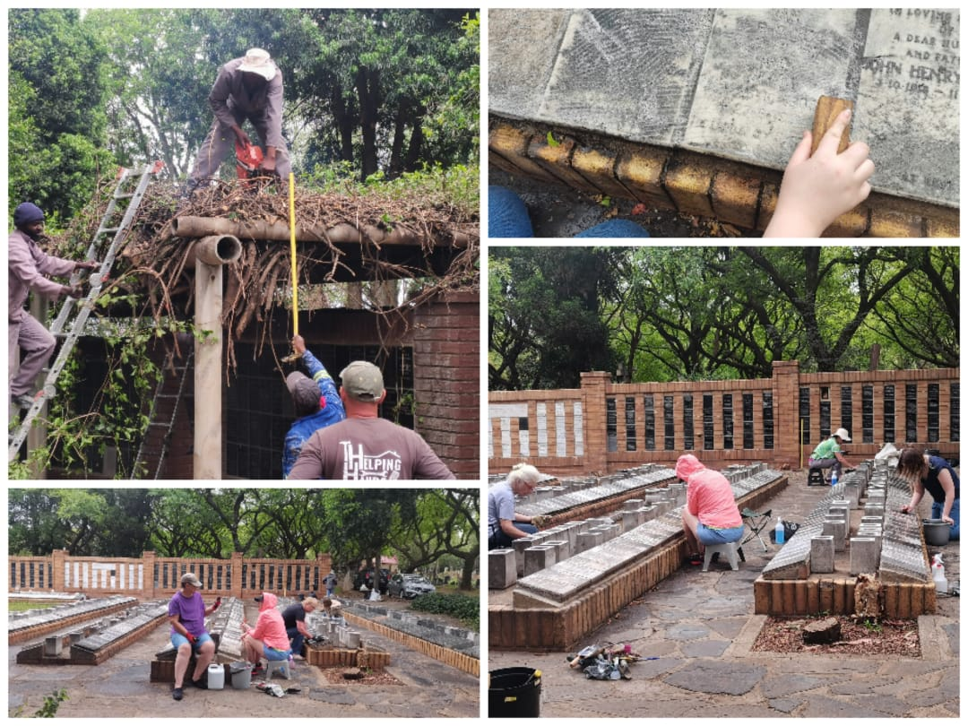
Record and Restore
Notes:
Ash Niches, Plaques and ash graves were recorded, verified and captured into database by volunteers
Plaques verified before being cemented into rightful positions.
Verified again after being placed
Vases that were broken and or moved were placed, where possible in their correct locations

Slide 8
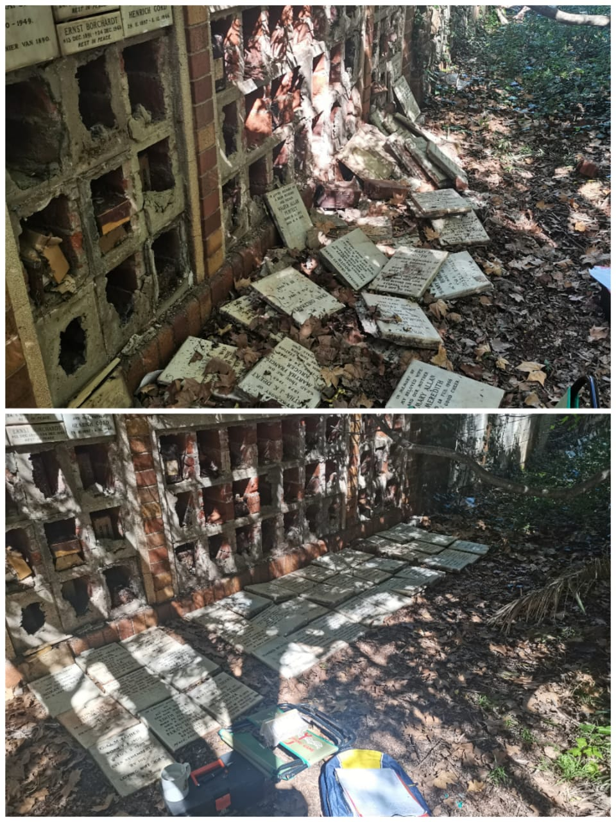
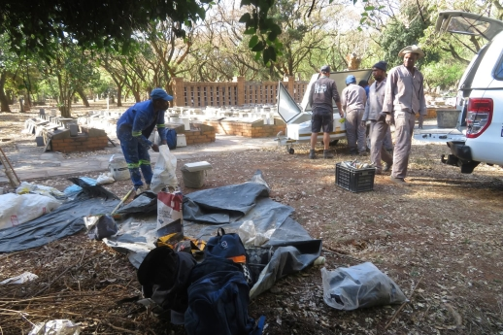
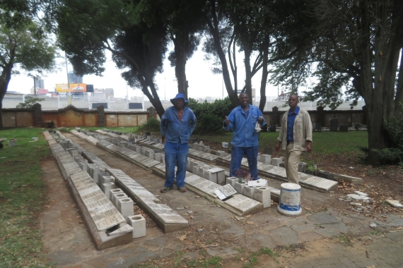
Record and Restore
Notes:
Recorded data captured onto an Excel Database.
Complete record also accessible to researches
Kept at the JHF Research/Resource Centre, maintained and kept up to date.

Slide 9
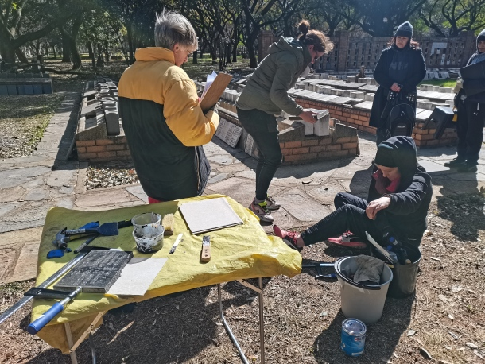
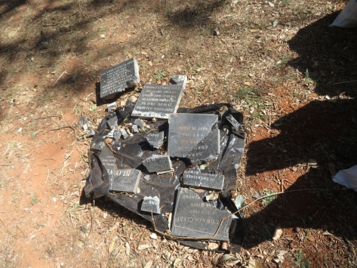
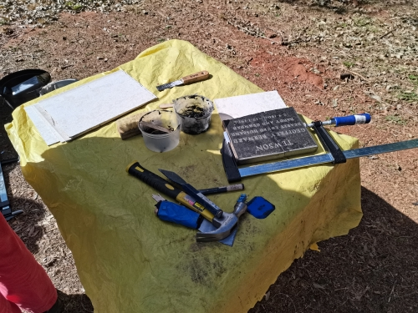
Record and Restore
Notes:
For most of 19months during restoration, three paid builders worked daily Monday to Friday.
Attaching broken pieces onto special boards and fixing plaques into their right places

Slide 10
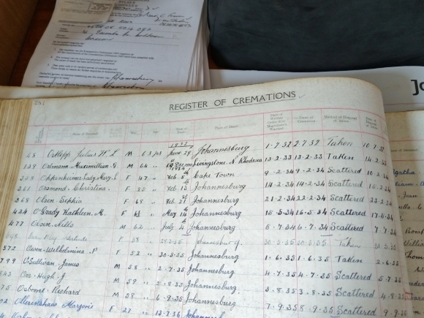
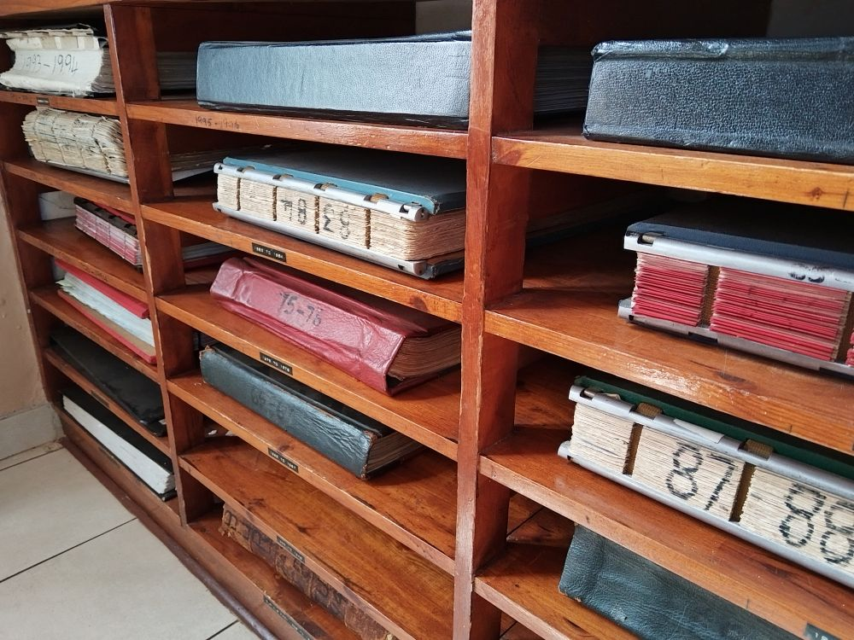
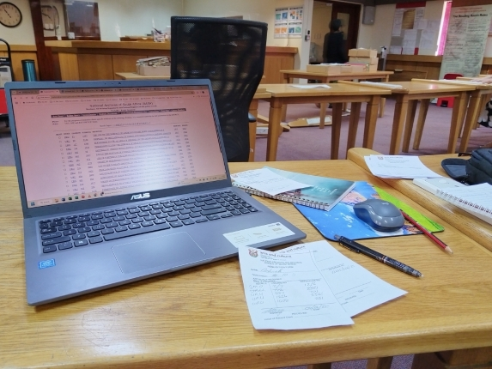

Research
Notes:
Research is done by members of FoJC
Digitised and available on line by applying to JHF.
Research covers ash niches and burials of the rich and famous and those with interesting backgrounds
All possible & accessible sources consulted such as Family Search, original cemetery records and, if necessary, the national archives

Slide 11
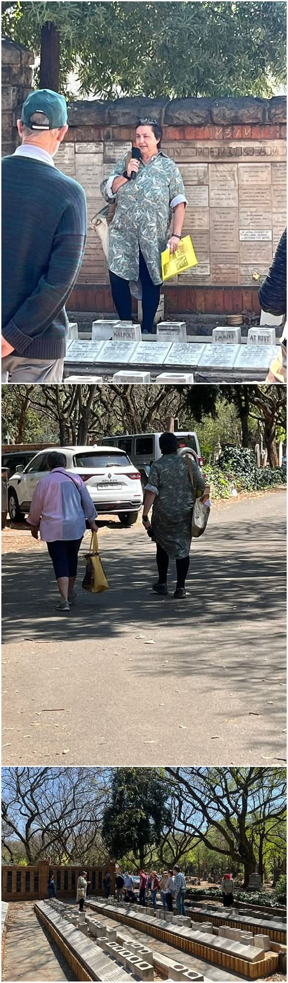
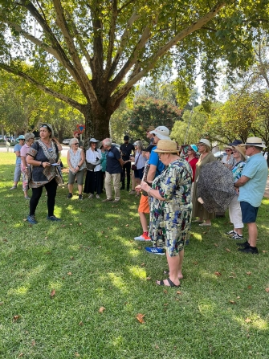
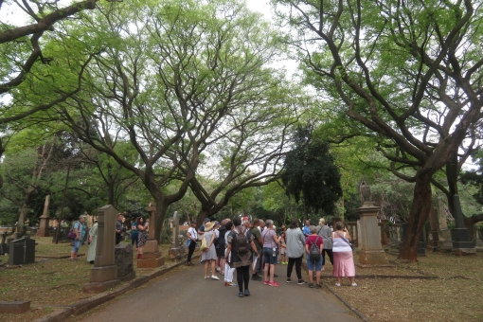
Tours
Notes:
Under auspices of JHF, tour guides conduct tours over pre-determined weekends
These tours highlight the history of Johannesburg and pay respect to those how have contributed to the development and growth of Johannesburg

Slide 12
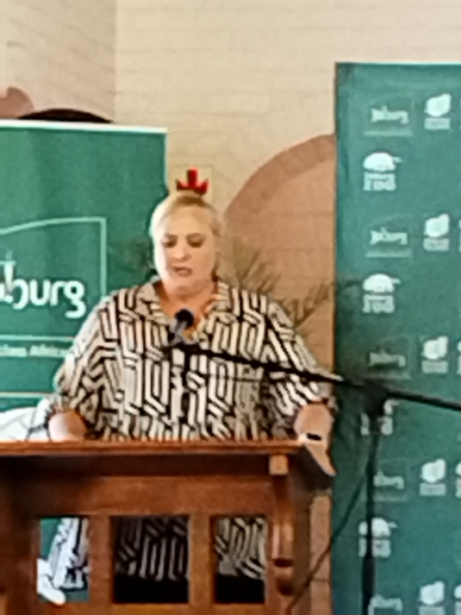
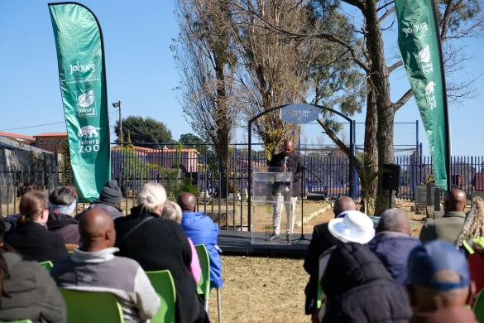
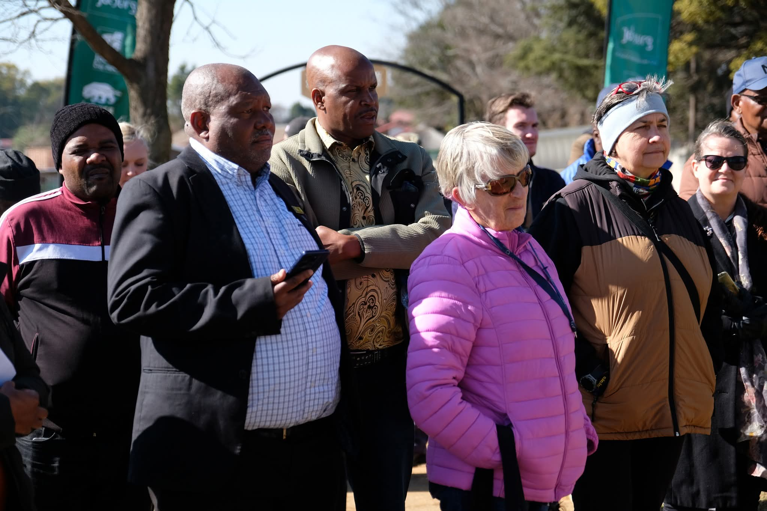
JCPZ
Notes:
The Friends work in close partnership with JCPZ to conduct work.
They help by making their records available to us
We worked together on the re-opening of the Hamberg Cemetery

Slide 13
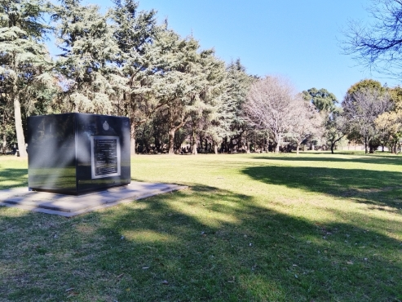
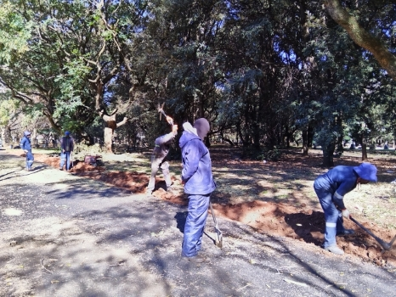
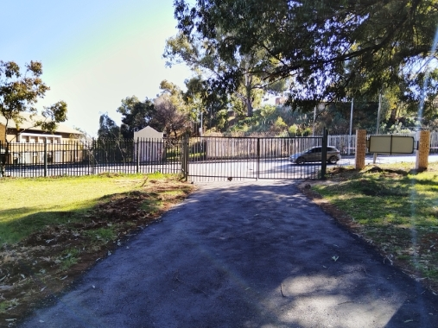
JCPZ
Notes:
Shared ideas on the enhancement of the Enoch Sontonga Memorial Park.
We envisage working on many other projects with JCPZ in the future

Slide 14
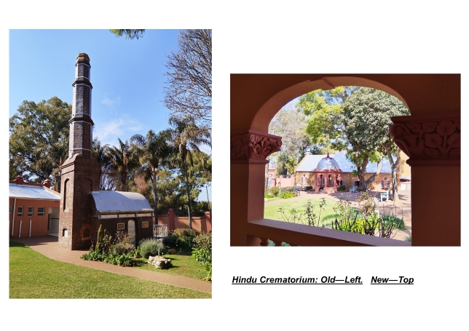
Communities
Notes:
FoJC is often called upon to advise on matters regarding plans & challenges faced by communities such as the Chinese, Hindu, Coloured & Muslim Communities
Chinese Community invited us to discuss repairing headstones in the Brixton Cemetery.
Also assisted in locating the grave of a Chinese Victim of 1922 Strike
Recently contributed input & advice to the Hindu Community for their application for parking facility ath the Hindu Crematorium at Brixton Cemetery

Slide 15
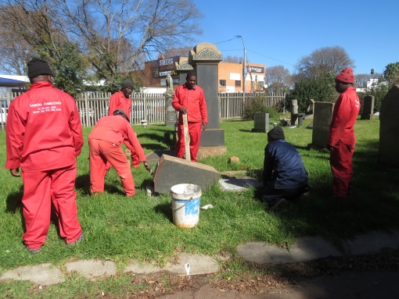
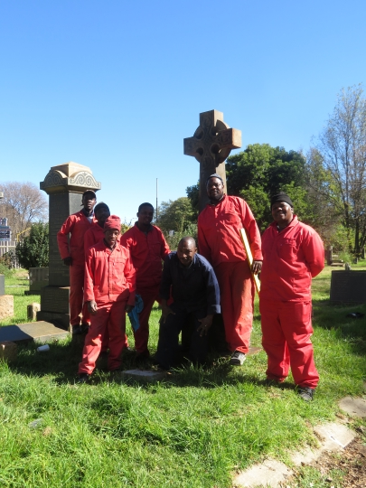
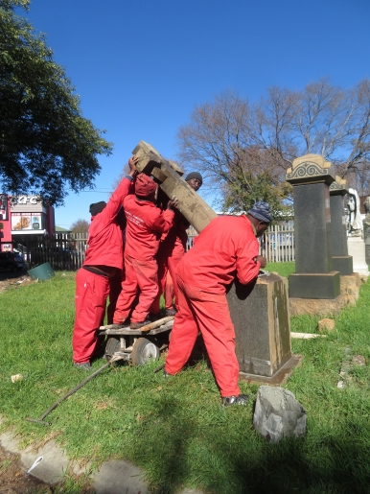
Communities
Notes:
Collaborated with the Coloured Community for restoration of headstone of Reverend Phillips.
FoJC paid for the restoration.
Work carried out by SAMCRO Tombstones

Slide 16
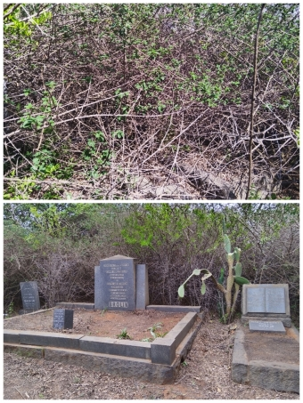
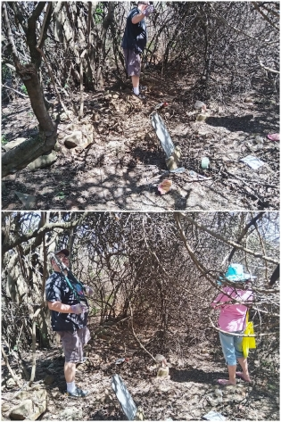
Communities
Notes:
2024 JCPZ, Muslim community and GSSA approached friends with regards to land in Linbro Park.
Land earmarked for Muslim Cemetery but possibly had graves of Brolin Family
Anticipated 1 or 2 graves but found 8
Learned of possibly more graves on the piece of land.
Found 8 more graves belonging to the De Beers family. Owners of the original Modderfontein Farm
Photographed all the graves and took GPS readings of their exact locations
Shared information including the de Beers Research group.

Slide 17
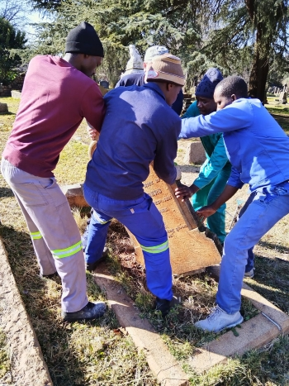
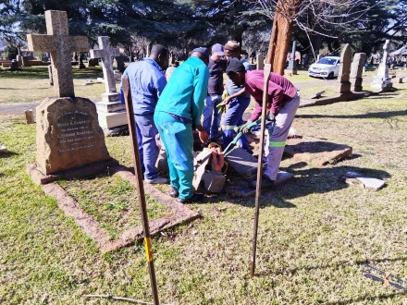
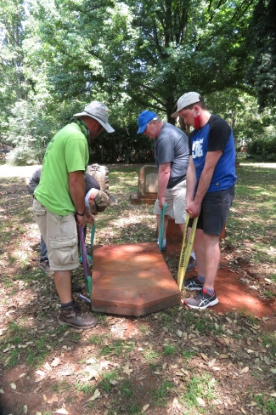
GSSA
Notes:
GSSA Grave project visits cemeteries across country to photograph and record every grave they find.
Aims to create comprehensive database for genealogical research.
FoJC helps the project by turning fallen headstones in Braamfontein & Brixton Cemeteries

Slide 18
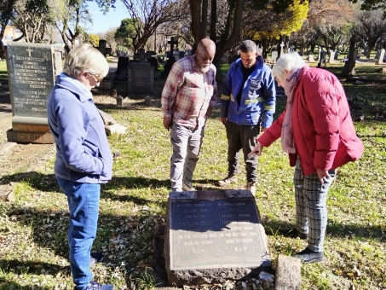
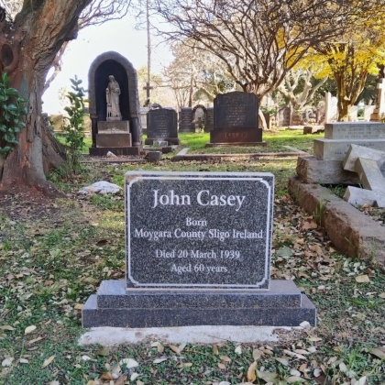
Public
Notes:
Upon request, members of the public approach FoJC help find graves of their loved ones.
Requests not just local but also from people living overseas
Sometimes FoJC asked to assist with the process of applying for permission to erect or repair a headstone

Slide 19
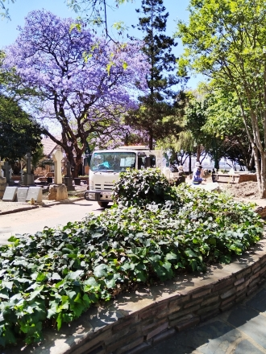
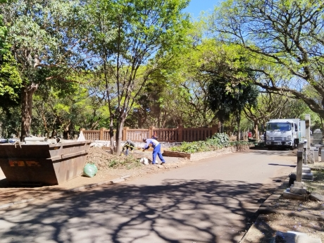
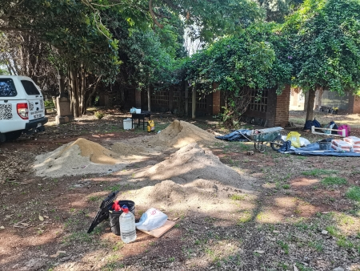
JCPZ
Notes:
JCPZ generously provided building material for repairs of vandalised niches at Braamfontein Cemetery.
Also provided a skip for the piles of rubble generated during the repair process.
Also removal and replacement of filled skips.

Slide 20
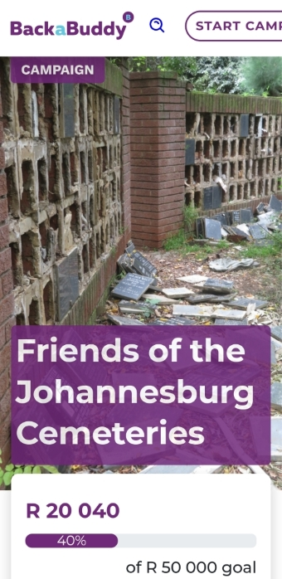
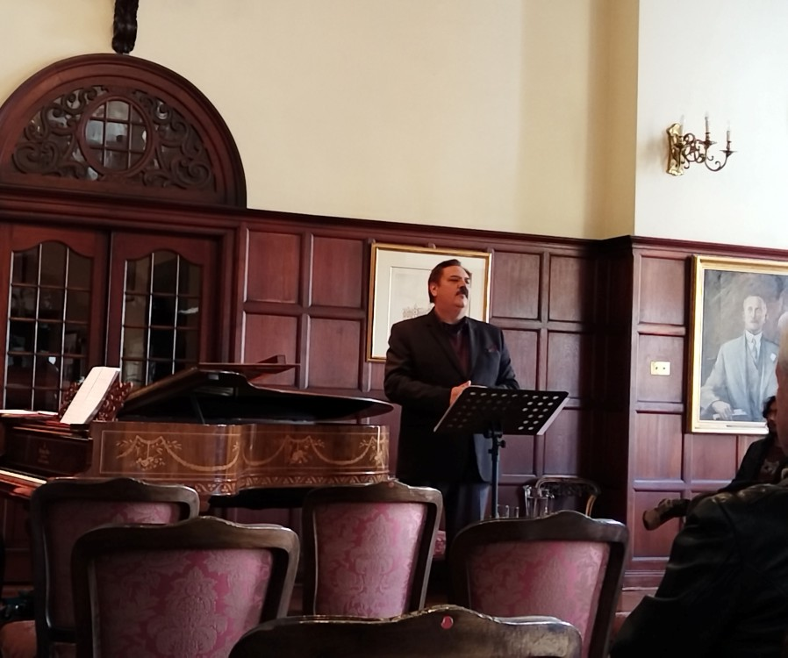
Fundraising
Notes:
Funding for the repairs were generated by donations, Back-a-Buddy and even a light classical music concert

Slide 21



Fruits of the Labour
Notes:
Funds raised made it possible for FoJC to employ 3 workers to repair and restore the vandalised ash walls and niches at Braamfontein Cemetery

Slide 22




Fruits of the Labour
Notes:
Through fundraising & work with JHF found graves and erected headstones and monuments such as the 1922 Strike memorial.
Erected a headstone for craftsmanGeorge Ness who worked with Sir Hebert Baker

Slide 23




Fruits of the Labour
Notes:
Also erected a headstone for the victims of Daisy de Melker.
In June discovered a recently damaged headstone in Brixton we called “Little Winnie”. We hope to restore very soon.
Also a hand of an Angel was recently broken off. Already secured the help of someone who can reattach the broken hand.
Repairs being done by volunteers of FoJC

Slide 24



Fruits of the Labour
Notes:
After restoring vandalised niches, we were unable to identify niches for several bags of ashes.
For these people FoJC with JCPZ had a tree planting ceremony to honour their memory.
Representatives from both sides attended.
The service was conducted by Reverend Tsepo Matubtuba
We were gifted old grave pillars that we will erect a stone in rememberance at the tree

Slide 25


Social Media
Notes:
Our Facebook page is for Friends locally and internationally can follow us, learn and explore ways they can help and support our work.
We have 2,5k followers
Our WhatsApp group has 91 members, mostly local but some international.
Through this channel we communicate about cemetery workdays and other relevant events

Slide 26


Media Awareness
Notes:
Community Newspapers and radio and Television stations every so often run features on the work that we do

Slide 27


Media Awareness

Slide 28
Challenges
Finance to do more work more often
Notes:
Primary challenge is securing adequate funding for future projects.
We aspire to conduct much more work in the cemeteries.
Further funds would also enable us where necessary to employ professional staff to repair broken headstones & statues for example.

Slide 29


Future Vision
Cemeteries as Recreational Parks
Notes:
Restore all the graves in Braamfontein & Brixton
Make cemeteries places where the public can walk, visit & spend time as they would a park.
Might be seen as disrespectful, but the current situation in our cemeteries is disrespectful to the deceased.
If opened as a cared for public space and treated as a controlled park, might become a safer place

Slide 30


Future Vision
Danes taking a stroll at Assistens Cemetery in Nørrebro | © Ty Stange
Hanging out at the burial site has become a tradition over the centuries. Nowadays, you’ll see fitness enthusiasts jogging amid the cherry blossom trees, millennials relaxing at the lawn, families taking a stroll along the endless passageways and, of course, tourists walking through the gardens searching for the most noteworthy graves.
Notes:
Studies around the world show that cemeteries opened as public green spaces are used for recreational purposes.
Studies were done….
Various aspects that can be kept in mind:
Growing demand for green Spaces
Integration of recreational activities
Respect and etiquette
Multifaceted Use

Slide 31



Future Vision
Notes:
Challenge we currently face is litter
Litter happens everywhere even Mount Everest
Even outer space.
Cant fix the world, but we can fix our own environment.
Strive to encourage a culture of non-littering.
Require a mind shift and education.

Slide 32



Future Vision
Notes:
Design & install boards, maps & marking sections & significant graves in collaboration with JCPZ.
Provide markers which are informative and not made of material attractive to recyclers or thieves
These kinds of developments make cemeteries more attractive for public to visit, create security & show respect for those who lie there.
Overtime the improvements could helped create heritage spaces where young guides could be employed

Slide 33
Thank you

