Slide 1


Slide 2
Challenges Faced by Provincial Forensic Pathology Services: Strengthening Collaboration with Local Government
Dr Relebohile Ncha
Chief Director: Forensic Pathology Services
National Department of Health
25 August 2025

Slide 3
PRESENTATION OUTLINE
Introduction to Forensic pathology services (FPS)
Processes in the management of unclaimed bodies
Major challenge: unclaimed bodies in mortuaries
Impact of unclaimed bodies on the mortuaries
Mass causalities and lessons learnt: LP, EC and NW experience
Take home message
Notes:
Unidentifiable is not just the lack of ID documentation but it talks to what the nakedness eye can see.

Slide 4
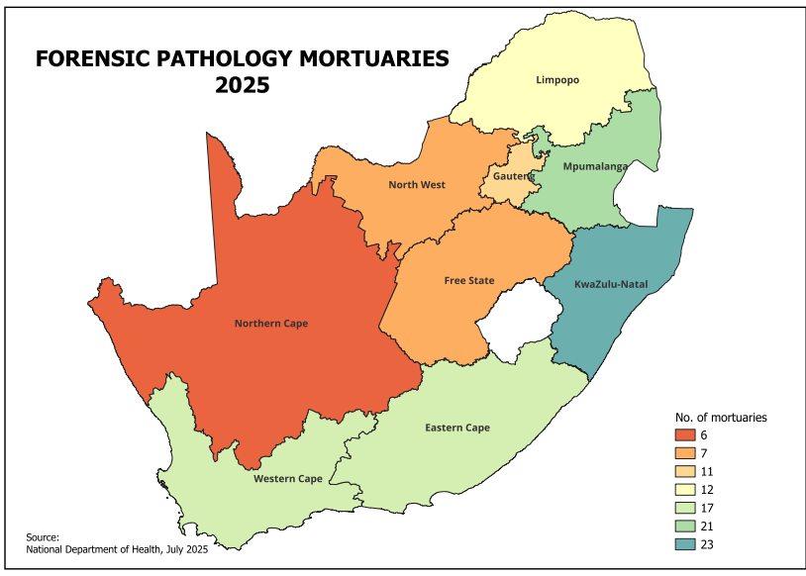
INTRODUCTION: FPS LANDSCAPE
Data source: Provincial Departments of health
Notes:
Unidentifiable is not just the lack of ID documentation but it talks to what the nakedness eye can see.

Slide 5
INTRODUCTION: FPS LANDSCAPE
Category of mortuaries | Body storage and management capacity
M1 | Up to 250
M2 | Up to 500
M3 | Up to 1000
M4 | Up to 1500
M5 | Up to 2000
M6 | More than 2000
In most our provinces we have all these categories of mortuaries
The bigger mortuaries are linked to Universities for under and post grad training
Notes:
Unidentifiable is not just the lack of ID documentation but it talks to what the nakedness eye can see.

Slide 6
PROCESS FLOW IN THE MANAGEMENT OF UNNATURAL DEATHS

Slide 7
DEFINITION / TERMINOLOGY
Unidentifiable body: a deceased body that does not have identifiable features (human remains, charred remains, decomposed bodies) - not merely the absence of an identity document
Unclaimed body: a body that family members have not come through to claim (majority of the unclaimed bodies are also unidentified)
Admission of a body to a facility: confirmation of the death, case number opened, clear photo of deceased taken, fingerprints and DNA samples taken (where possible)
Importance of ID: Conclusion of a postmortem examination requires that the body be identified, so that a death certificate may be issued.
Notes:
Unidentifiable is not just the lack of ID documentation but it talks to what the nakedness eye can see.

Slide 8
ROLE PLAYERS IN FORENSIC PATHOLOGY SERVICES
HEALTH
SAPS
COGTA
Conduct post-mortems and determine the cause the death
Investigates the cause of death
Assist with identification processes
Assist with pauper burials for the unclaimed bodies

Slide 9
BODY IDENTIFICATION PROCESSES
Identifiable bodies
Body admitted and checked for identifiable features
Take fingerprints
Start the process of tracing family members
Unidentifiable bodies
Body admitted and checked for identifiable features, if not present then proceed
Take fingerprints and DNA samples
Start the process of identifying the deceased: SAPS and Home affairs
Samples are collected by Forensic Pathologists / Senior Medical Officers and previously were also collected by SAPS (Victim Identification Centre)
Pathologists are assisted by Forensic Pathology Officers in sampling and packaging the DNA samples

Slide 10
MAJOR CHALLENGE: UNCLAIMED BODIES IN MORTUARIES

Slide 11
UNCLAIMED BODIES PROVINCIAL STATISTICS
Province* | Number of unclaimed bodies
Free State | 65
Limpopo | 267
North-West | 132
Northern Cape | 71
Mpumalanga | 99
Kwa-Zulu Natal | 695
Gauteng | 868
Eastern Cape | 485
Western Cape | 176
Total | 2858
Total bodied in the country as of February 2025: 2858
Provinces mostly affected: KZN, EC and GP
Bodies have been stored for (range): 5 months- 3 years
Regulations 341: pauper burial conducted after 30 days if the body remains unidentified
* The data is not static, it changes anytime

Slide 12
FACTORS LEADING TO UNCLAIMED BODIES
Community issues
Provincial and municipal issues
Facility issues
All these factors contribute to high numbers of unclaimed bodies at facilities
In most cases all three factors are present in the problem

Slide 13
CHALLENGES HIGHLIGHTED
Community level
Bodies arrive without any form of identification
Family members don’t come through to look for their relatives
Facility level
Delays in transportation and analysis of DNA samples
Provincial and Municipal level
Delays with pauper burials due to non- availability of burial spaces
Foreign nationals not identified
Outstanding Investigating Officer (IO) pauper statements
Once identified, families don’t come to claim the bodies
Poor quality of collected fingerprints
Budgets constraints at Municipality level

Slide 14
IMPACT OF UNCLAIMED BODIES ON THE MORTUARIES

Slide 15
IMPACT OF UNCLAIMED BODIES ON THE SYSTEM
Stored bodies:
Bodies start to decompose while in storage
Environmental impact: smell in the facility
Occupations health hazard for employees
Running costs
Procurement of additional storage capacity
Running cost: electricity, diesel etc.
Maintenance of fridges become more frequent
Storage capacity
Take up storage in the facility
↓ storage capacity for new bodies

Slide 16
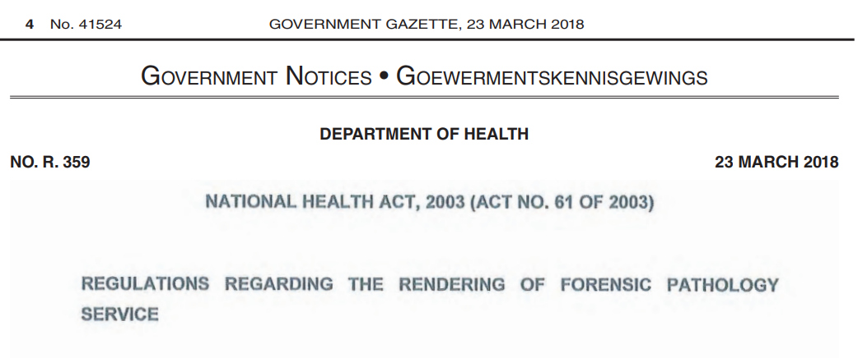
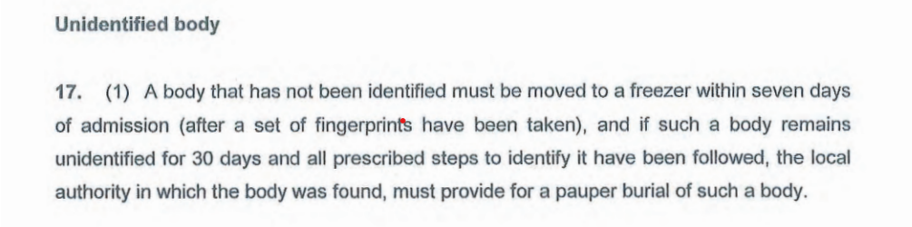
Management of unidentified/unclaimed bodies

Slide 17
Misalignment with municipal processes or cemetery management.
Municipality issues
Challenges with availability of budgets for pauper burials
Budgeting periods do not align with burial plans for facilities
Limited burial sites, e.g. Ethekwini municipality
Procurement processes of service providers by municipalities delays the burials
Using one grave for many bodies: may be an issue when bodies are exhumed
No discussions about possible cremations vs physical burials

Slide 18
WHAT HAS BEEN DONE SO FAR CONT.
Provincial interventions
Provinces are encouraged to engage with stakeholders such as COGTA, Justice, Crime Prevention and Security (JCPS), SAPS and NHLS regularly to discuss issues that pertains to pauper burials, transportation and analysis of DNA samples and toxicology backlogs, respectively.
Closely monitor the outstanding results and the number of bodies and intervene early
Facility level intervention
Addressing administrative issues at facility level: IO involvement
Cleared the backlogs of samples for DNA/Toxicology
Regular interactions with the Municipalities
Notes:
Digital fingerprint project
Project is current a pilot: LP and GP
Project is supported by the Centre for Public Service Innovation
Need: Digital scanners and laptops for facilities
Where the project is being piloted, fingerprints are of a good quality and helps with early identification

Slide 19
DISASTER MANAGEMENT AND MASS FATALITIES
LIMPOPO BUS ACCIDENT
EASTERN CAPE FLOODS
NORTH-WEST MINING DISASTER

Slide 20
BACKGROUND TO THE DISASTERS
LIMPOPO
Bus crash which claimed 45 lives and 1 survivor
There was no role for the municipality as all bodies were repatriated to Botswana
EASTERN CAPE
Floods in Umtata where there were over 100 victims
Families were able to identify and bury their loved ones
NORTH-WEST
Mining “zama-zama” disaster in January 2025
Total bodies recovered | Total bodies identified | Total pauper burials
78 | 28 | 50
Notes:
Digital fingerprint project
Project is current a pilot: LP and GP
Project is supported by the Centre for Public Service Innovation
Need: Digital scanners and laptops for facilities
Where the project is being piloted, fingerprints are of a good quality and helps with early identification

Slide 21
KEY LESSONS LEARNT
The responses were led by Forensic Pathology Service
Identified important and relevant stakeholders and involved them early
Understanding the complexity of the case by everyone allowed the response teams to move in a similar direction
Clear differentiation between the role of Political office and the experts
Clear timelines and deliverables were set for the project and regular monitoring meetings were held
Management of intergovernmental relations and this worked well in NW
Communication strategy as the department, province and the country and there was centralized communication point
Notes:
Digital fingerprint project
Project is current a pilot: LP and GP
Project is supported by the Centre for Public Service Innovation
Need: Digital scanners and laptops for facilities
Where the project is being piloted, fingerprints are of a good quality and helps with early identification

Slide 22
TAKE HOME MESSAGES
Centralized communication
Clear timelines and deliverables
Clear leader of the response
Inter-departmental and government relations
HEALTH
SAPS
COGTA
+
Notes:
Digital fingerprint project
Project is current a pilot: LP and GP
Project is supported by the Centre for Public Service Innovation
Need: Digital scanners and laptops for facilities
Where the project is being piloted, fingerprints are of a good quality and helps with early identification

Slide 23
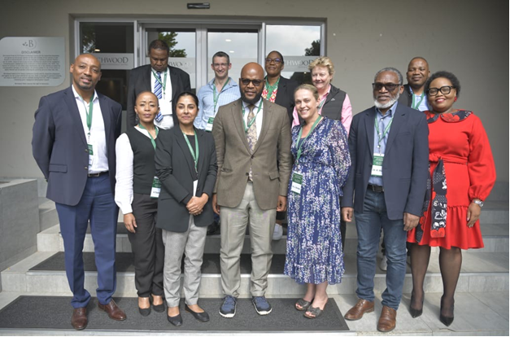
The committee: 2024-2027

Slide 24

Thank You

