Slide 1
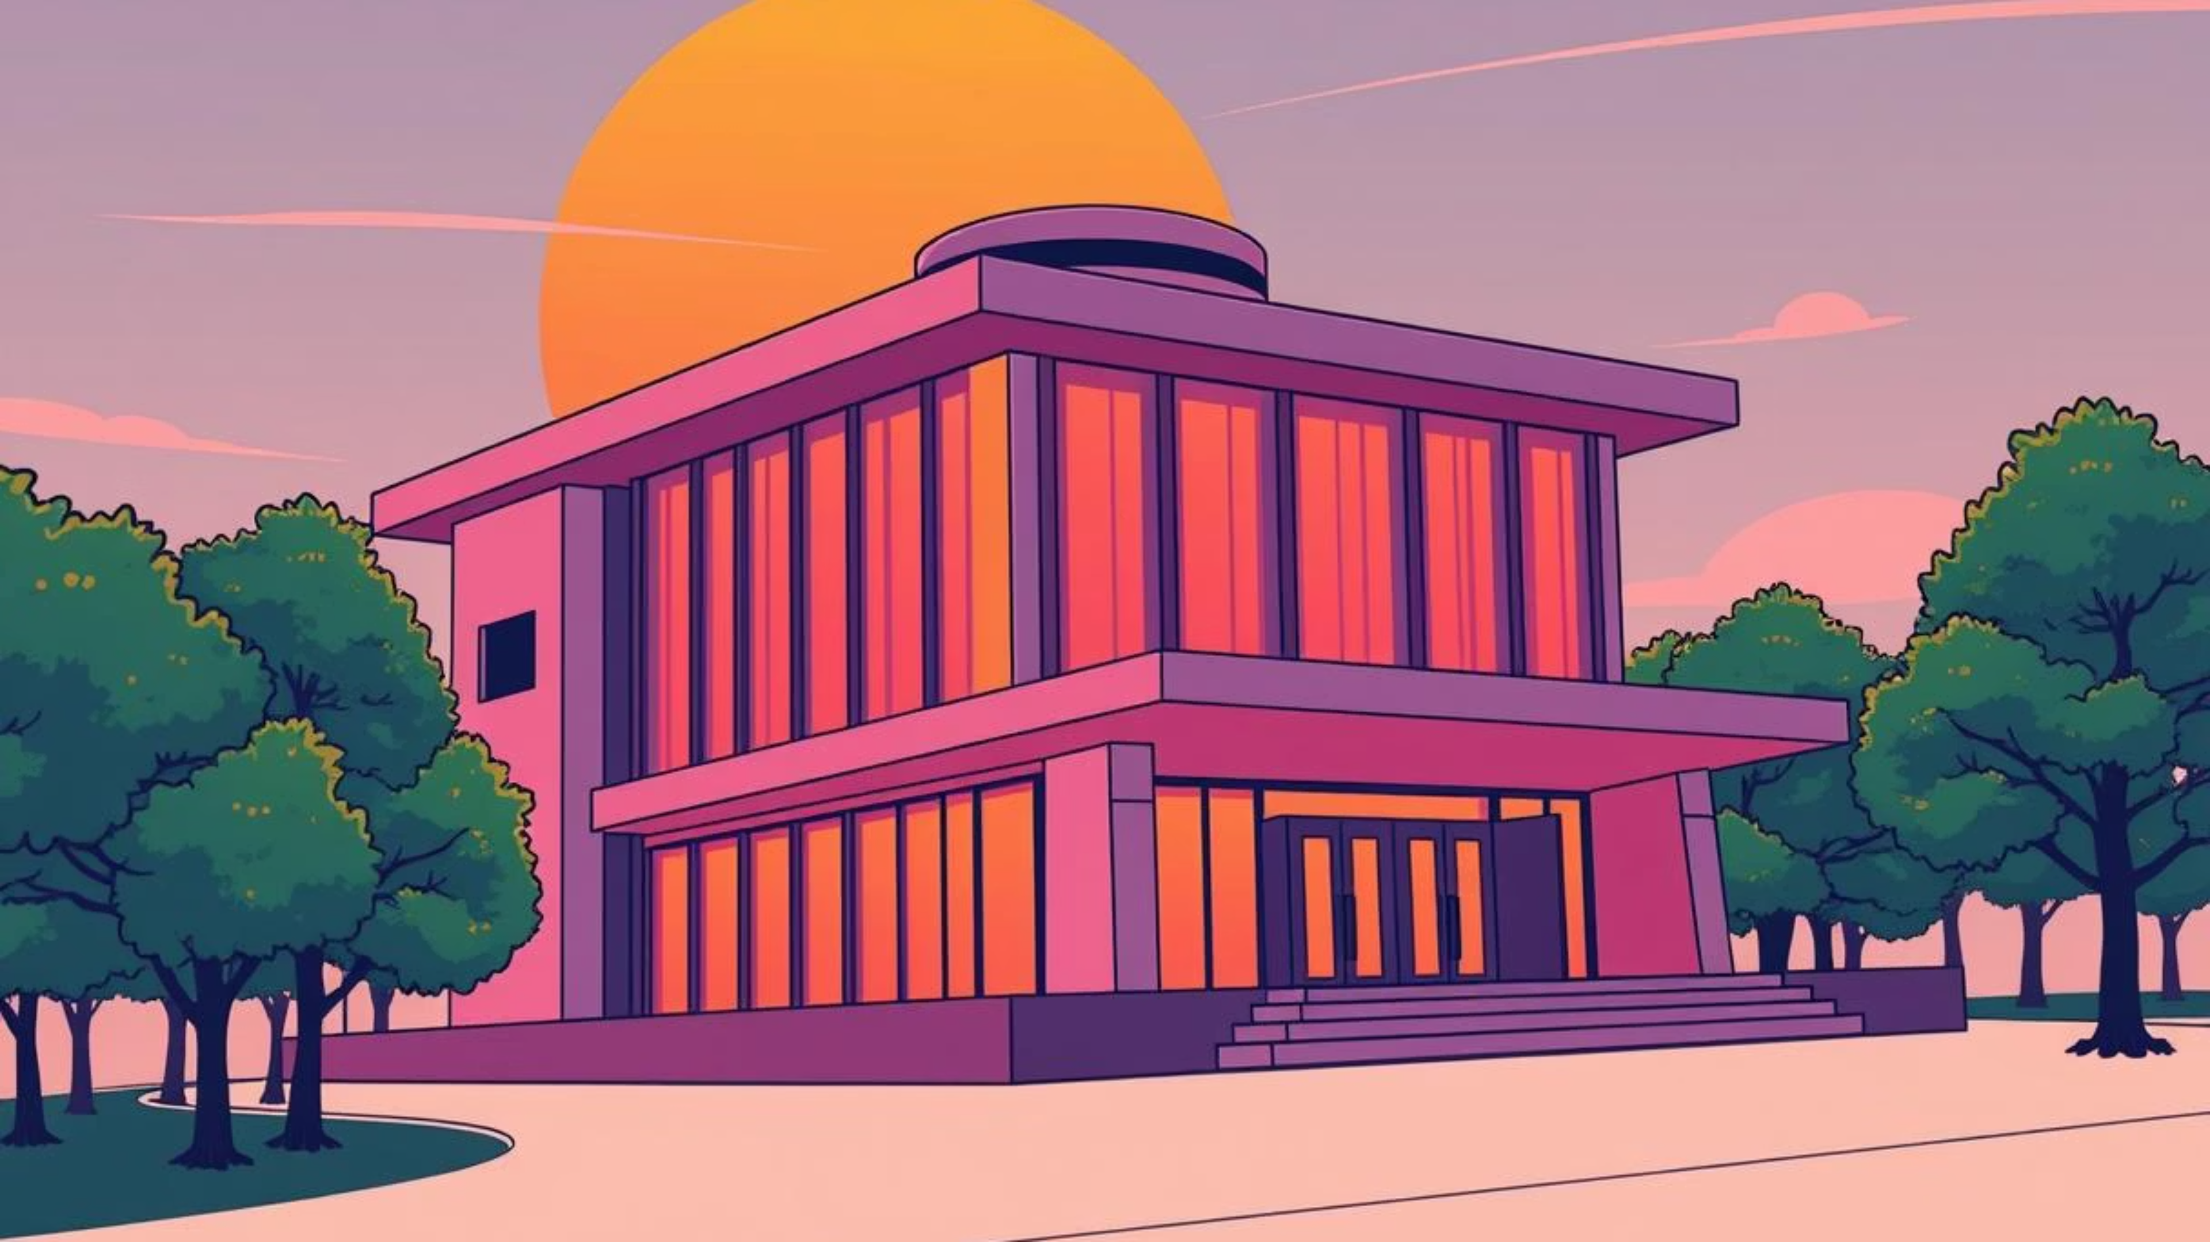

Flames of Innovation
Entrepreneurial Models for Sustainable Transformation in Urban Crematorium Infrastructure
25-27 August | SACA National Conference
Chantel Carelse-Williams –Masters Student- CPUT
Mrs. Linda Paul- Supervisor CPUT

Slide 2

CONTEXT/INDEX
Introduction & Background
Research Aim & Objectives
Research Questions
Conceptual Framework
Methodology
Key Themes & Case Studies
Barriers & Opportunities
Conclusion & Recommendations

Slide 3
INTRODUCTION
Re-imagining Cremation in the 21st Century
As urbanisation intensifies and environmental consciousness grows, the demand for sustainable end-of-life solutions becomes critical. Traditional cremation, with its high energy consumption and carbon emissions, presents a significant challenge.
Urgent Need for Sustainability
Current Challenges
Opportunity for Eco-Design
Urbanization and environmental pressures demand sustainable end-of-life solutions.
Traditional cremation is energy-intensive and carbon-heavy, requiring innovation.
Innovation through entrepreneurship and eco-design can transform the industry.

Slide 4
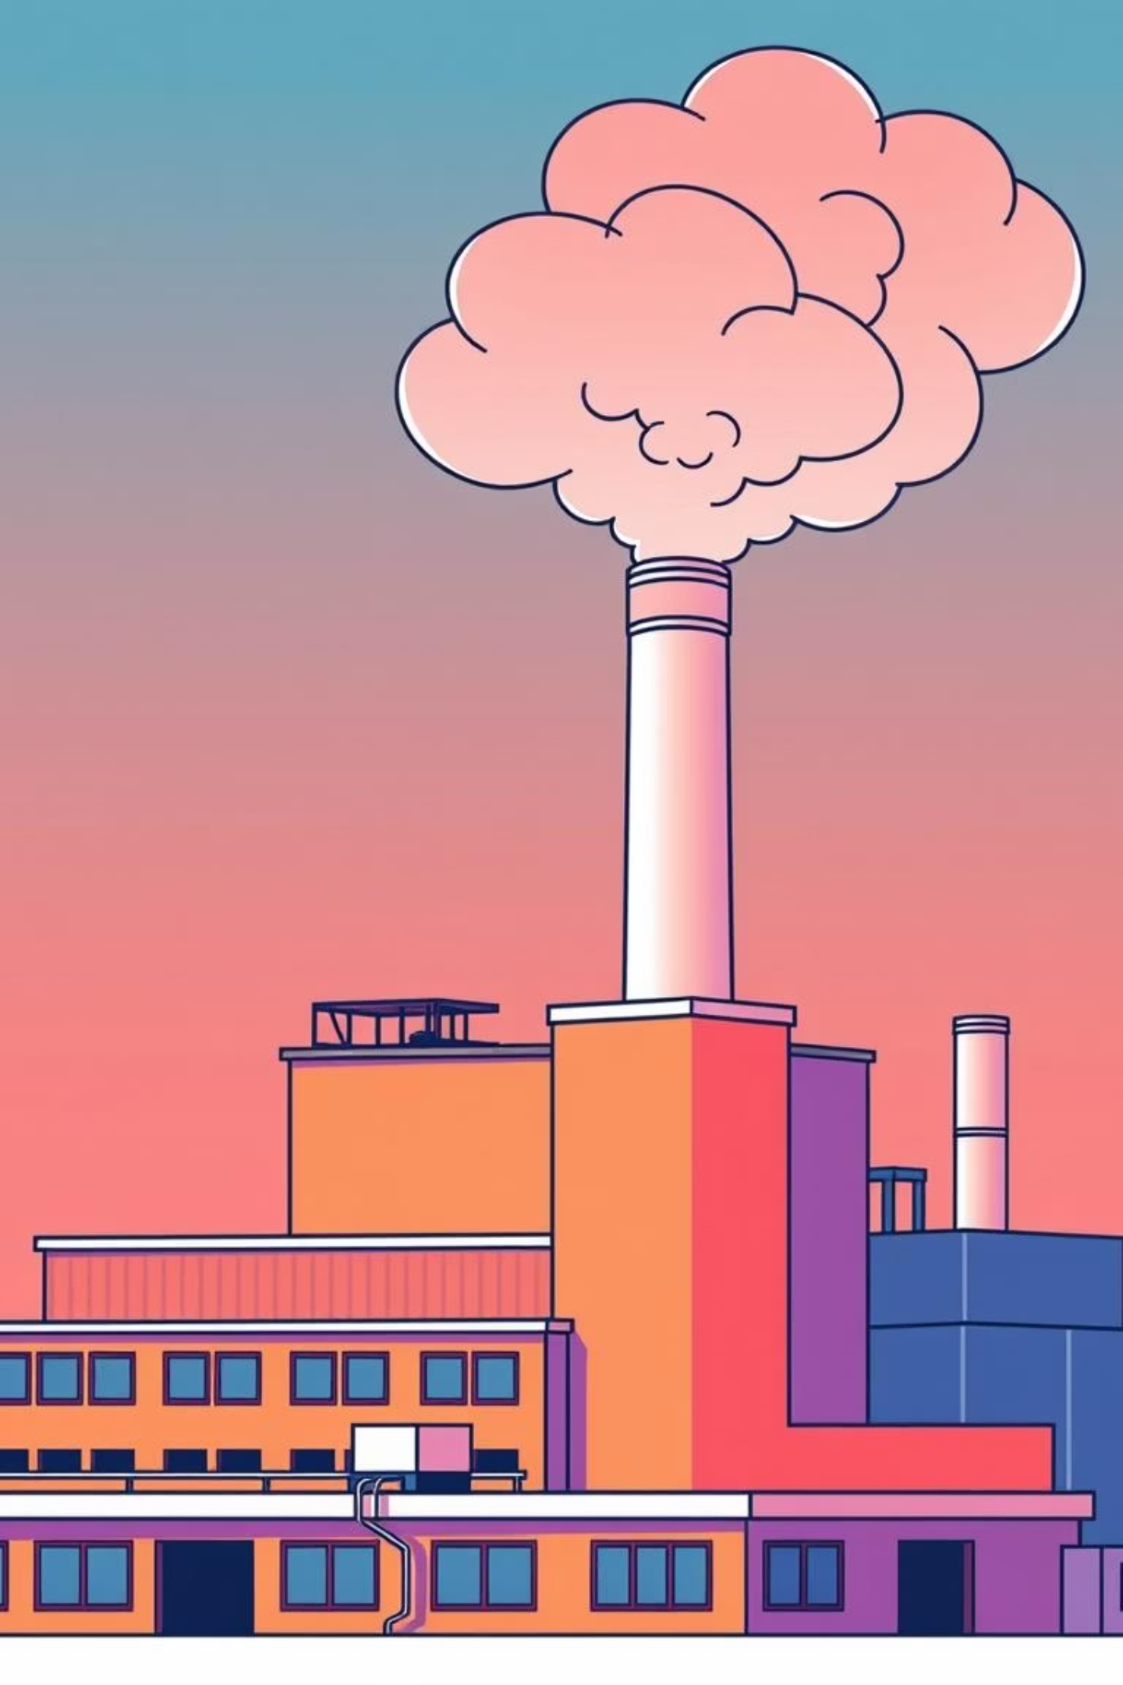
PROBLEM STATEMENT
Challenges in Current Urban Cremation Infrastructure
High carbon emissions from traditional methods.
Outdated infrastructure and lack of green alternatives.
Limited space for burial and memorialization in dense urban areas.
Public resistance due to cultural and religious considerations.

Slide 5

RESEARCH AIM
To explore how entrepreneurial models can facilitate sustainable transformation within urban crematorium infrastructure, balancing environmental, social, and cultural needs.

Slide 6
RESEARCH QUESTIONS AND OBJECTIVES
QUESTIONS
OBJECTIVES
What are the primary sustainability challenges in urban cremation infrastructure?
Identify key environmental and operational challenges in current crematorium practices.
How can entrepreneurial models support transformation in the sector?
Investigate emerging entrepreneurial approaches and innovations in the sector.
What innovations currently exist, and how effective are they?
Assess the potential for integration of eco-technologies in urban settings.
How can community and cultural factors be integrated into future models?
Develop recommendations for sustainable, scalable crematorium models.

Slide 7
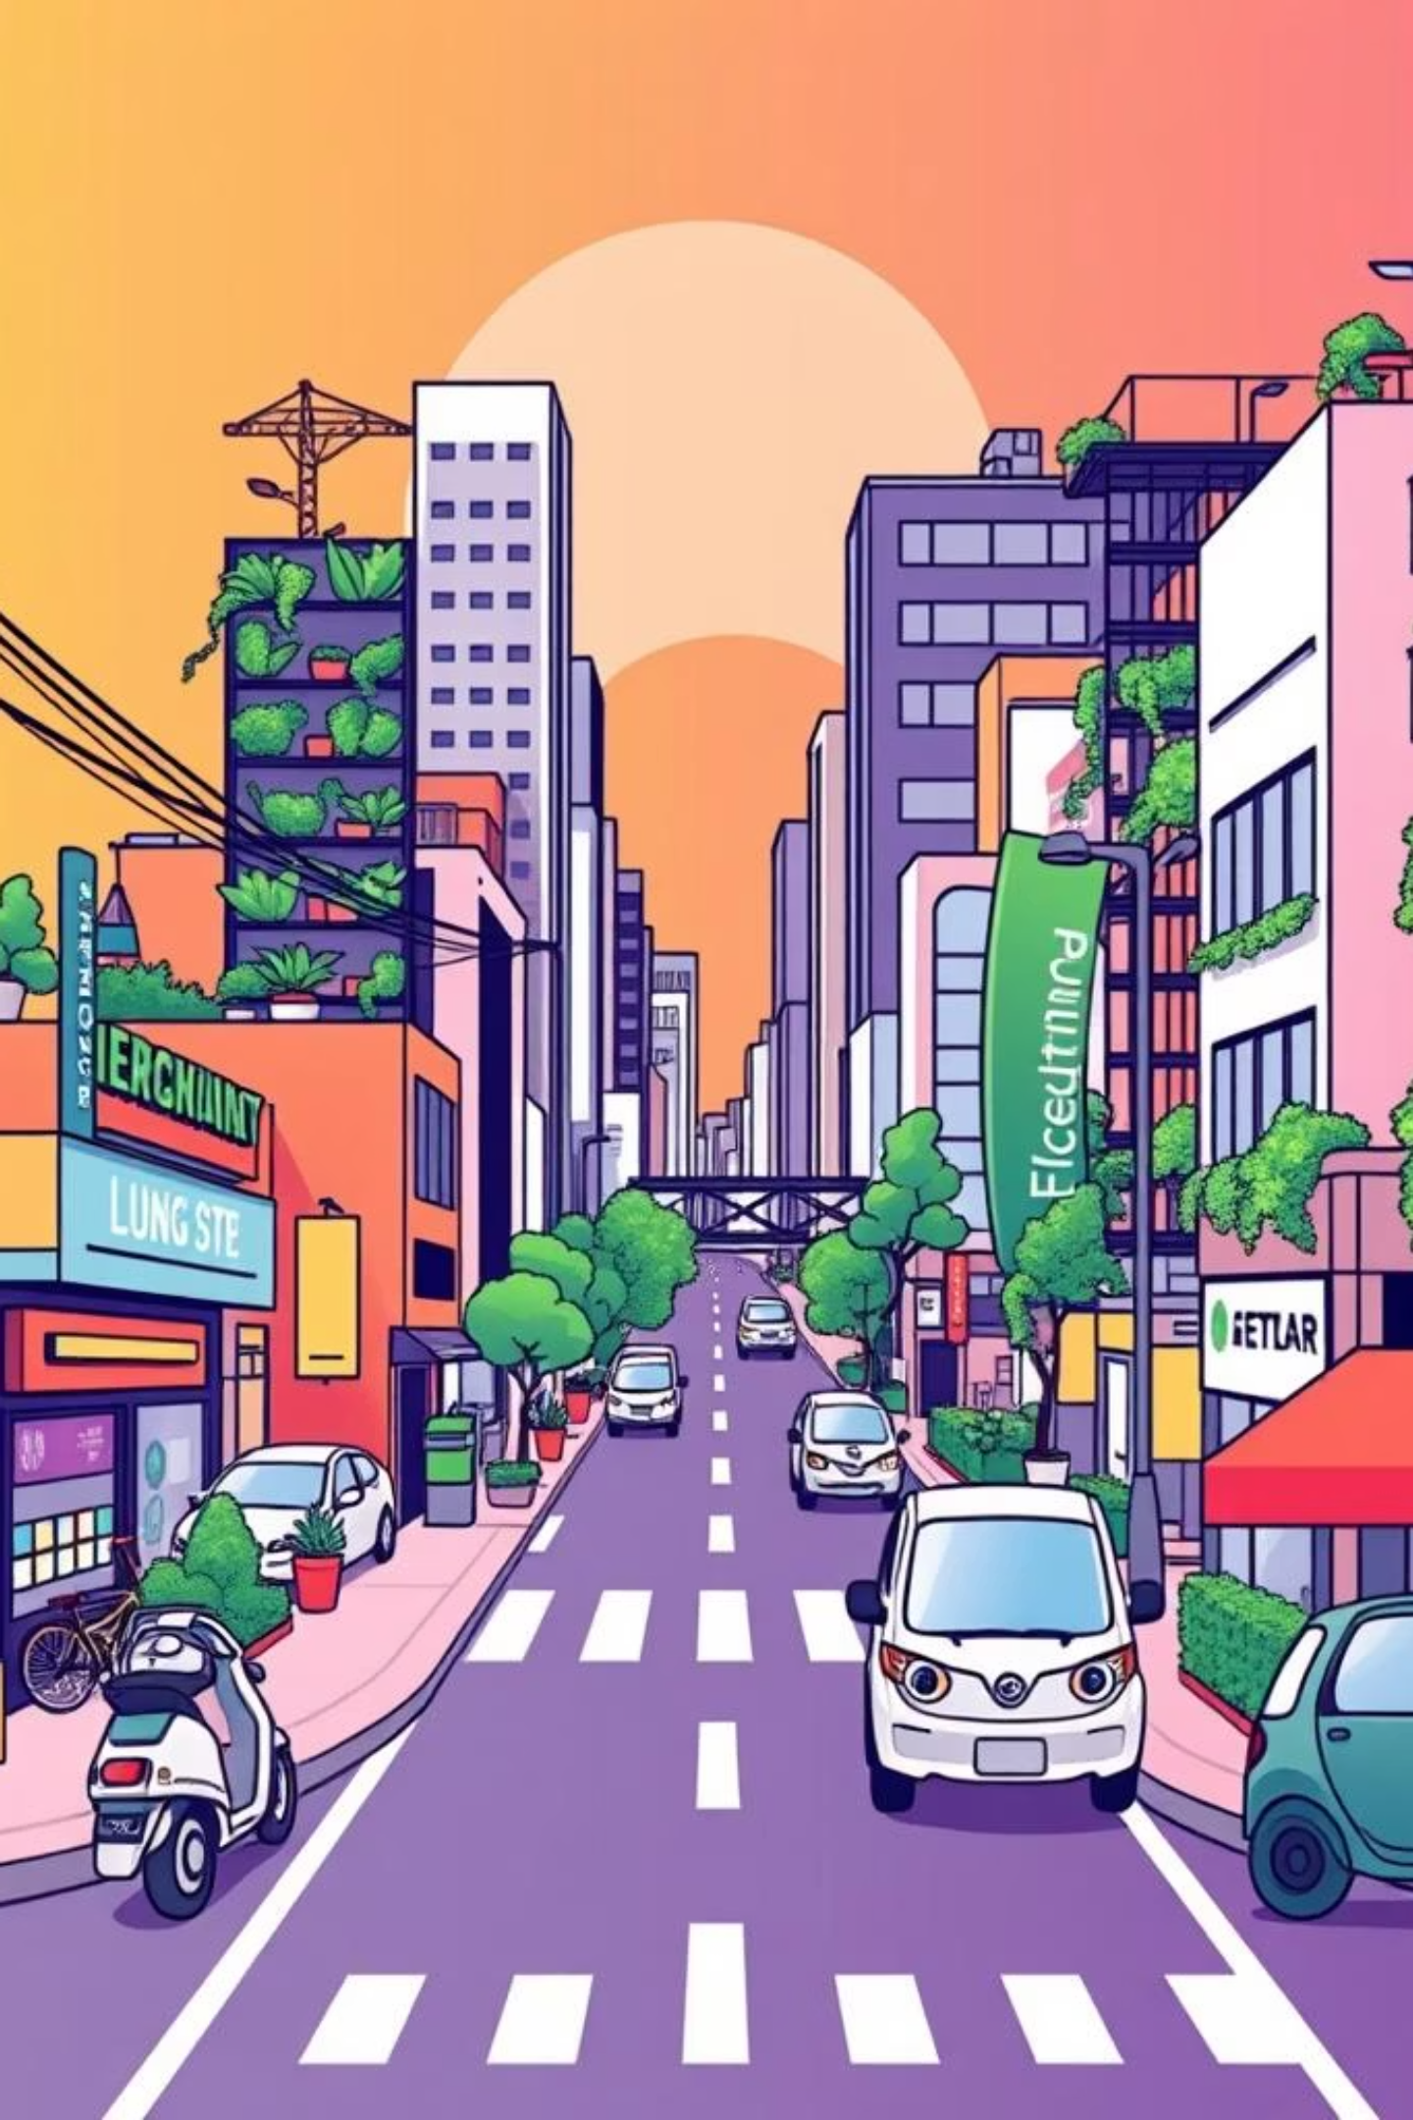
CONCEPTUAL FRAMEWORK
•Grounded in the intersection of sustainability, entrepreneurship, and urban innovation.
•Key Theories:
- Systems Thinking (Meadows)
- Sustainable Development Goals (UN SDG 11)
- Triple Bottom Line (People, Planet, Profit)
- Diffusion of Innovation (Rogers)

Slide 8



RESEARCH METHODOLOGY
Qualitative research approach:
Semi-structured interviews with experts and entrepreneurs
2
Case study analysis (international and local examples)
1
Thematic analysis to identify trends and opportunities
3

Slide 9




What Does a Sustainable Urban Crematorium Look Like?
Energy-Efficient Units
Renewable Energy Integration
Utilizing electric or water-based systems to minimize energy consumption.
Harnessing solar, wind, or biogas to power operations.
Digitally Managed Services
Eco-Memorial Gardens
Online platforms for arrangements, virtual ceremonies, and memorials.
Green spaces for remembrance, blending nature with memorialization.

Slide 10
Innovation at the Core: Entrepreneurial Models
New ventures are emerging to address the challenges in the deathcare industry, offering innovative and sustainable solutions.
Tech-Driven Memorial Platforms
Green Cremation Startups
Innovating with digital tributes, virtual ceremonies, and online grief support.
Companies pioneering alkaline hydrolysis and electric cremation for a lower environmental impact.
Public-Private Partnerships
Social Enterprises
Collaborations with municipalities to renew and modernize infrastructure.
Community-owned crematoria focusing on environmental justice and affordability.

Slide 11

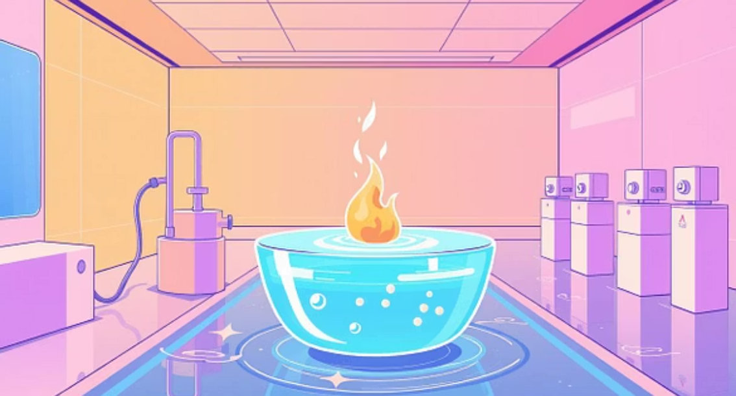

Global Inspiration: Pioneering Case Studies
Recompose (USA)
Aquamation Technologies
Urban Memorial Forests (Japan)
A leading example of human composting, offering an ecological alternative to burial and cremation.
Specializing in water-based cremation (alkaline hydrolysis), a more eco-friendly process.
Innovating with tree-based remembrance, providing green burial options in densely populated cities.

Slide 12

FINDINGS
Transforming Death-care with Purpose
1
2
Reduced Carbon Footprint
Greater Accessibility
Significantly lowering emissions through greener technologies.
Ensuring dignified end-of-life services for all communities.
3
4
Sustainability Alignment
Inclusive Remembrance
Contributing to global sustainability goals
(UN SDGs).
Fostering a modern, tech-forward, and culturally sensitive approach to memorialization.

Slide 13

CHALLENGES
Barriers and Considerations
While the path to sustainable cremation is promising, several challenges must be addressed for successful implementation.
Regulatory limitations and outdated legal frameworks.
High upfront costs of new infrastructure and
technology.
Cultural and religious sensitivity requiring respectful engagement.
Building public awareness and trust in new
methods.

Slide 14




RECOMMENDATIONS: Next Steps in Innovation
To drive meaningful change, a multi-faceted approach involving collaboration and advocacy is essential.
Research & Pilot New Models
Engage Stakeholders
Explore and test emerging sustainable technologies.
Collaborate with community, government, and investors.
Advocate for Policy Updates
Design with Empathy
Push for regulatory changes that support innovation.
Prioritize human needs and sustainability in every design.

Slide 15

CONCLUSION
Lighting the Flame of Innovation
Urban crematoriums must evolve to meet sustainability goals and shifting public values.
Innovation is key to enabling greener, tech-enabled, and inclusive end-of-life services.
Recommendations:
Invest in innovation hubs within the death-care
Foster public-private partnerships.
Launch pilot projects and public awareness campaigns.
Future models must prioritise empathy, cultural diversity, and accessibility to create meaningful urban memorial experiences.

Slide 16
REFERENCES
Anderson, L. and Doyle, C., 2021. Sustainable innovation in deathcare: Eco-cremation and the future of memorial services. Journal of Environmental Innovation, 12(3), pp.145–159.
Bryson, J.R. and Vanchan, V., 2020. Entrepreneurship and innovation in urban infrastructure. Urban Studies, 57(2), pp.387–403.
Coutts, C., Basmajian, C. and Chapin, T.S., 2018. Urban green burial and sustainable deathcare: Exploring changing attitudes and practices. Cities, 74, pp.319–326.
González, A. and Viscidi, L., 2022. Cremation and climate change: Environmental costs and future alternatives. Environmental Science & Policy, 128, pp.45–52.
Meadows, D.H., 2008. Thinking in systems: A primer. Chelsea Green Publishing.
Rogers, E.M., 2003. Diffusion of innovations. 5th ed. New York: Free Press.
Smith, J. and Williams, D., 2019. The triple bottom line and entrepreneurship in sustainable urban design. Journal of Urban Entrepreneurship, 6(1), pp.33–49.
United Nations, 2015. Transforming our world: The 2030 Agenda for Sustainable Development. [online] United Nations. Available at: https://sdgs.un.org/2030agenda.
Walker, C. and Johnson, P., 2021. Disrupting death: The rise of green cremation technologies and digital memorials. Innovation in Society, 9(4), pp.87–103.

Slide 17


Slide 18

THANK YOU

