Slide 1
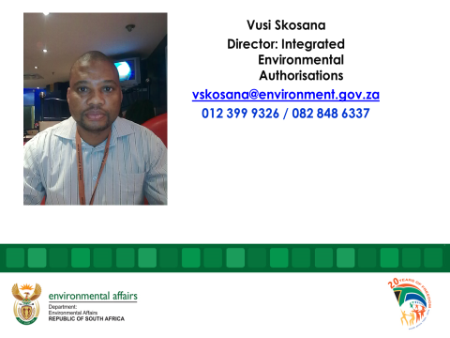
Vusi Skosana
Academic Qualifications
MSc Environmental Ecology: (Masters): University of Pretoria
Masters in Environmental Management: (Masters): University of Free State
Baccaleurus Technology (BTech Natural Science): Conservation; University of South Africa (UNISA)
National Diploma: (Natural Science): Conservation; Mangosuthu University of Technology
Employment History: Over 26 years experience in Government
Worked for
National Department of Environmental Affairs
National Department of Water Affairs and Forestry
Gauteng Provincial Department of Agriculture, Conservation and Environment
Mpumalanga Provincial Department of Agriculture, Conservation,
Current Position:
Director: Department of Forestry,
Fisheries and the Environment

Slide 2


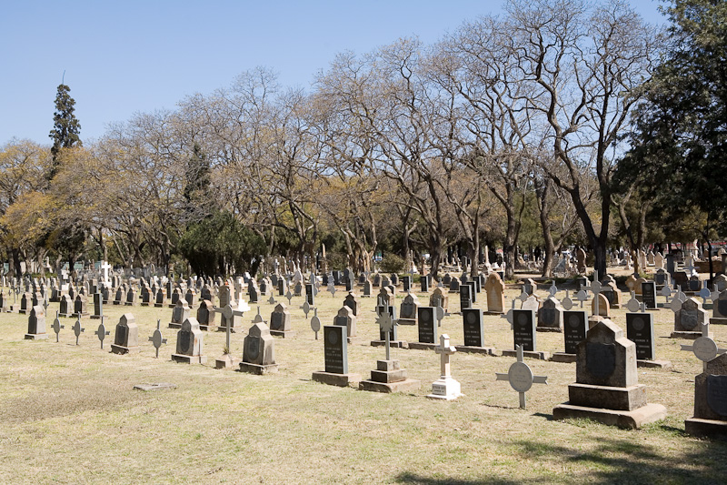
Regulations Governing Cemetery Development: The Environmental Impact Assessment (EIA) Process
Vusi Skosana Department of Forestry, Fisheries and the Environment Tel: +27 (0) 12 399-9326 Cell: +27 (0) 82 848 6337 E-Mail: vskosana@environment.gov.za

Slide 3
PRESENTATION OUTLINE
INTRODUCTION
WHAT IS ENVIRONMENTAL IMPACT ASSESSMENT (EIA) ?
LEGISLATION: THE SUPREME LAW
NEMA PROVISIONS
WHY DO WE NEED EIA
NEMA EIA LISTING NOTICES
BAR REQUIREMENTS FOR CEMETERY DEVELOPMENT
PERCEPTIONS ABOUT EIAs
BAR PROCESS IN APPLYING FOR CEMETERY DEVELOPMENT
ROLES AND RESPONSIBILITIES OF MUNICIPALITIES ON EIA IN TERMS OF NEMA
CONCLUSION

Slide 4
INTRODUCTION
The country is facing a serious crisis in terms of among other things, burial sites and so on.
Land availability to develop more cemeteries remain a challenge and municipalities find themselves in a dire situation to acquire space and land to meet this rising demand
New development of cemeteries has become a high demand instantly so
Development of Cemeteries is a listed activity in terms of NEMA EIA Regulations 0f 2014 as amended.
This means that municipalities have to apply for an Environmental Authorisation for any new development of cemeteries now and in future.
To obtain an Environmental Authorisation, an Environmental Impact Assessment (EIA) has to be undertaken first
The EIA process and the EA will both be explained in details below including the reasons why EIA is a vital component in this whole dimension..

Slide 5
WHAT IS ENVIRONMENTAL IMPACT ASSESSMENT (EIA) ?
Environmental Impact Assessment (EIA) - means a systematic process of identifying, assessing, predicting, evaluating and mitigating the biophysical, social and other relevant effects of development proposal and reporting environmental impacts associated with an activity.
Identifying potential positive and negative impacts on the environment (biophysical, socio-economic, cultural) associated with proposed activity.
Examine alternatives/ mitigatory management measures to minimise negative and optimise positive consequences in order to prevent substantial detrimental harm to the environment
Two types of EIA process:
Basic assessments- small scale activities
Scoping and EIA- Large scale activities
All Developments/Activities listed in NEMA EIA Regulations must have an Environmental Authorisation granting permission before commencement.
An Environmental Authorisation is the written statement from the Competent Authority permitting or refusing the proposed activity.

Slide 6


LEGISLATION: THE SUPREME LAW
Constitution

Slide 7
NEMA makes Provisions for the Minister to identify activities that would require environmental authorisations prior to commencement of that activity and to identify competent authorities in terms of sections 24(2) and 24D of the Act.
Nature of an activity
Extent of the activity
Ambit of listing notices
Location of the activity

Slide 8
WHY DO WE NEED EIA
Ensure that environmental considerations are explicitly addressed and incorporated into the development decision-making process
Anticipate and avoid, minimize or offset the adverse significant biophysical, social and other relevant effects of development proposal
Protect the productivity and capacity of natural systems and the ecological processes which maintain their functions, and
Promote development that is sustainable and optimize resource use and management opportunities

Slide 9
NEMA EIA LISTING NOTICES
Listing Notice 1 (BA)
Listing Notice 2 (S&EIA)
Listing Notice 3 (BA- geographic areas)

Slide 10

Regulations Governing Cemetery Development NEMA EIA Regulations 2014; Listing Notice 1 BAR REQUIREMENTS FOR CEMETERY DEVELOPMENT.
Activity 23: The development of cemeteries of 2 500 square metres or more in size
Activity 44: The expansion of cemeteries by 2 500 square metres or more.

Slide 11
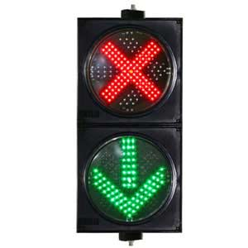
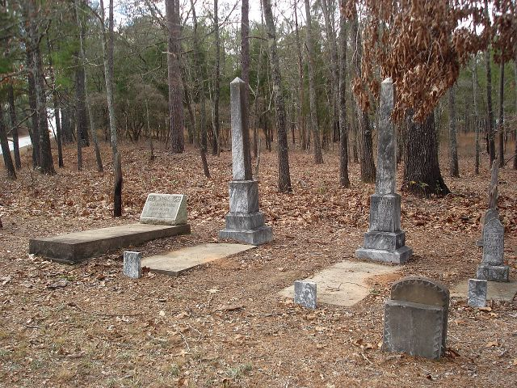
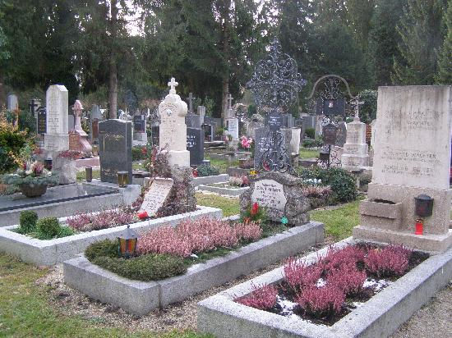
CONTINUE……….

Slide 12

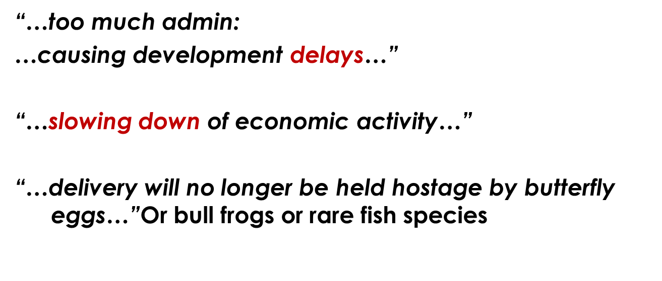

PERCEPTIONS ABOUT EIAs

Slide 13
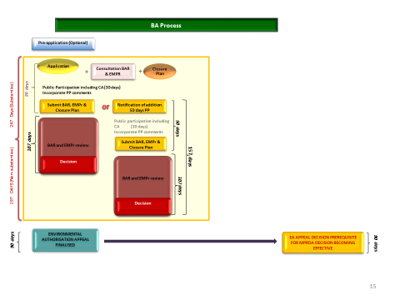
BAR PROCESS IN APPLYING FOR CEMETRY DEVELOPMENT

Slide 14
ROLES AND RESPONSIBILITIES OF MUNICIPALITIES ON EIA IN TERMS OF NEMA
Municipalities must place community & its needs at the forefront of its concern, and serve physical, psychological, developmental, cultural and social interests equitably
Development in municipal areas must be socially, environmentally and economically sustainable-relates to mitigation and prevention of ecosystem loss, pollution, waste etc.
Ensure participation of all interested and affected parties must be promoted
Ensure that decisions must take into account interests, needs and values of all I&AP- including traditional communities

Slide 15

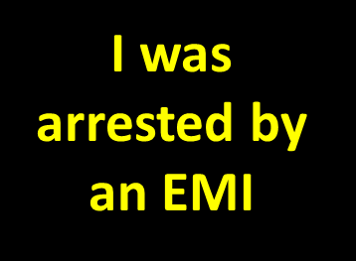


CONCLUSION
Non-compliance with the LAW is a criminal offence.

Slide 16
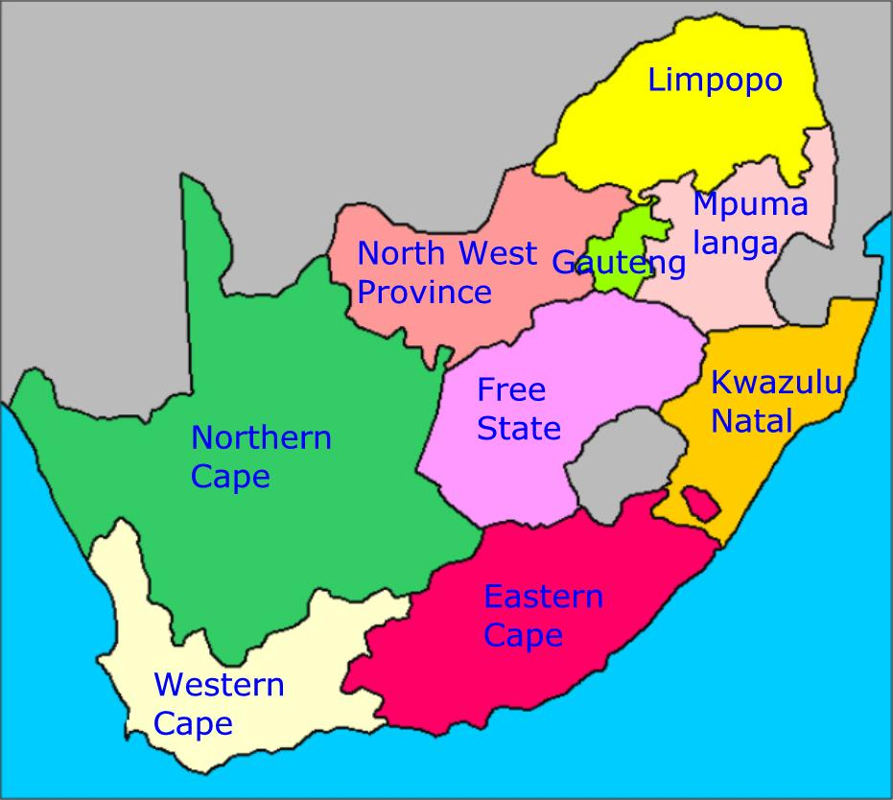
A Comprehensive List of Provincial Contacts is appended as an appendix 1 for ease of reference if you want to apply or inquire from a particular Province

Slide 17



THANK YOU!
D: National Infrastructure Development
Department of Forestry, Fisheries and the Environment
Tel: 012 399 9326 | Mobile: 082 848 6337
Website: http://www.environment.gov.za
Address: The Environment House, 473 Steve Biko Road, Arcadia, Pretoria, 0083

