Slide 1



THE SUSTAINABILITY OF CEMETERIES
WITHIN LONG-TERM SETTLEMENT PLANNING
Kate Sarabjiet
CoGTA: Spatial Planning
SACA Conference 2025
August 2025
GROWING KWAZULU-NATAL TOGETHER

Slide 2

1. BACKGROUND
Although cemeteries and crematoria provide essential services to people, it was not until the COVID-19 pandemic that government started to pay greater attention to issues regarding the management and functionality of such facilities as well as plans for the future.
In this regard, the Social Protection, Community and Human Development Cluster (SPCHD) tasked CoGTA with establishing a structure where relevant Sector Departments and representatives from each District Municipality could engage on issues relating to the management Cemeteries and Crematoria, both generally and in the context of COVID-19.
As such, the Provincial Task Team for the Sustainable Planning and Management of Cemeteries in KZN (PTT) was established in 2020 and is currently functional. The PTT is comprised by representatives from each District and Local Municipalities as well as various Sector Departments and key organisations including, the Provincial House of Traditional and Khoi-San Leaders (PHTKL) and AMAFA.
In support of its objectives, the Department was requested to develop a means of building the capacity of both Municipalities and the Private Sector in terms of establishing and/or expanding existing facilities. Internally developed, the current Provincial Protocols focuses, for now, solely on urban areas (where information is more readily available). Going forward, the next Phases of the project will review burials in “non-urban” areas (Traditional Authority and farm land) to determine a strategic way forward.
One of the critical areas discussed within the Protocols is the need for alternative methods to burials – when understanding the current development and settlement context.
2

Slide 3
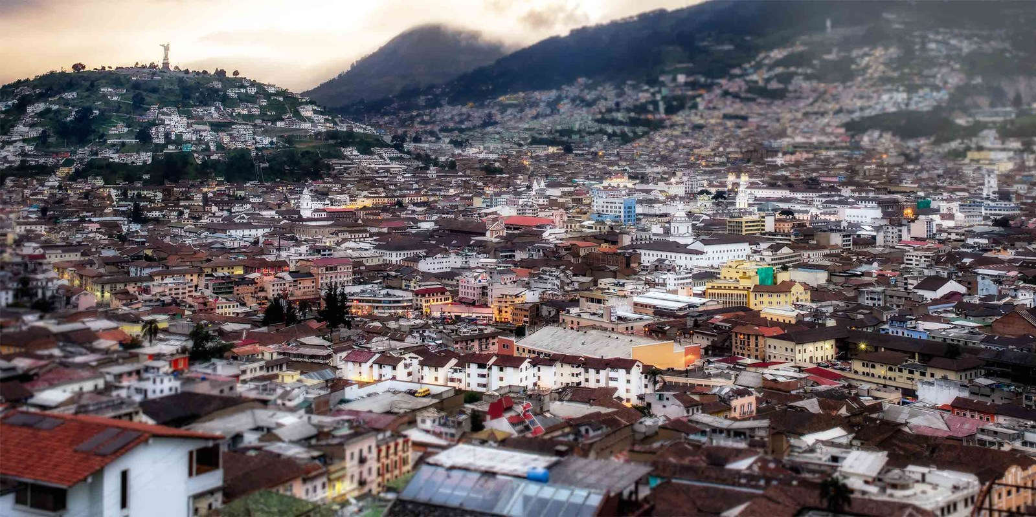
2. IMPACT OF URBANISATION
Many towns, across the country, are currently subject to rapid urbanisation due to limited accessibility to services and job opportunities in surrounding areas.
This does not just mean an increase in the number of informal settlements in and around a major town, but also an increase in the number of people renting or purchasing property within that town.
As per the World Bank 69% of South Africans are already living in urban areas, and that statistic will increase to 71% by 2030, and 80% by 2050.
The most direct impact of this is an increasing pressure on infrastructure, housing, and public services – all of which require land.
3

Slide 4
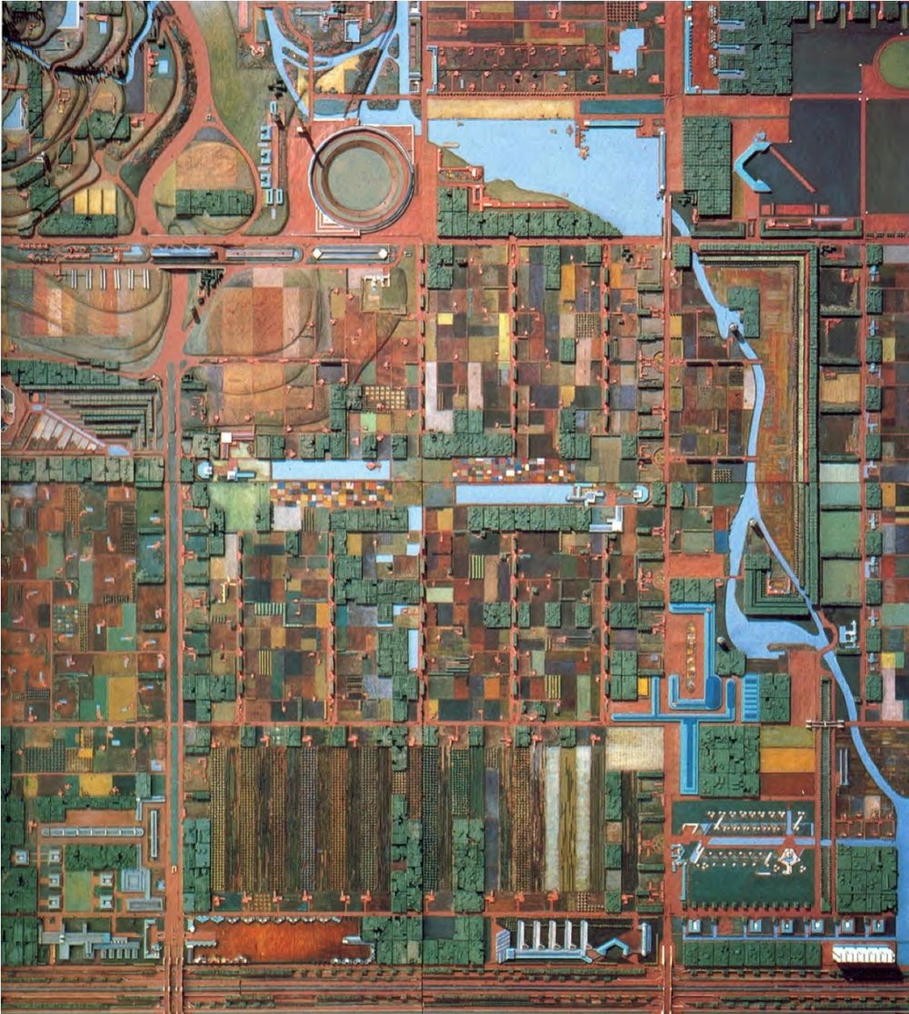
3. LAND AVAILABILITY
So, the more people that live or depend on a town, the more services (schools, clinics, water, sanitation etc.), businesses and accommodation is required – which attracts more people.
And so the cycle begins again.
…BUT, LAND IS A SCARCE RESOURCE.
If you picture a town as a blank canvas, almost 50% is used just for housing. The remainder of the canvas gets divvied up between: offices, businesses, retail, industries, schools, health facilities, worship sites, government buildings, stadiums, sports fields, open spaces, parks, tourism facilities, community halls, libraries, utilities, reservoirs, servitudes, landfills etc. – and a few existing cemeteries and crematoria.
This picture is now looking quite overcrowded. So what about the area outside of town?
4

Slide 5
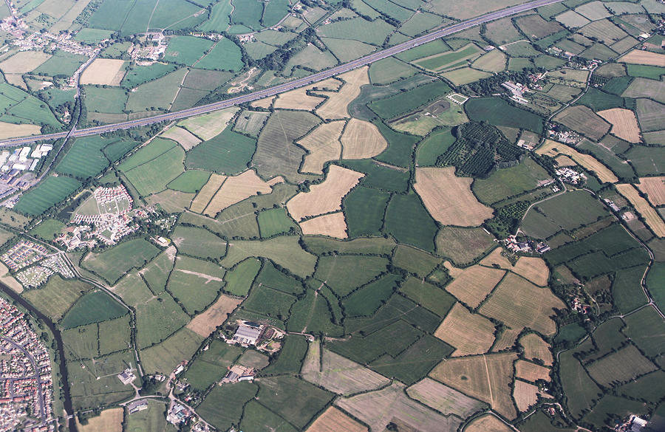
3. LAND AVAILABILITY
Here land is predominantly used for either commercial agriculture, grazing, or it has already been settled – as Traditional areas, farm settlements, or through land restitution. Other uses would include some form of tourism, heritage sites, agro-processing, or social facilities.
This “outer area” also includes: protected areas, private nature reserves, forests (protected by DAFF), wetland, Critical Biodiversity Areas, Ecological Support Areas, wetlands, World Heritage sites, dams, geologically sensitive areas etc. – all of which restrict development.
Ok. But what if we found land that was not being used or preserved for anything else?
5

Slide 6
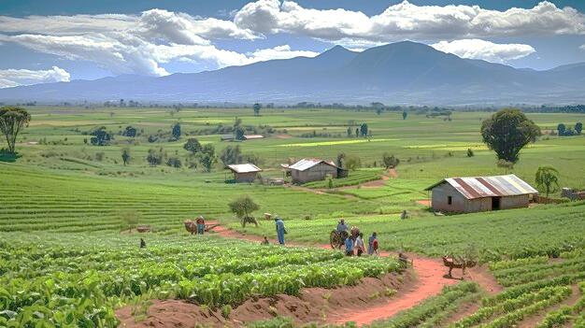
3. LAND AVAILABILITY
Then we would also need to note that land which falls outside of an Urban Scheme area, and is not State owned land or Traditional Authority administered, is subject to the Subdivision of Agricultural Land Act 70 of 1970 (now PDALA). Subjective land cannot be transformed or subdivided for non-agricultural uses unless that land has a low-medium agricultural potential, or it has already been settled.
In terms of Traditional Authority areas, it is most customary for burials to be undertaken on homesteads, as opposed to burials on communal sites. Most “rural” Municipalities have noted that engagements with Amakhosi for the proposed establishment of a public cemetery have not gone well.
Ok. But what if we found land that was not being used or preserved for anything else, and is not on Traditional Land, or it has low-medium agricultural potential?
Well then it would still have to meet specific locational requirements to be both credibly and legally suitable for the development of a cemetery.
6

Slide 7
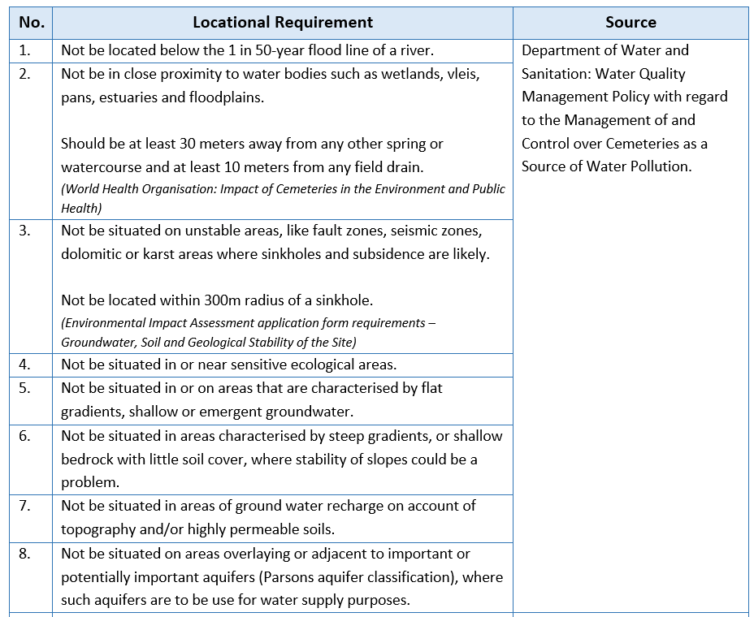
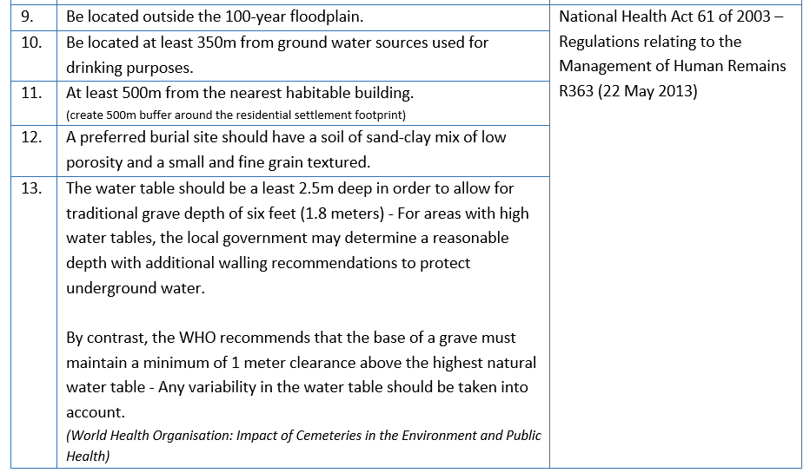
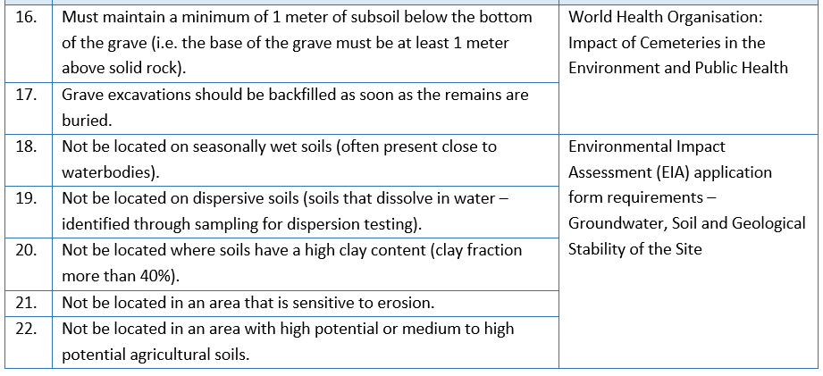
3. LAND AVAILABILITY
7

Slide 8
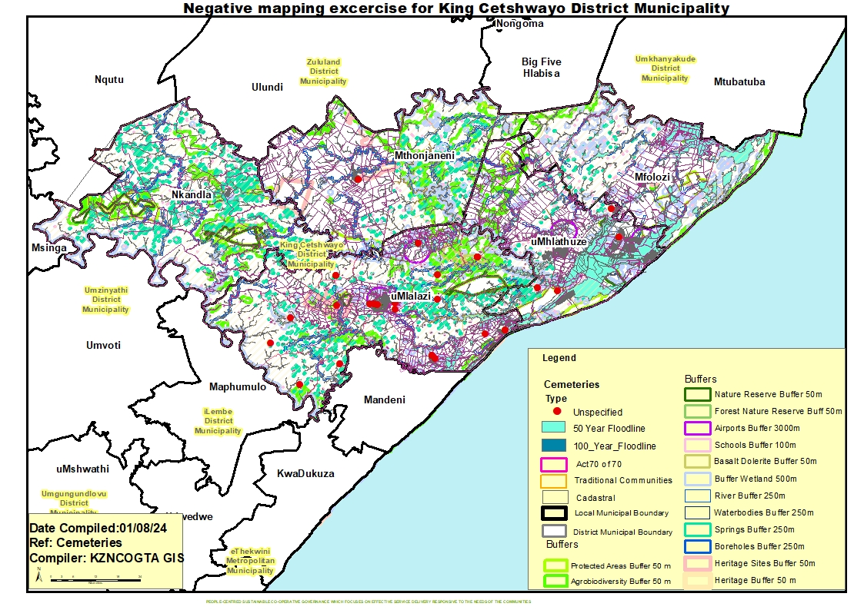
3. LAND AVAILABILITY
8

Slide 9
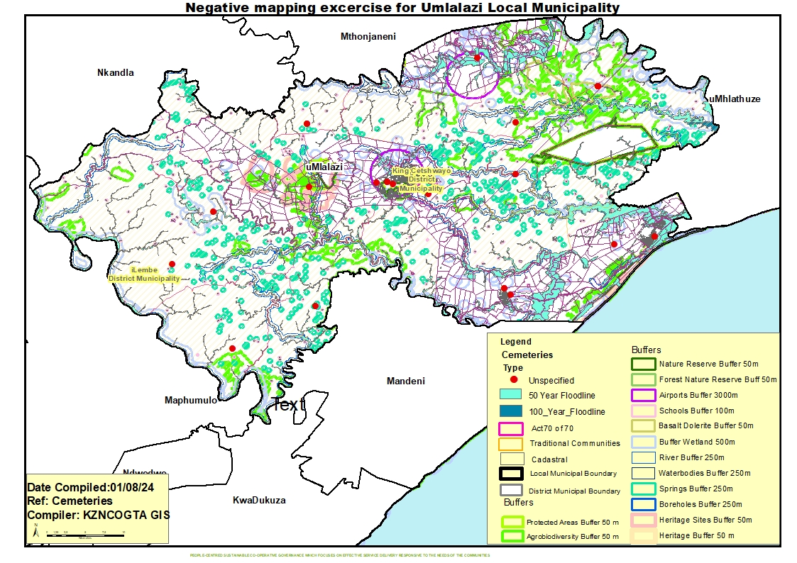
3. LAND AVAILABILITY
9

Slide 10
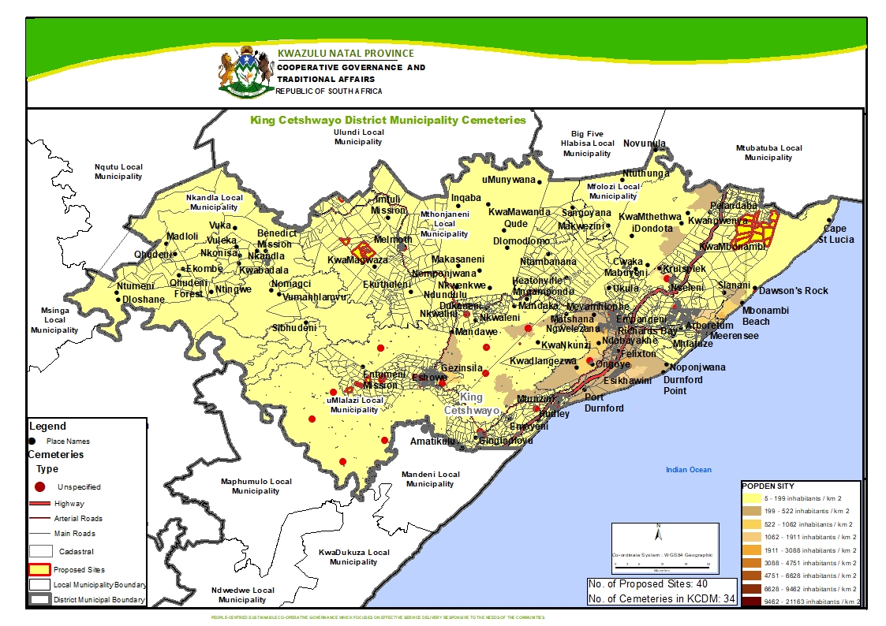
3. LAND AVAILABILITY
10

Slide 11
3. LAND AVAILABILITY
However, in order to decrease conflicting and unsustainable land use practices, we still need to test the identified feasible sites against the Municipal Spatial Development Framework (SDF) – which is the long-term plan for the Municipality in terms of growth and development.
This will cross-reference possible sites with the following:
Areas that have already been developed (settlement footprint);
Areas for current and future catalytic projects;
Areas required to support planned government projects over the MTEF period;
Areas of current and future nodal areas as well as corridors;
Areas for public and private investment in support of economic growth and development;
Planned locations for future housing developments;
Future proposals for the location of required bulk infrastructure and services (including social facilities);
Areas with medium-high grazing potential; and
Areas with Eco-Tourism, Cultural and/or Heritage significance/importance.
11

Slide 12
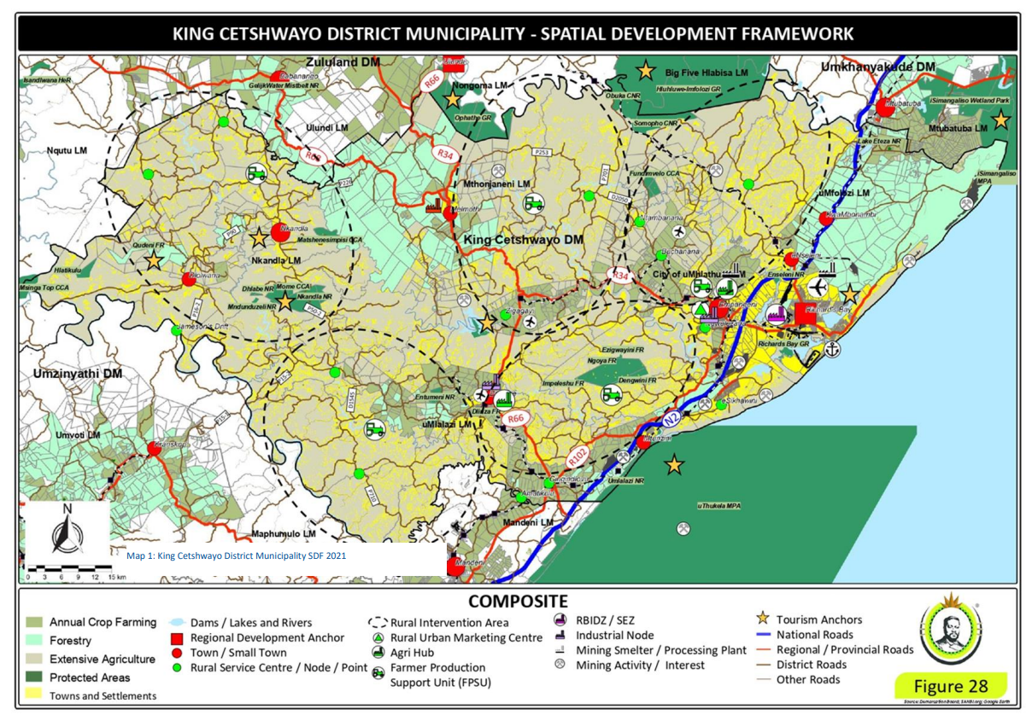
3. LAND AVAILABILITY
12

Slide 13
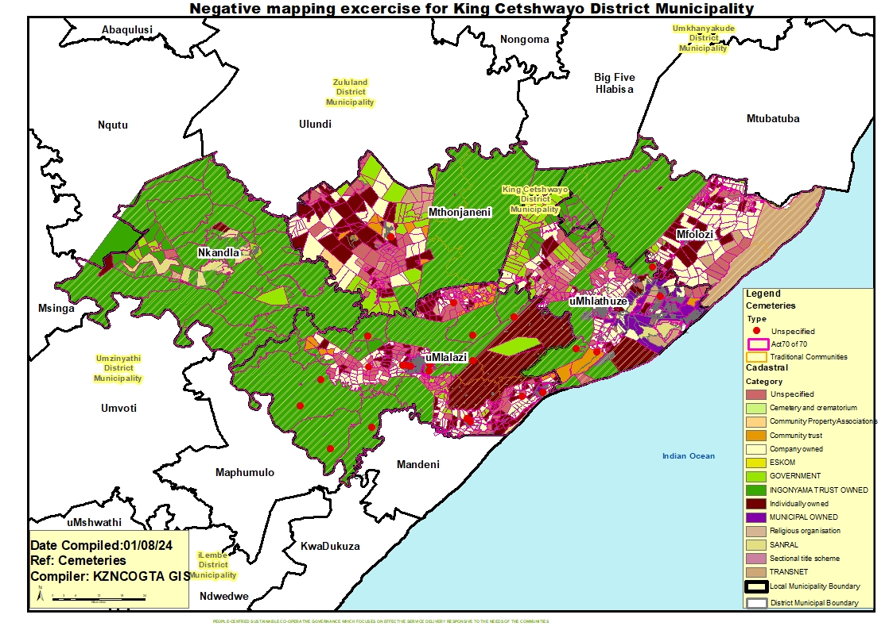
3. LAND AVAILABILITY
13

Slide 14

3. LAND AVAILABILITY
Is that it? Not quite. Finding land is one thing, acquiring said land is completely different.
Due to its limited revenue collection and economic add-value, cemeteries are not given the time nor the budget that it needs to function properly.
In our engagements with Municipalities, it was noted that a large number of existing facilities have closed due to limited capacity, and that a large number of the ones that are still operational only have a few hundred graves left.
Of those same Municipalities, only a very few have identified new sites or areas of expansion – even though all Municipalities are aware that the legislated environmental and planning authorisations could take up to 3 years.
The main issue, at this point, is that senior management within Municipalities are just not taking the issue seriously. Cemetery Plans are not being budgeted for. Land acquisition is not being budgeted for. Environmental studies are not being budgeted for.
14

Slide 15
3. LAND AVAILABILITY
Even if a suitable site was found, one would still have to undertake a development application requesting for authorization from the competent authority in terms of different pieces of legislation.
In this regard, there are three primary applications which are undertaken for most types of developments, including cemeteries:
The submission of a Basic Assessment Report (BAR) or Scoping and Environmental Impact Report to EDTEA as per the requirements of the National Environmental Management Act 107 of 1998 (NEMA) Environmental Impact Assessment Regulations (R543 of 18 June 2010), as amended;
The submission of a Water Use Authorization application to DWA in terms of the National Water Act 36 of 1998 (NWA); and
The submission of a Planning application (for the rezoning, sub-division, and/or consolidation of land) to the Local Municipality in terms of SPLUMA.
As most of us are aware, whilst the EIA and WULA applications can, in parts, be undertaken in tandem, the SPLUMA application is generally undertaken once Environmental Authorisation has been received – some 247 days later (in the case of substantive applications).
In this regard, the SPLUMA application could be for a subdivision or consolidation of properties, but it will most definitely be for a rezoning to a zone that allows for the development of a cemetery as a free entry use.
15

Slide 16
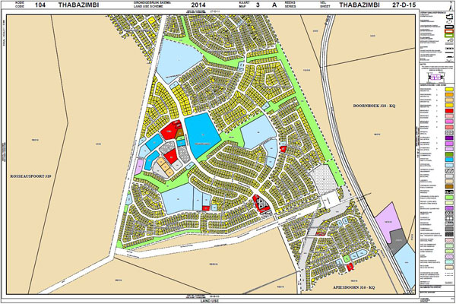
3. LAND AVAILABILITY
As part of this rezoning process, Planner’s would need to determine the compatibility of the cemetery with surrounding uses wherein the CSIR Guidelines for the Provision of Social Facilities in South African Settlements notes that such a facility is only compatible with: police stations, fire stations, nature conservation areas, industry, or a District Hospital.
Further, unlike other forms of urban land use, rezoning to a cemetery is generally a long process, more specifically related to public participation - which is often fraught with difficulties.
16

Slide 17
4. THE SUSTAINABILITY OF A CEMETERY
As we have noted, land is a very scarce resource which needs to be used carefully to maximize its potential to be both sustainable and productive.
A cemetery, however, is counter-intuitive wherein it sterilizes a property as well as its surrounds (including underground) for future development, diversification, or expansion. Cemeteries cannot be “densified” in terms of upward vertical expansion, but rather downward (up to 3 tier burials) but this is hindered by a number of complex environmental requirements and sensitivities.
Whilst no one actively wants to live in close proximity to a cemetery, the cemetery itself needs to be accessible to its users and therefore, cannot be too far away from its supporting population.
Accordingly, cemeteries have often, in the past, been located on the outskirts of a settlement or town - which is away from habitable buildings but close enough for public transportation. Although it may have started off this way, with rapid urbanisation, that gap has quickly closed in where a number of those cemeteries now exist as a barrier for future growth in a particular direction, or an island of inactivity in a densifying residential area.
So, what does all of this mean?
Based on long-term population projections, the general estimation of graves, average use of current facilities, and the outcomes of a GIS negative mapping exercise, we estimate that the KZN Province will run out of land for burials in around 15 to 20 years – which is not taking into consideration the accelerated effect of another pandemic or natural disaster.
17

Slide 18
5. WHAT CAN WE DO?
In the short-term, Municipalities can, and have, increased the number of burials per facility by undertaking second and third tiered internments - but this puts more and more pressure on the natural environment.
Some Municipalities have also started reopening closed cemeteries after undertaking new surveys of previously identified environmentally sensitive areas. With newer technologies, it means that these sensitive areas are more specifically defined to allow for additional burials – but over time, these sensitive areas can expand or shift, which may affect excavated areas.
In the short-term, Municipalities can amend their Policies and By-Laws to solely cremate both Paupers and Indigent persons.
As a matter of urgency, Municipalities need to develop Cemetery Plans that determine long-term land requirements and identify feasible sites through a negative mapping exercise. The outcomes of this Plan will need to feature within both the IDP Budget and the Municipality’s Capital Expenditure Framework. Remember, unless donated by the State (Premier or Public Works), land acquisition will have to be undertaken with Municipal funds (MFMA).
In the medium-long term Municipalities may need to explore the option of transforming historical cemeteries, within prime areas, to other uses which may support economic development. However, due to historical, religious and cultural significance, this can be an uphill battle.
In the long-term, from a planning perspective, the development of a cemetery is an unsustainable land development practice, wherein other forms of internment or disposal need to be investigated and pursued as a matter of urgency.
18

Slide 19
5. WHAT CAN WE DO?
SACA and SALGA could assist with facilitating engagements/exhibitions for Provinces around alternative methods of disposal (aquamation etc.) and newer (and greener) cremation technology.
As a priority, Provincial Departments and SALGA, need to actively work together to engage with interfaith leaders on the matter of alternative burial methods and, most importantly, determine a measurable way forward.
We, as Provincial Departments, require dedicated teams to engage with Municipalities on the management and planning of cemeteries and crematoria so as to identify challenges and areas of intervention.
District Municipalities need to embed standing items as part of their DDM Social Cluster agendas to ensure that such challenges are giving the necessary airtime and prioritisation that it needs as well as related resources.
In terms of KZN, the assessment of the functionality and management of Cemeteries and Crematoria are undertaken through Annual Local Government Assessment Reports as well as through the assessment of both the Spatial Development Framework (SDF) and the IDP.
District Municipalities to explore the development of District Cemetery Plans, where Local Municipalities are unable to develop such documents in the near future.
Work together. Learn from each other. Create a network of support.
19

Slide 20


THANK YOU
Kate Sarabjiet
Professional Town Planner
CoGTA: Spatial Planning
katharine.sarabjiet@kzncogta.gov.za
084 616 0685

