Slide 1
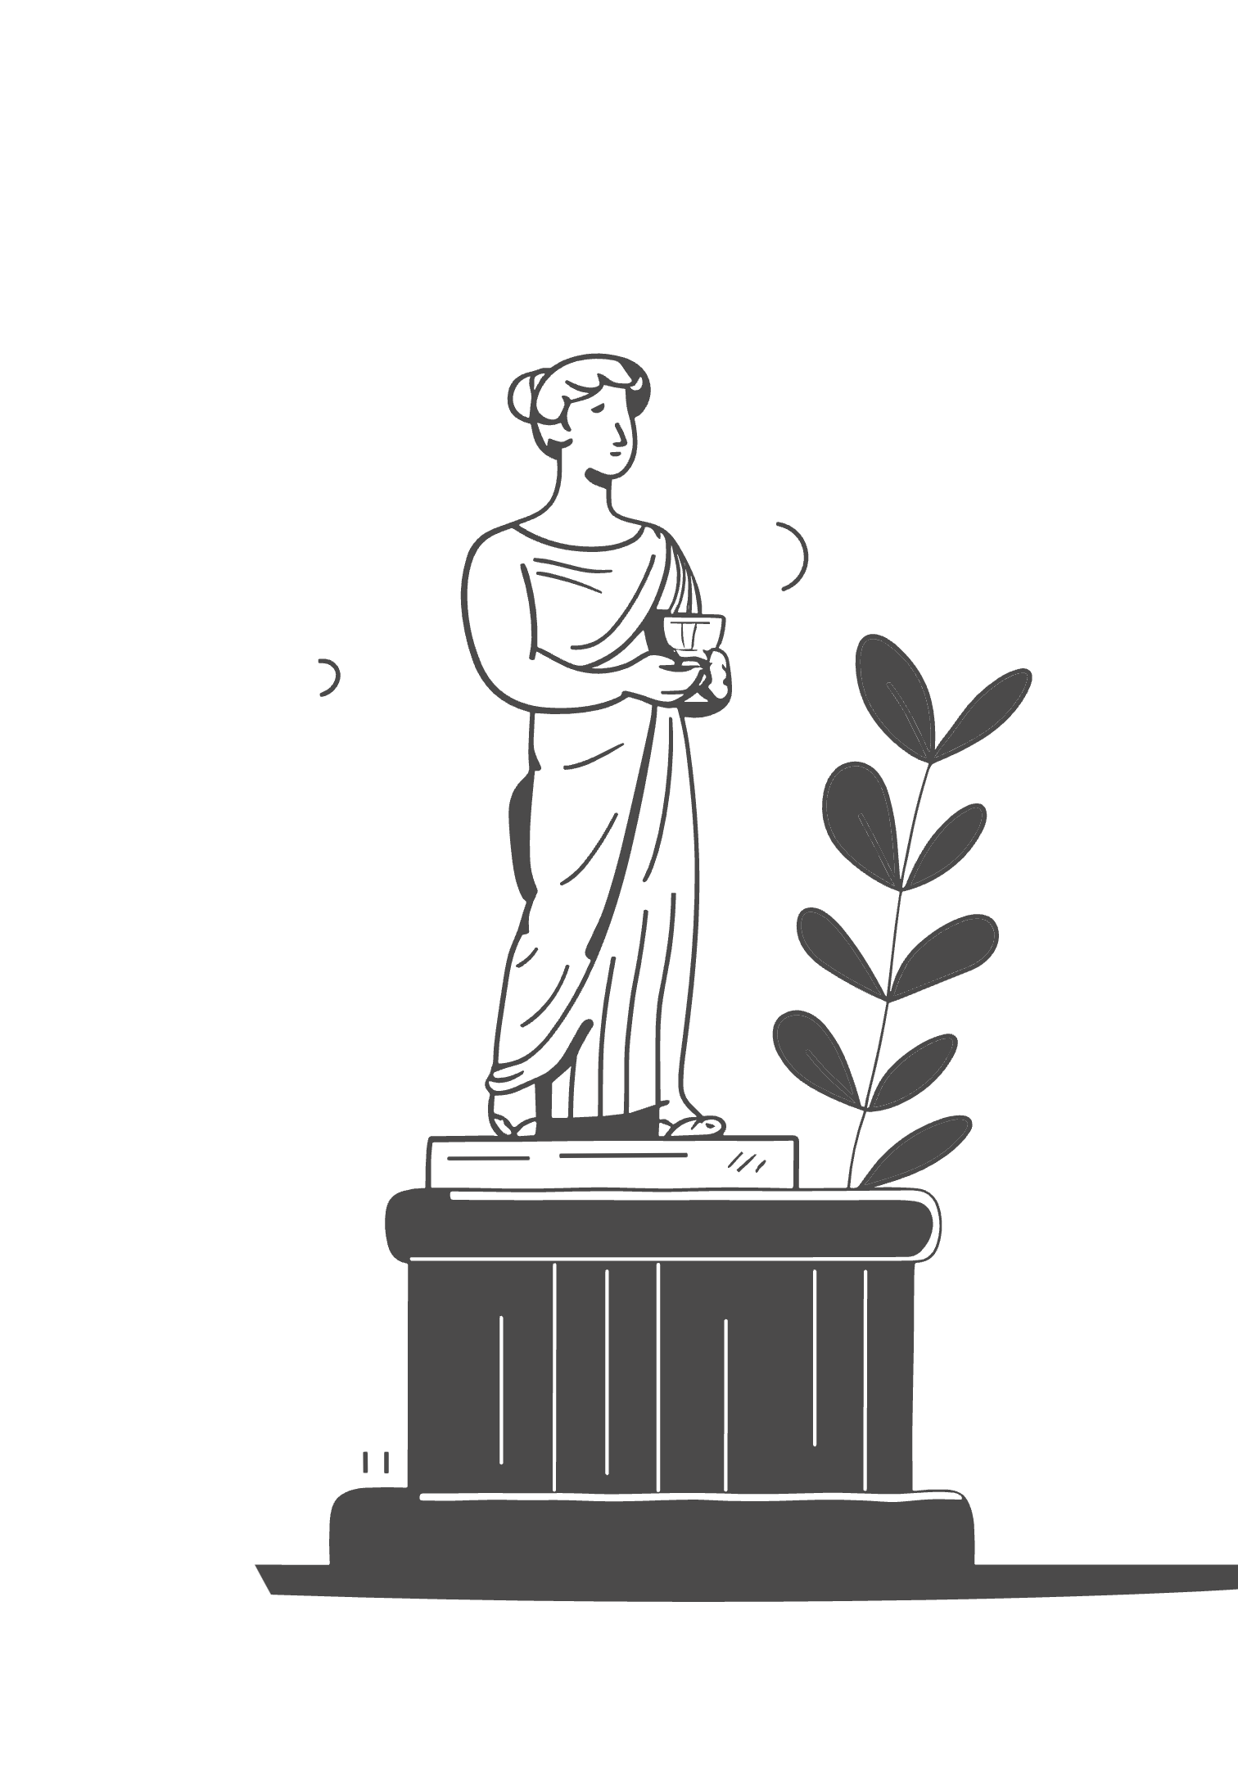

Greening the Final Resting Place
A Review of Sustainable Cemetery Innovations and Policy Trends in Urban South Africa
Bongumusa Walter Ngema
Cape Peninsula University of Technology
Linda Paul, Lecturer and Prof Rena, Co-Author

Slide 2
Table of Contents
Introduction
Navigating Urban Burial Challenges in South Africa
Purpose and Objectives
Charting Sustainable Burial Practices
Conventional Practices
Limitations of Traditional Urban Cemeteries
Conceptual Framework
Ecological Modernization Theory (EMT)
EMT in Action
Comparative City-Level Analysis
Methodology
Qualitative Approach and Data Sources (2019–2024)
Findings: Cape Town
Green Innovation and Pilot Projects
Durbanville Memorial Park
A Case of Multifunctional Urban Burial
Findings: Johannesburg & Durban
Cultural Dynamics and Institutional Gaps
Conclusion
Policy Gaps and Opportunities for Reform
Contact & Acknowledgements
Author and Supervisor Information
Thank You

Slide 3
Introduction: Navigating Urban Burial Challenges
Urban centers across the globe are grappling with mounting pressures on traditional burial spaces. South Africa, with its rapidly urbanizing population exceeding 67% (StatsSA, 2023), faces acute challenges of space scarcity and environmental degradation in its cemeteries. This study delves into how three key metropolitan areas Cape Town, Johannesburg, and Durban are responding to these challenges by integrating sustainable burial practices into their urban planning frameworks.
Space Scarcity
Environmental Degradation
Cultural Shifts & Adaptations
Limited land for new cemeteries in densely populated urban areas, leading to pressure on existing sites.
Impacts of conventional burial practices, including groundwater contamination and land degradation.
Evolving societal attitudes towards death and remembrance, alongside traditional practices.

Slide 4
Purpose and Objectives: Charting a Sustainable Path
This research aims to critically assess the adoption of sustainable practices within South Africa's urban cemeteries. We focus on identifying innovative policies and on-the-ground initiatives that contribute to more ecologically sound and spatially efficient burial solutions.
1
2
Policy & Practice Evaluation
Urban Planning Review
To evaluate current policy frameworks and practical innovations for sustainable cemetery management.
To review existing planning policies in Cape Town, Johannesburg, and Durban concerning burial spaces.
3
4
Technology & Green Practices
Stakeholder Engagement
To identify emerging green burial technologies and practices driving ecological transformation.
To examine the role of key stakeholders crucial for successful implementation and community acceptance.

Slide 5
Methodology: A Qualitative Deep Dive
This study adopts a qualitative research approach, primarily relying on secondary data analysis spanning from 2019 to 2024. This methodology was chosen to navigate the complex policy landscapes and facilitate a robust cross-city comparison.
Data Sources: Municipal IDPs (Integrated Development Plans), SDFs (Spatial Development Frameworks), EIAs (Environmental Impact Assessments), and academic literature.
Case Study Cities: Cape Town, Johannesburg, and Durban.
Analytical Tools: Thematic analysis was employed to identify recurring patterns and insights, complemented by a structured document review protocol.
Verification: All data sources were rigorously verified for credibility and official origin to ensure reliability.

Slide 6
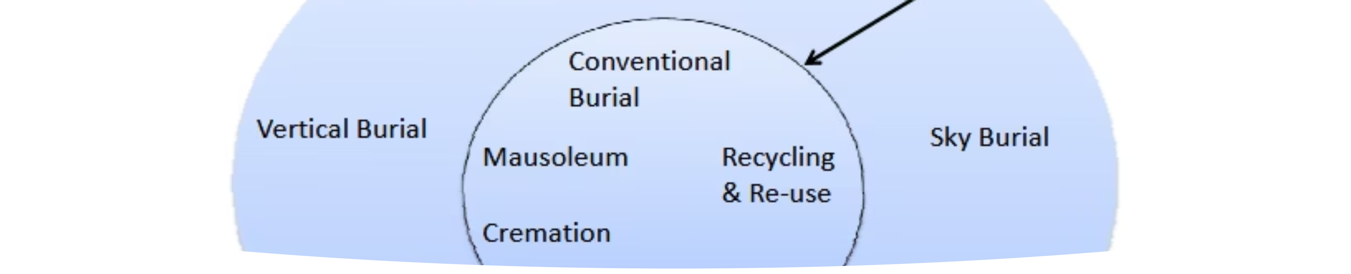
Conventional Cemetery Practices in South Africa
Traditional cemeteries in South Africa, as in many parts of the world, often feature dense rows of headstones, manicured lawns requiring extensive water and chemical use, and significant land footprint. These practices, while culturally embedded, present considerable environmental and spatial challenges in rapidly expanding urban areas.

Slide 7








Conceptual Framework: Ecological Modernization Theory (EMT)
Our analysis is framed by the Ecological Modernization Theory (EMT), which posits that environmental problems can be addressed through the very institutional systems that created them, via continuous reform and innovation.
Policy Innovation
Stakeholder Collaboration
Progressive environmental policies.
Cooperation among diverse groups.
Ecological Transformation
Technological Advancement
Resulting green burial practices.
New tools for environmental management (e.g., GIS).
This framework helps explain the varied municipal responses, such as Cape Town's success compared to the cultural resistance observed in Johannesburg and Durban.

Slide 8
EMT in Action: Interpreting the Findings
The application of the Ecological Modernization Theory reveals distinct trajectories in the three case study cities, highlighting varying degrees of success in integrating sustainable cemetery practices.
1
2
3
Cape Town: A Model of EMT Application
Johannesburg: Challenges to EMT
Durban: Culturally Sensitive, but Lacking EMT Drivers
Demonstrates successful EMT application through municipal innovation, proactive pilot projects, and robust stakeholder coordination.
Encounters significant hurdles, with institutional inertia and strong cultural resistance impeding the pace of reform.
Prioritizes cultural consultation but shows weakness in leveraging policy and technological drivers central to EMT.

Slide 9



Findings: Cape Town's Green Leadership
Cape Town emerges as a trailblazer in sustainable cemetery innovation, setting a precedent for other South African cities. Its integrated approach demonstrates a strong commitment to ecological modernization within urban planning.
Pilot Projects
Ecological Corridors
Strong Collaboration
Successful initiatives like the Durbanville Natural Burial Zone.
Integration of cemeteries into broader urban ecological networks, enhancing biodiversity.
Effective partnerships between city planners, conservation groups, and environmental officials.

Slide 10

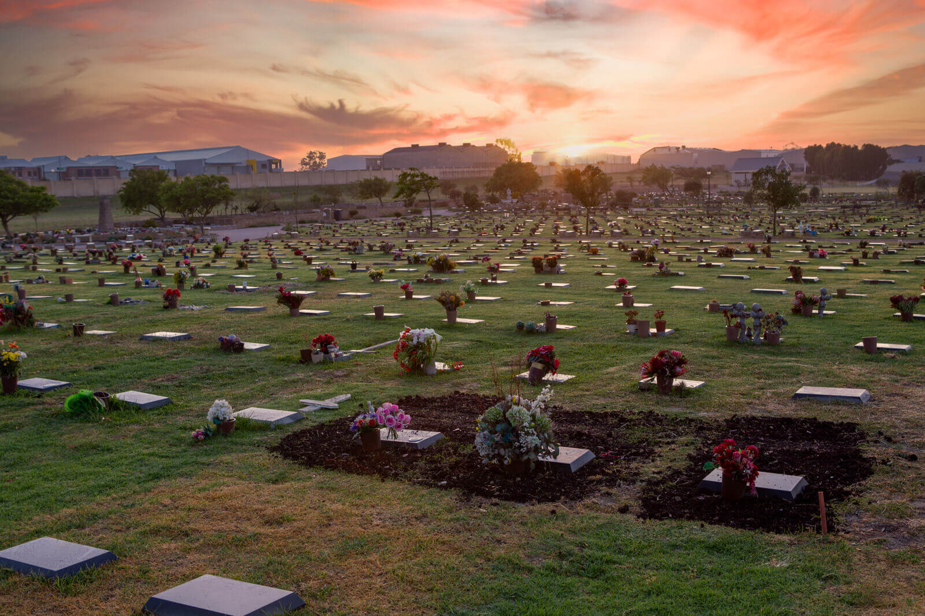
Durbanville Memorial Park: A Vision Realized
The Durbanville Memorial Park stands as a prime example of Cape Town's pioneering efforts. This site not only provides burial options but also functions as a biodiverse green space, contributing to urban ecology and recreation. It exemplifies how thoughtful design can transform traditional cemeteries into sustainable, multi-functional landscapes.

Slide 11
Findings: Johannesburg & Durban's Path Ahead
While Cape Town demonstrates proactive engagement with sustainable cemetery practices, Johannesburg and Durban face distinct challenges in adopting such innovations, largely due to differing institutional capacities and cultural dynamics.
Johannesburg: Recognizing Scarcity, Limited Action
Durban: Cultural Consultation, Missing Initiatives
Policy Recognition: The City of Johannesburg's IDP 2023 acknowledges critical land scarcity for burials.
Cultural Sensitivity: Ethekwini (Durban) emphasizes extensive cultural consultation in its planning processes related to cemeteries.
Cultural Dominance: Strong traditional burial practices significantly influence cultural norms, slowing the adoption of alternative, greener methods.
Absence of Pilots: Unlike Cape Town, Durban currently lacks formalized green burial plans or observable pilot initiatives.
Limited Implementation: Despite policy recognition, there's limited evidence of concrete pilot projects or widespread green burial initiatives.
Future Potential: Strong community engagement provides a foundation for future sustainable practices, but requires more proactive policy and project development.

Slide 12
Conclusion
Sustainable cemetery planning is gaining momentum, but implementation varies widely across South African cities.
Cape Town has evaluated and adopted innovative practices, aligning with EMT.
Johannesburg and Durban show the need for more culturally embedded and inclusive strategies.
The study successfully evaluates policies and practices, highlighting the importance of reforming burial systems within local realities.

Slide 13
Policy Implications
Municipal : Integrate cemetery planning into urban and climate frameworks (IDPs, SDFs).
Municipal + National: Co-develop culturally appropriate green burial models with national policy backing.
Municipal: Enhance community education, involving local cultural leaders.
All levels: Invest in GIS tools and allocate long-term resources for cemetery innovation.

Slide 14
References
1. Chirenje, L.I. & Gondo, T. (2020). Rethinking urban spaces: cultural practices and cemetery planning in African cities. Journal of African Urban Studies, 12(1), pp.33–49.
2. City of Cape Town. (2023). Integrated Development Plan (IDP) 2022–2027. Cape Town: City of Cape Town Municipality.
3. City of Johannesburg. (2023). Integrated Development Plan (IDP) Review 2023/24. Johannesburg: City of Johannesburg Metropolitan Municipality.
4. DeathLab. (2022). Designing for the Afterlife: Ecological Burial and Urban Space. Columbia University DeathLab Report. [Online] Available at: https://deathlab.org
5. eThekwini Municipality. (2022). Environmental Planning and Climate Resilience Strategy. Durban: eThekwini Municipality.
6. Foster, J.B. (2021). Ecological Modernization Revisited: Limits, Contradictions, and Alternatives. Monthly Review, 73(2), pp.27–43.
7. Gibson, K. (2023). Resting Green: Innovations in Urban Cemetery Design. Environment and Planning B: Urban Analytics and City Science, 50(1), pp.115–130.
8. Mayer, L., Vásquez, A. & McLaren, D. (2021). Death and sustainability: The environmental footprint of funerary practices. Ecological Indicators, 128, pp.107803.

Slide 15
QUESTIONS?

Slide 16
THANK YOU
Bongumusa Walter Ngema
Cellphone:0606260805
Email: bongumusawalter596@gmail.com
ORCID: https://orcid.org/0009-0009-8597-8000

