Slide 1
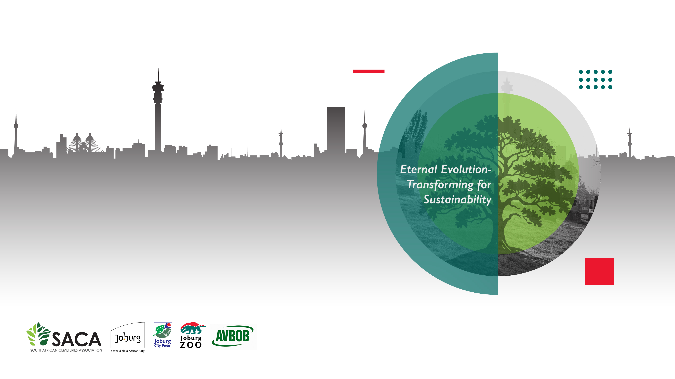
Efficient Space Use in Burial Sites

Slide 2
The study explores the efficient space use in burial sites through a case study of Oslo and Copenhagen in Denmark-Norway.
The concept of liminality describes border crossings: spaces where different worlds interweave Depending on the object of study, liminality can be operationalised in various way.
Cemeteries’ liminality lies not only in their spatial character but also in their ability to accommodate complex meanings, different from other urban spaces. Such liminality situates cemeteries between clear positions and static forms, both in public space discourse and in people’s everyday lives.
The liminal dimension can be discovered in the tensions between various sets of meanings played out in cemeteries

Slide 3
The spiritual space is the second dimensions that are attributed to death and burial.
The presence of death brings spirituality, which we understand as “the search for the sacred” .
We cannot avoid immersing ourselves in a discussion about the relationship between spirituality and religion.
Religion and spirituality are often rejected by urban planners as part of the private sphere, irrelevant to the secular nature of the profession and even something potentially divisive

Slide 4
Cemetery can be explored as a multicultural space, which is another dimension, which highlights the presence of different ethnic and religious groups in society and their right to positive inclusion.
Cemeteries can be considered monofunctional where they used foe one purpose
They are created primarily as burial grounds and places for memorialisation but play many secondary functions
Oslo’s and Copenhagen findings

Slide 5
Cemeteries occupy a substantial amount of Oslo’s and Copenhagen’s green space.
Although the cemeteries were often established on the outskirts of the cities, due to urban expansion, many of them are now situated in built-up areas.
Because of high cremation rates and grave-reuse practices, Oslo’s and Copenhagen’s cemeteries (unlike many cities worldwide) do not lack space.
Some cemeteries in Copenhagen even have a surplus of burial space.
Both cities manage their cemeteries themselves, so municipalities play the leading role in determining and financing cemetery development.

Slide 6
The cemeteries in Oslo and Copenhagen accommodate both coffin burial and interment of ashes, which means that there is no difference between cemeteries and crematoria gardens, common in other parts of Europe.
In the future, cemeteries could better accommodate individualised choices for the deceased and bereaved.
A landscape architect from Copenhagen confirmed that people wish for more individualised ways of dealing with the losses, and cemeteries must adapt.
Public spaces may have various meanings in different societies which is especially true for cemeteries.

Slide 7
Recommendations
It's important to note that traditional burial practices are deeply ingrained in South African culture, often involving elaborate ceremonies and significant financial investment.
However, increasing awareness of environmental concerns and changing social dynamics are prompting discussions about more sustainable and cost-effective alternatives.
However, with the current space challenges faced by most councils in South Africa call for an alternative solution to address the problem.

Slide 8
1. Cremation
While not traditionally common in South Africa, cremation is gaining traction as a more environmentally friendly and sometimes more affordable option.
The ashes can be scattered in a meaningful location or kept in an urn.
2. Urn burial
An urn burial is a burial method where cremated remains are placed inside a decorative container (an urn) and then interred in the ground, often within a cemetery. It's a respectful and permanent way to memorialize a loved one, offering a designated space for remembrance and reflection

Slide 9
3. Ash scattering
It is also known as ash spreading or dispersing cremated remains, and is the practice of releasing a deceased person's ashes in a meaningful outdoor location.
This can be a way to honor their memory, find closure, and allow their remains to return to nature.
Popular choices for ash scattering include natural settings like parks, gardens, forests, or bodies of water.
4. Forest burial
It involves burying a body or cremated remains in a biodegradable container or shroud directly into the earth, often within a designated forest or meadow area.
This practice allows the body to decompose naturally and contribute to the ecosystem, offering a "green" or sustainable way to care for the deceased.

Slide 10
5. Mausoleum burial
This involves above-ground burial in a mausoleum, a structure that houses multiple tombs.
This can be a more expensive option, but it can also be a way to create a lasting memorial.
6. Home or family burial
Some families choose to bury their loved ones on their property, which can be a way to keep the deceased close and part of the family (both living and deceased).

Slide 11
7. Natural burial
This involves burying the body directly in the earth, without embalming or a coffin (or using a biodegradable one), allowing for natural decomposition.
This can be seen to a return to nature and minimize environmental impact.

Slide 12
Conclusion
To implement the above alternative burial options the following must be applicable.
Develop a strategy to address the issues of alternative burial.
That a thorough consultation and campaigns with communities be made with regard to alternative burial methods.
Communities be allowed to make inputs and suggestions with regards to alternative burial options to save the burial space.
Thank you

