Slide 1
SOUTH AFRICAN CEMETERIES ASSOCIATION
IMPACT OF HOMELESSNESS, INFORMAL RECYCLING AND ILLEGAL DUMPING IN THE CITY OF JOBURG CEMETERIES
Senior Manager: Bishop Ngobeli
Acknowledge: Prof Trynos Gumbo, Dr Retsepile Kalaoane, Dr Abdulrasaq Ishola, Ms Liziwe Makoro, Mr Theo Bernahardt, Ms Image Moloto,

Slide 2
What is homelessness
Homelessness is a complex and pervasive issue that affects millions of people worldwide. It is defined as the condition of not having a stable, safe, and adequate place to live. It is a distressing social problem that demands urgent attention and compassionate.
Homelessness generally refers to the state of lacking a stable, safe, and adequate place to live, meaning someone is without a home and may be living in temporary, insecure, or unsafe housing situations.

Slide 3
Type of Homelessness
According to du Toit (2010) there are three groups of homeless persons that can be identified in the South African metropolitan context:
Detached homeless individuals which are characterized by the absence of social structures and does not consider actual housing circumstances (Flynn: 1986),
Temporary overnight sleepers’ which occurs when people are displaced due to employment, natural disasters or housing issues. (Bassuk et al: 1984).
Informal settlement dwellers who reside in improvised housing which are known as shacks (du Toit: 2010).

Slide 4
Homelessness in statistics
According to United Nations the estimate places the number at roughly 1.1 billion people living in some form of homelessness.
There are varying estimates for the number of homeless people in Africa, but recent data suggests a figure of approximately 54.1 million homeless people in 2023
According to the South African census 2022, there were 55,719 homeless people in South Africa

Slide 5
What cause Homelessness in SA
Homelessness in South Africa is a complex and pervasive issue deeply rooted in the country's socio-economic disparities, particularly the legacy of apartheid, leading to high rates of unemployment, inadequate affordable housing, and poverty, which disproportionately affect marginalized communities;
This results in a significant population of individuals living on the streets, facing challenges like lack of access to basic needs, health services, and social support, demanding a multi-faceted approach from government agencies, NGOs, and civil society to address the structural causes and provide effective interventions to alleviate the issue.

Slide 6
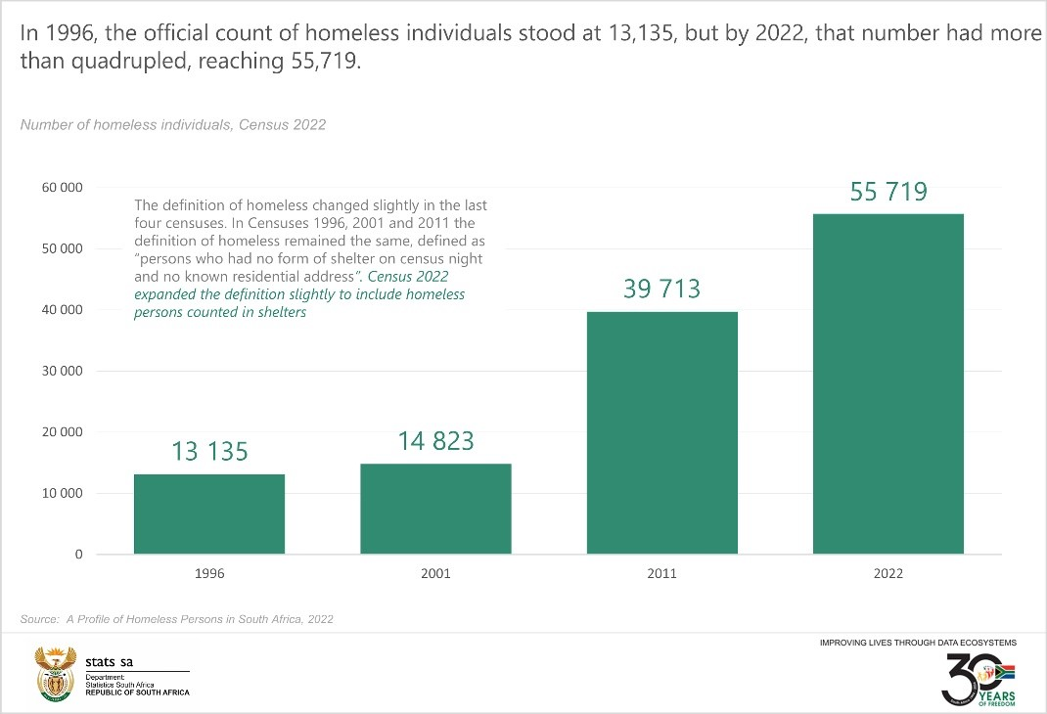

Slide 7
Homelessness in City of Joburg
The City of Joburg as the mega City in Africa and World is not exception when it comes to homelessness.
People come to the City looking for the greener pastures and when that is not achieved people find themselves residing in public open spaces such as parks, rivers and streams, cemeteries and other ecological sensitive areas.
There is no single, current official count, but recent estimates place the number of homeless people in Johannesburg between 15,000 and 20,000 people, with stakeholders using these figures for planning purposes, according to the Johannesburg Inner City Partnership (JICP) and the City of Johannesburg.

Slide 8
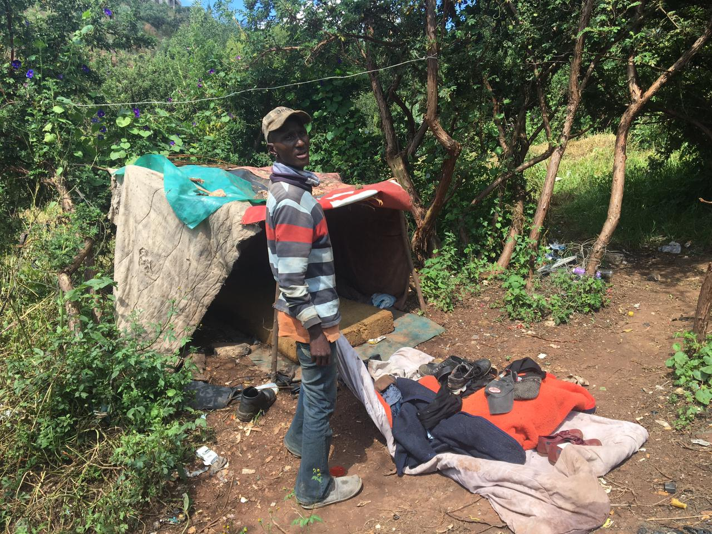
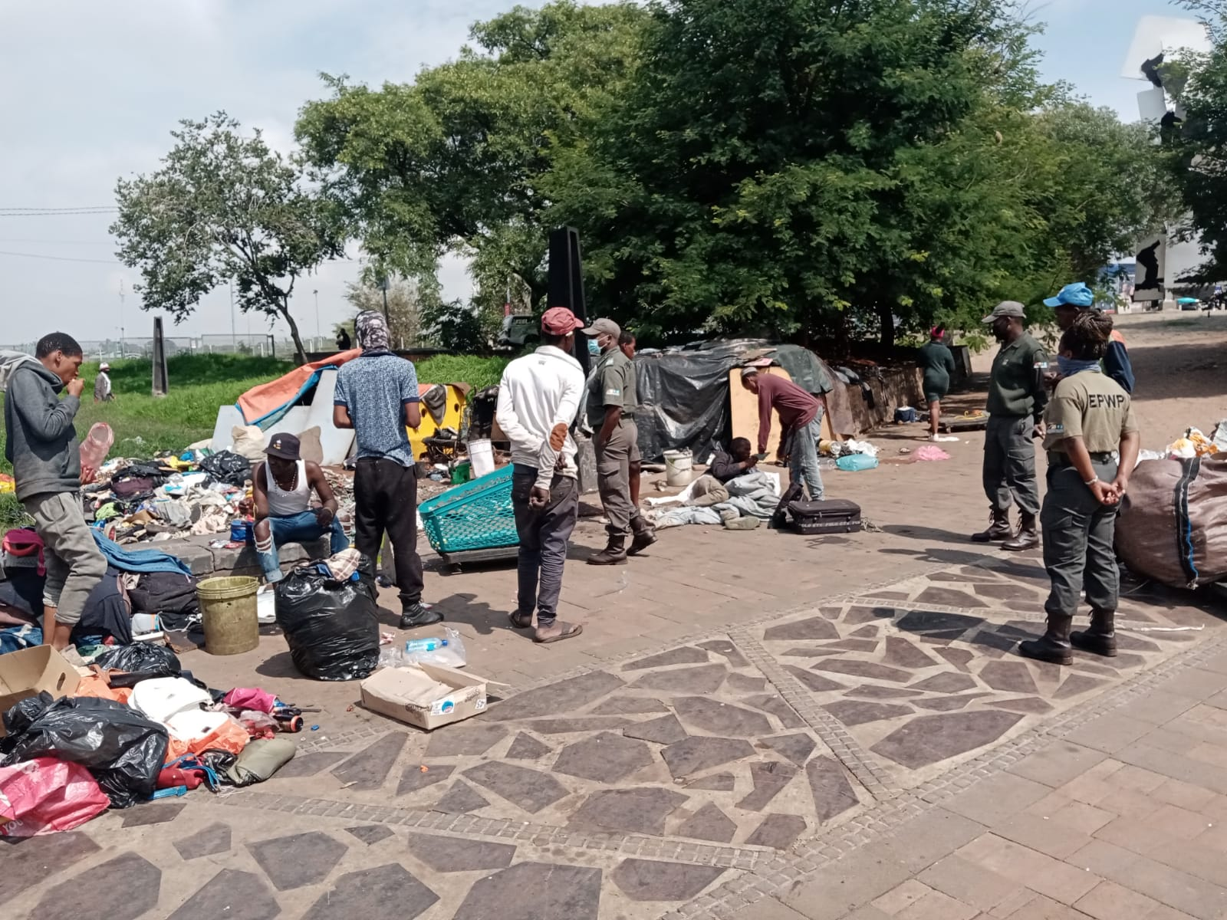

Slide 9
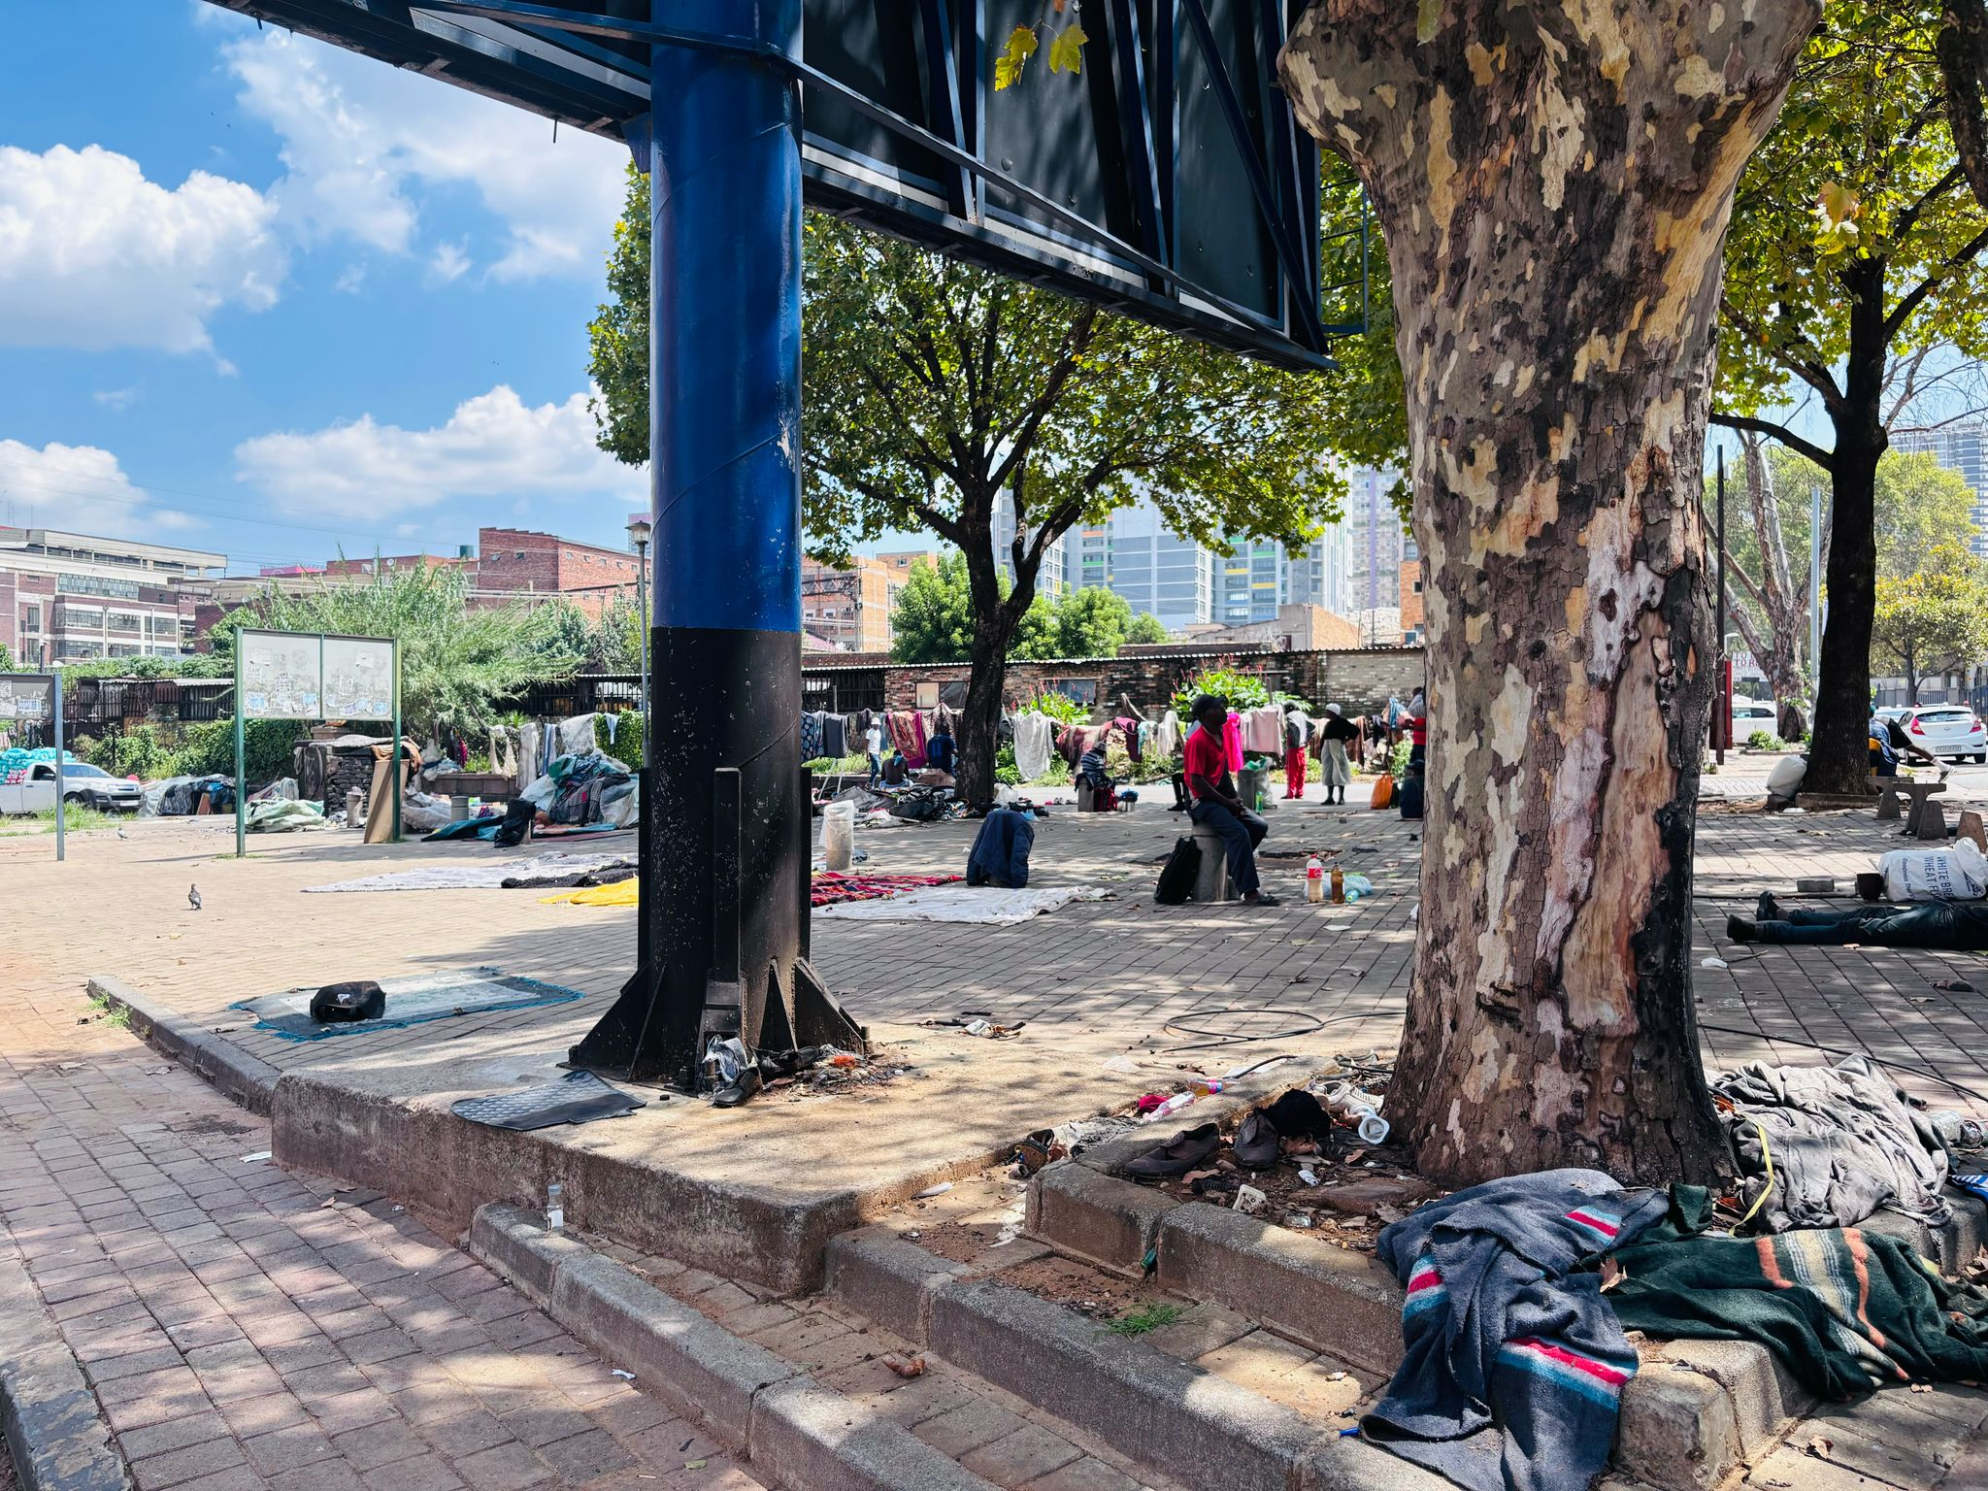
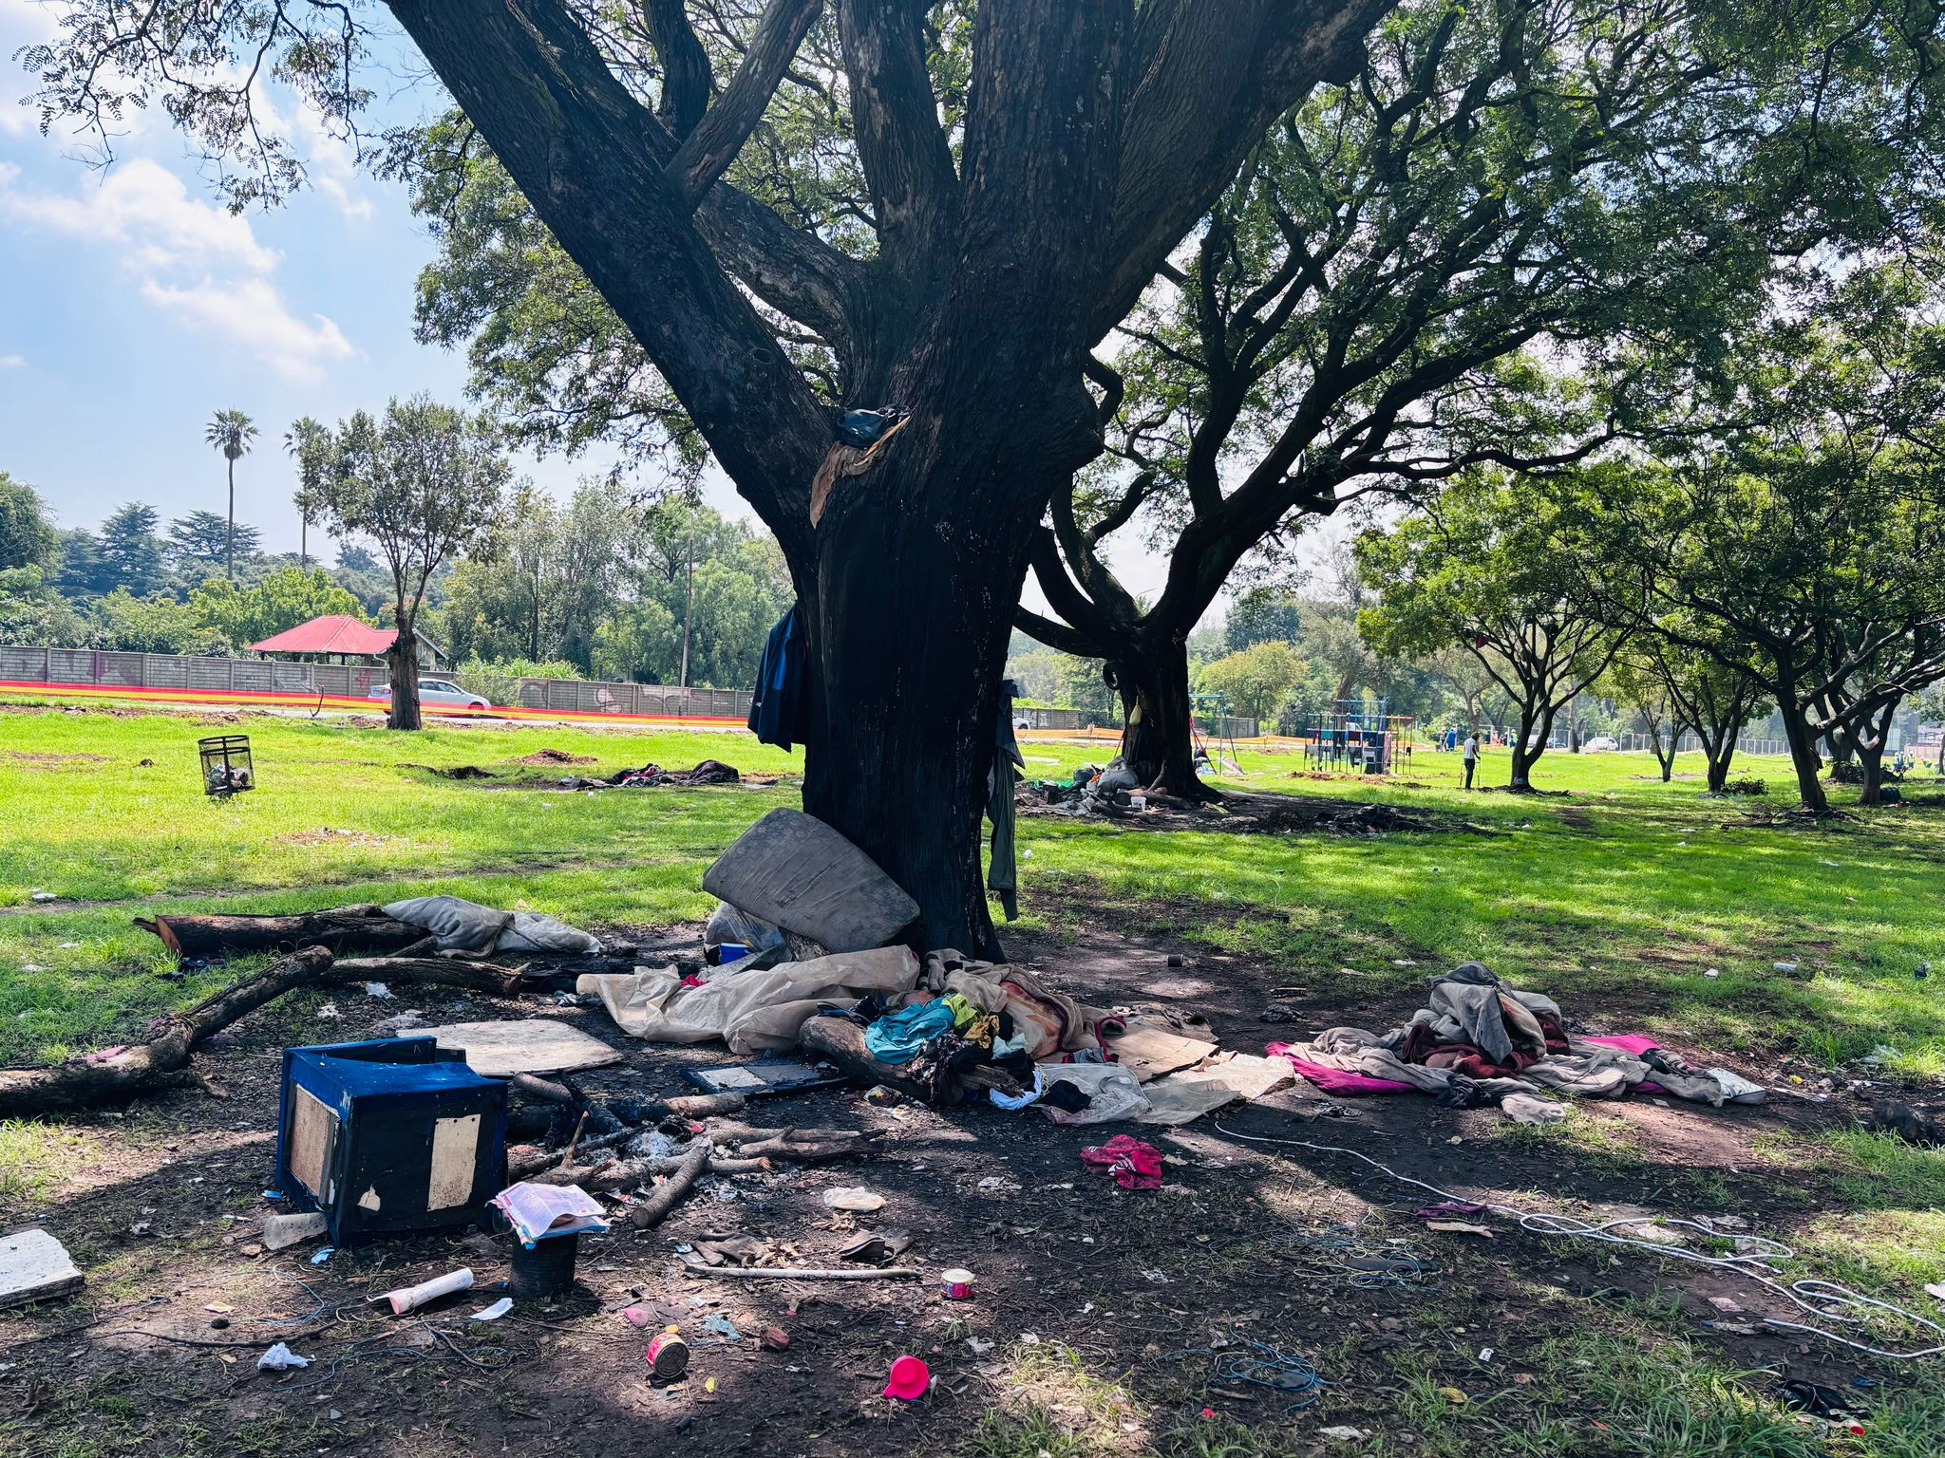

Slide 10
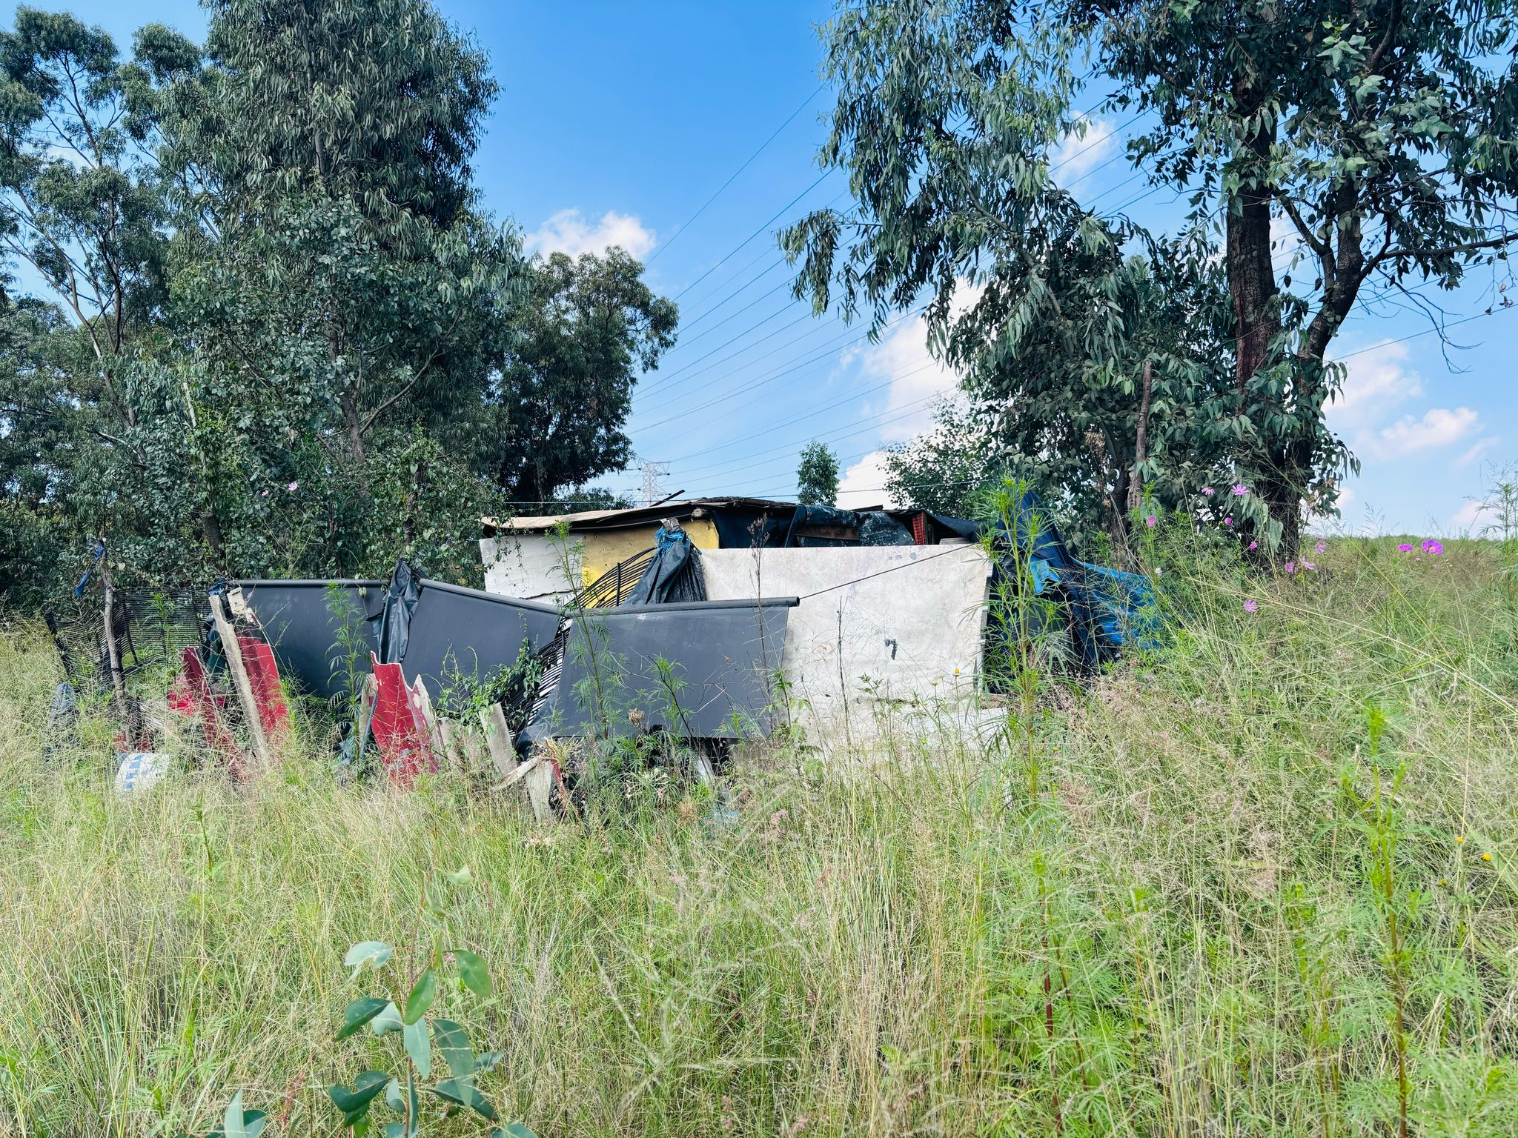

Slide 11
Homelessness lead to try and survive in
City of Joburg
Residing and Recycling in Spaces

Slide 12
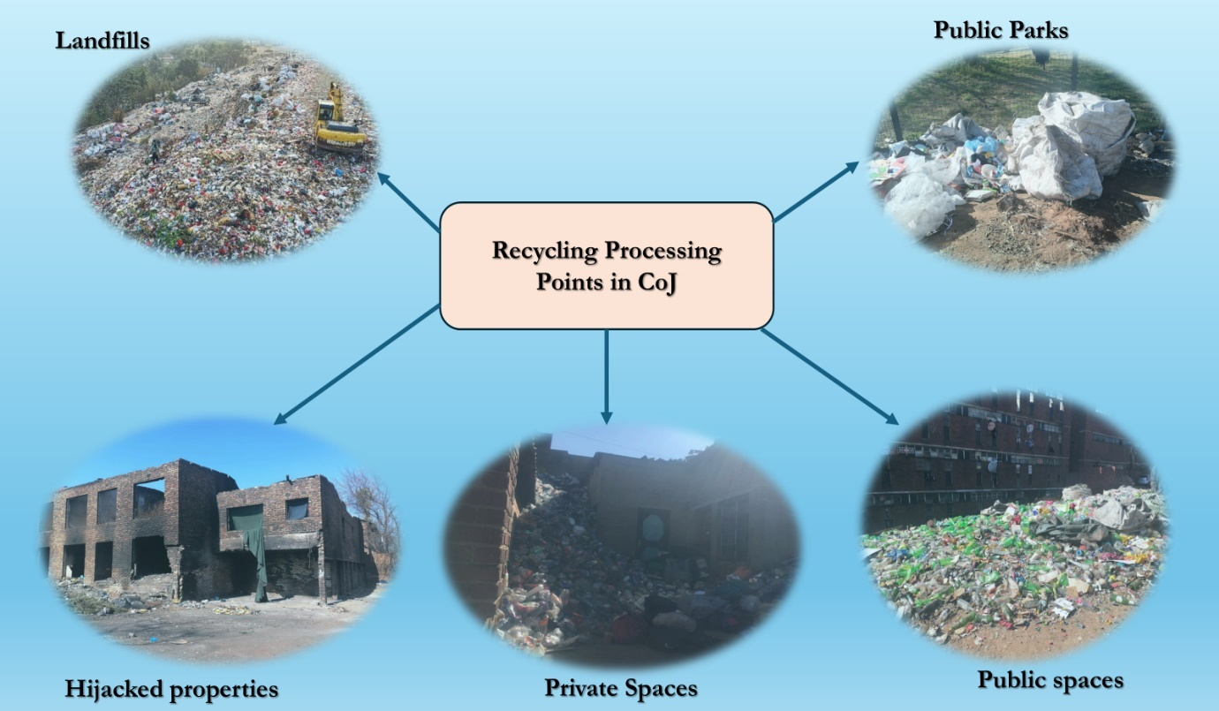

Slide 13
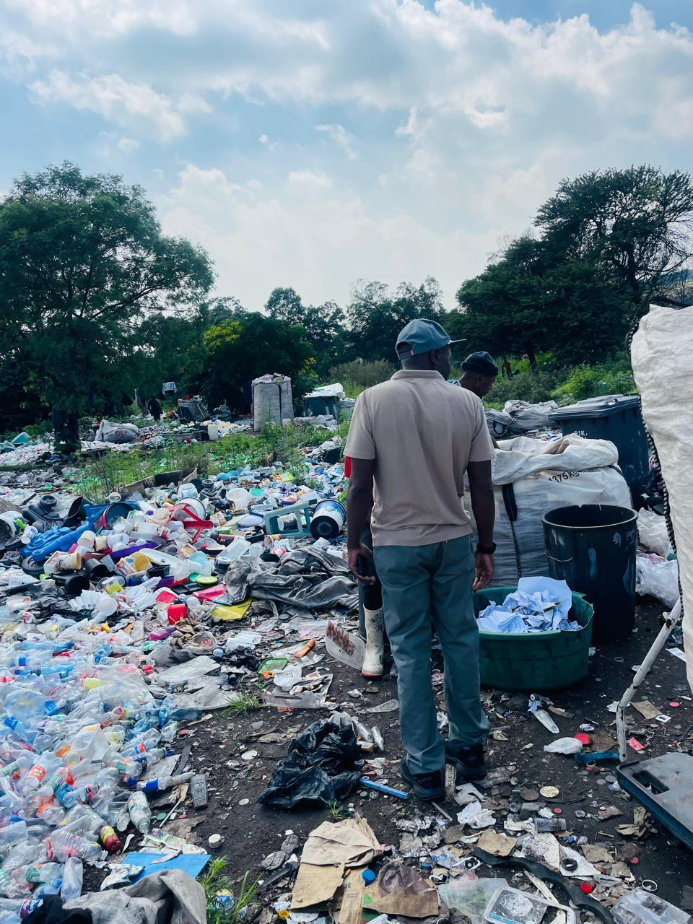
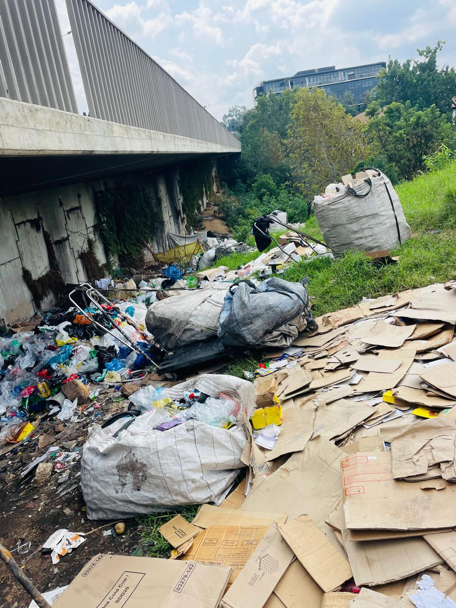

Slide 14
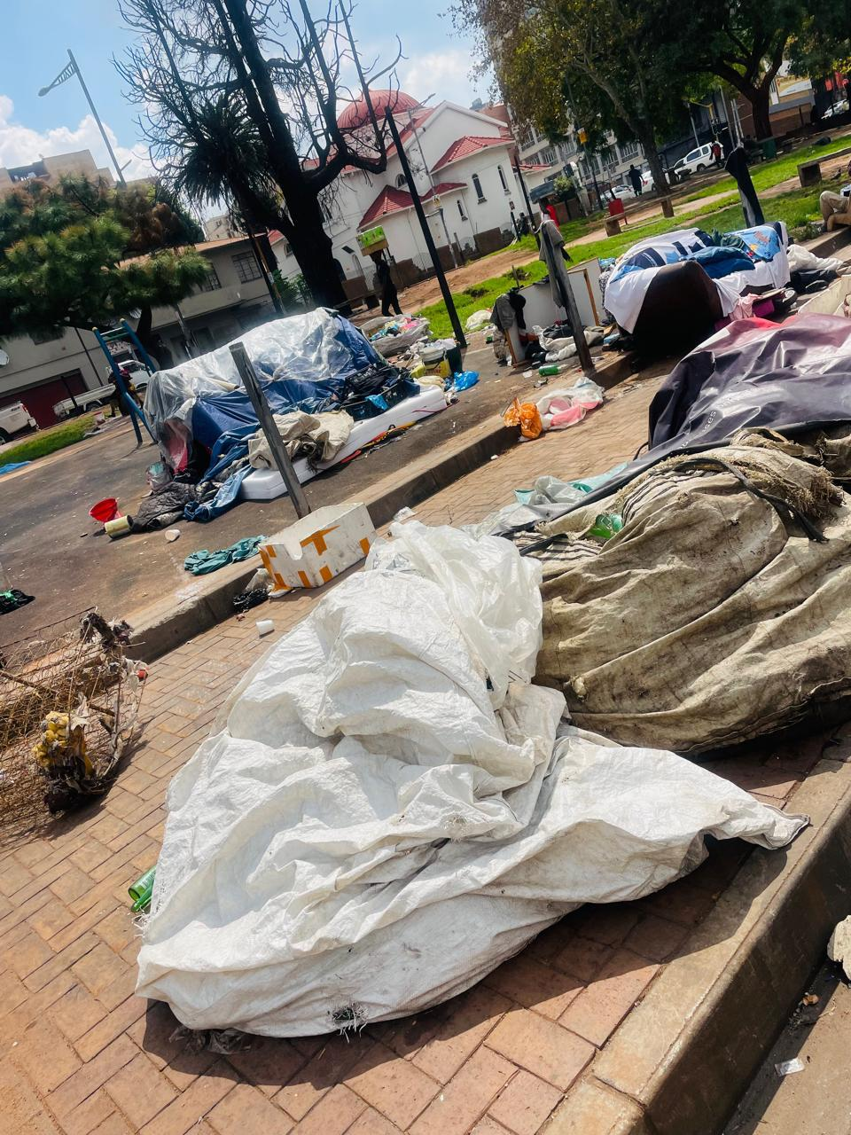
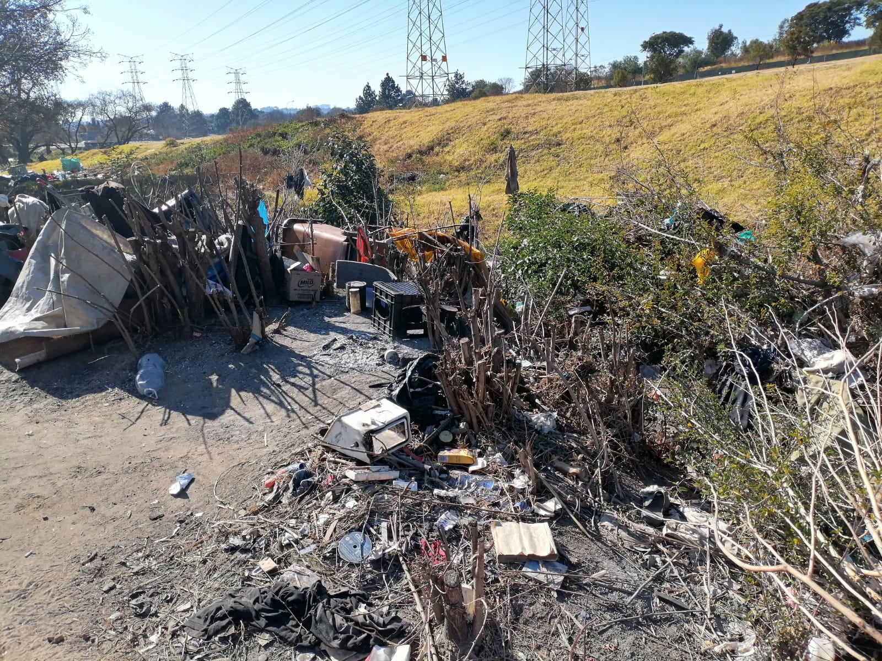

Slide 15
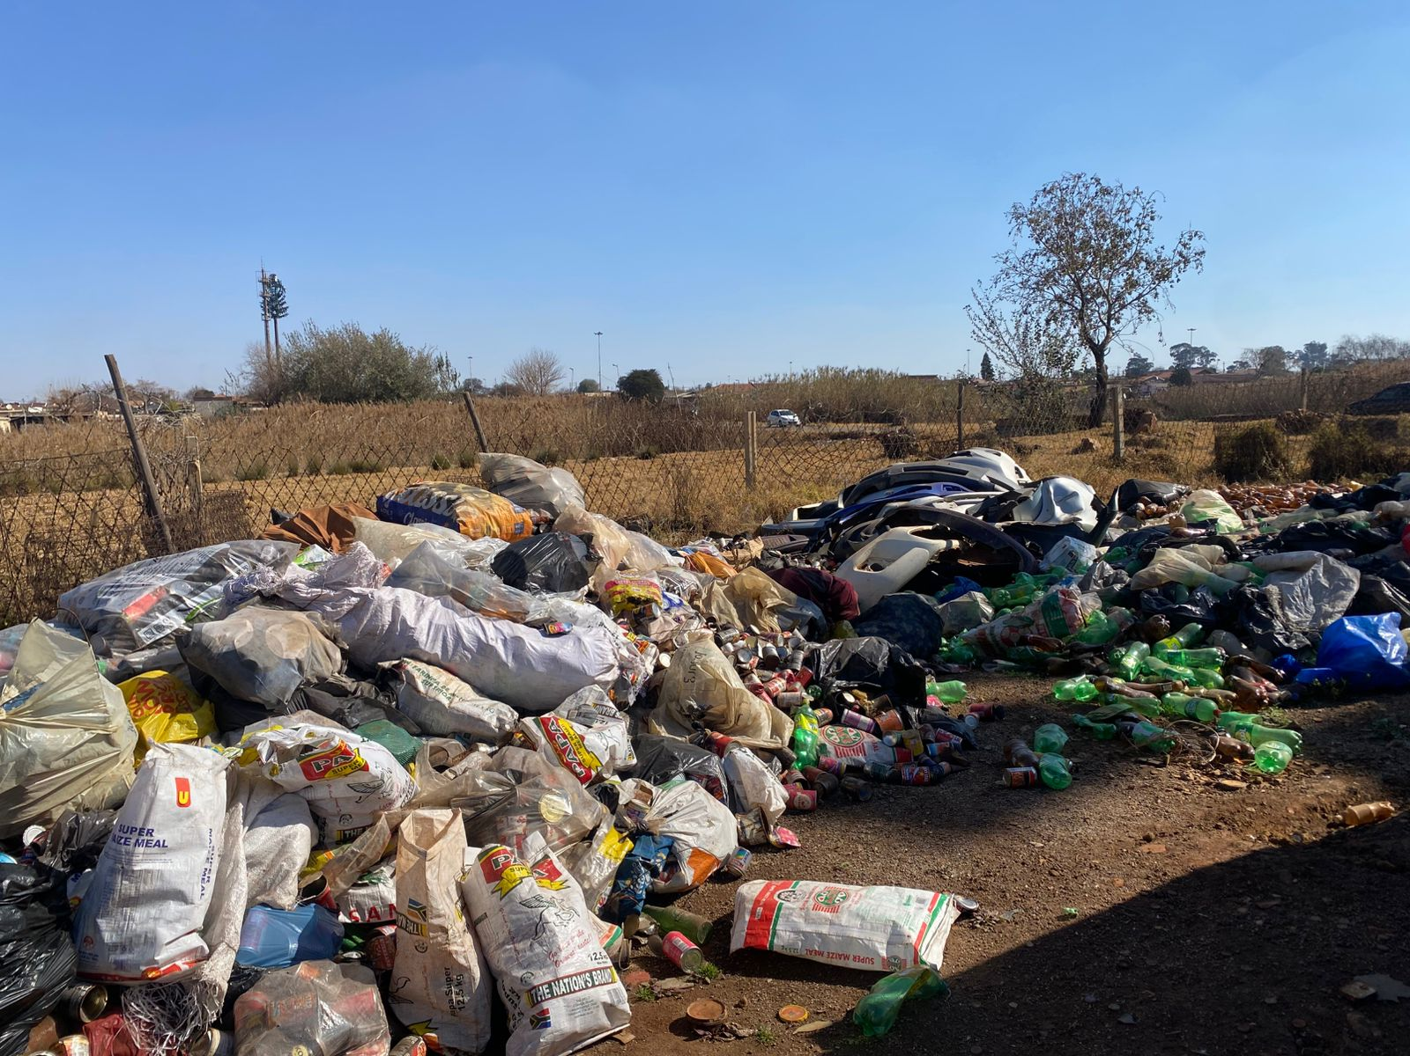
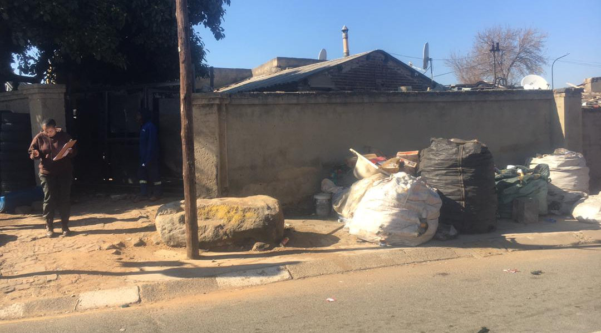
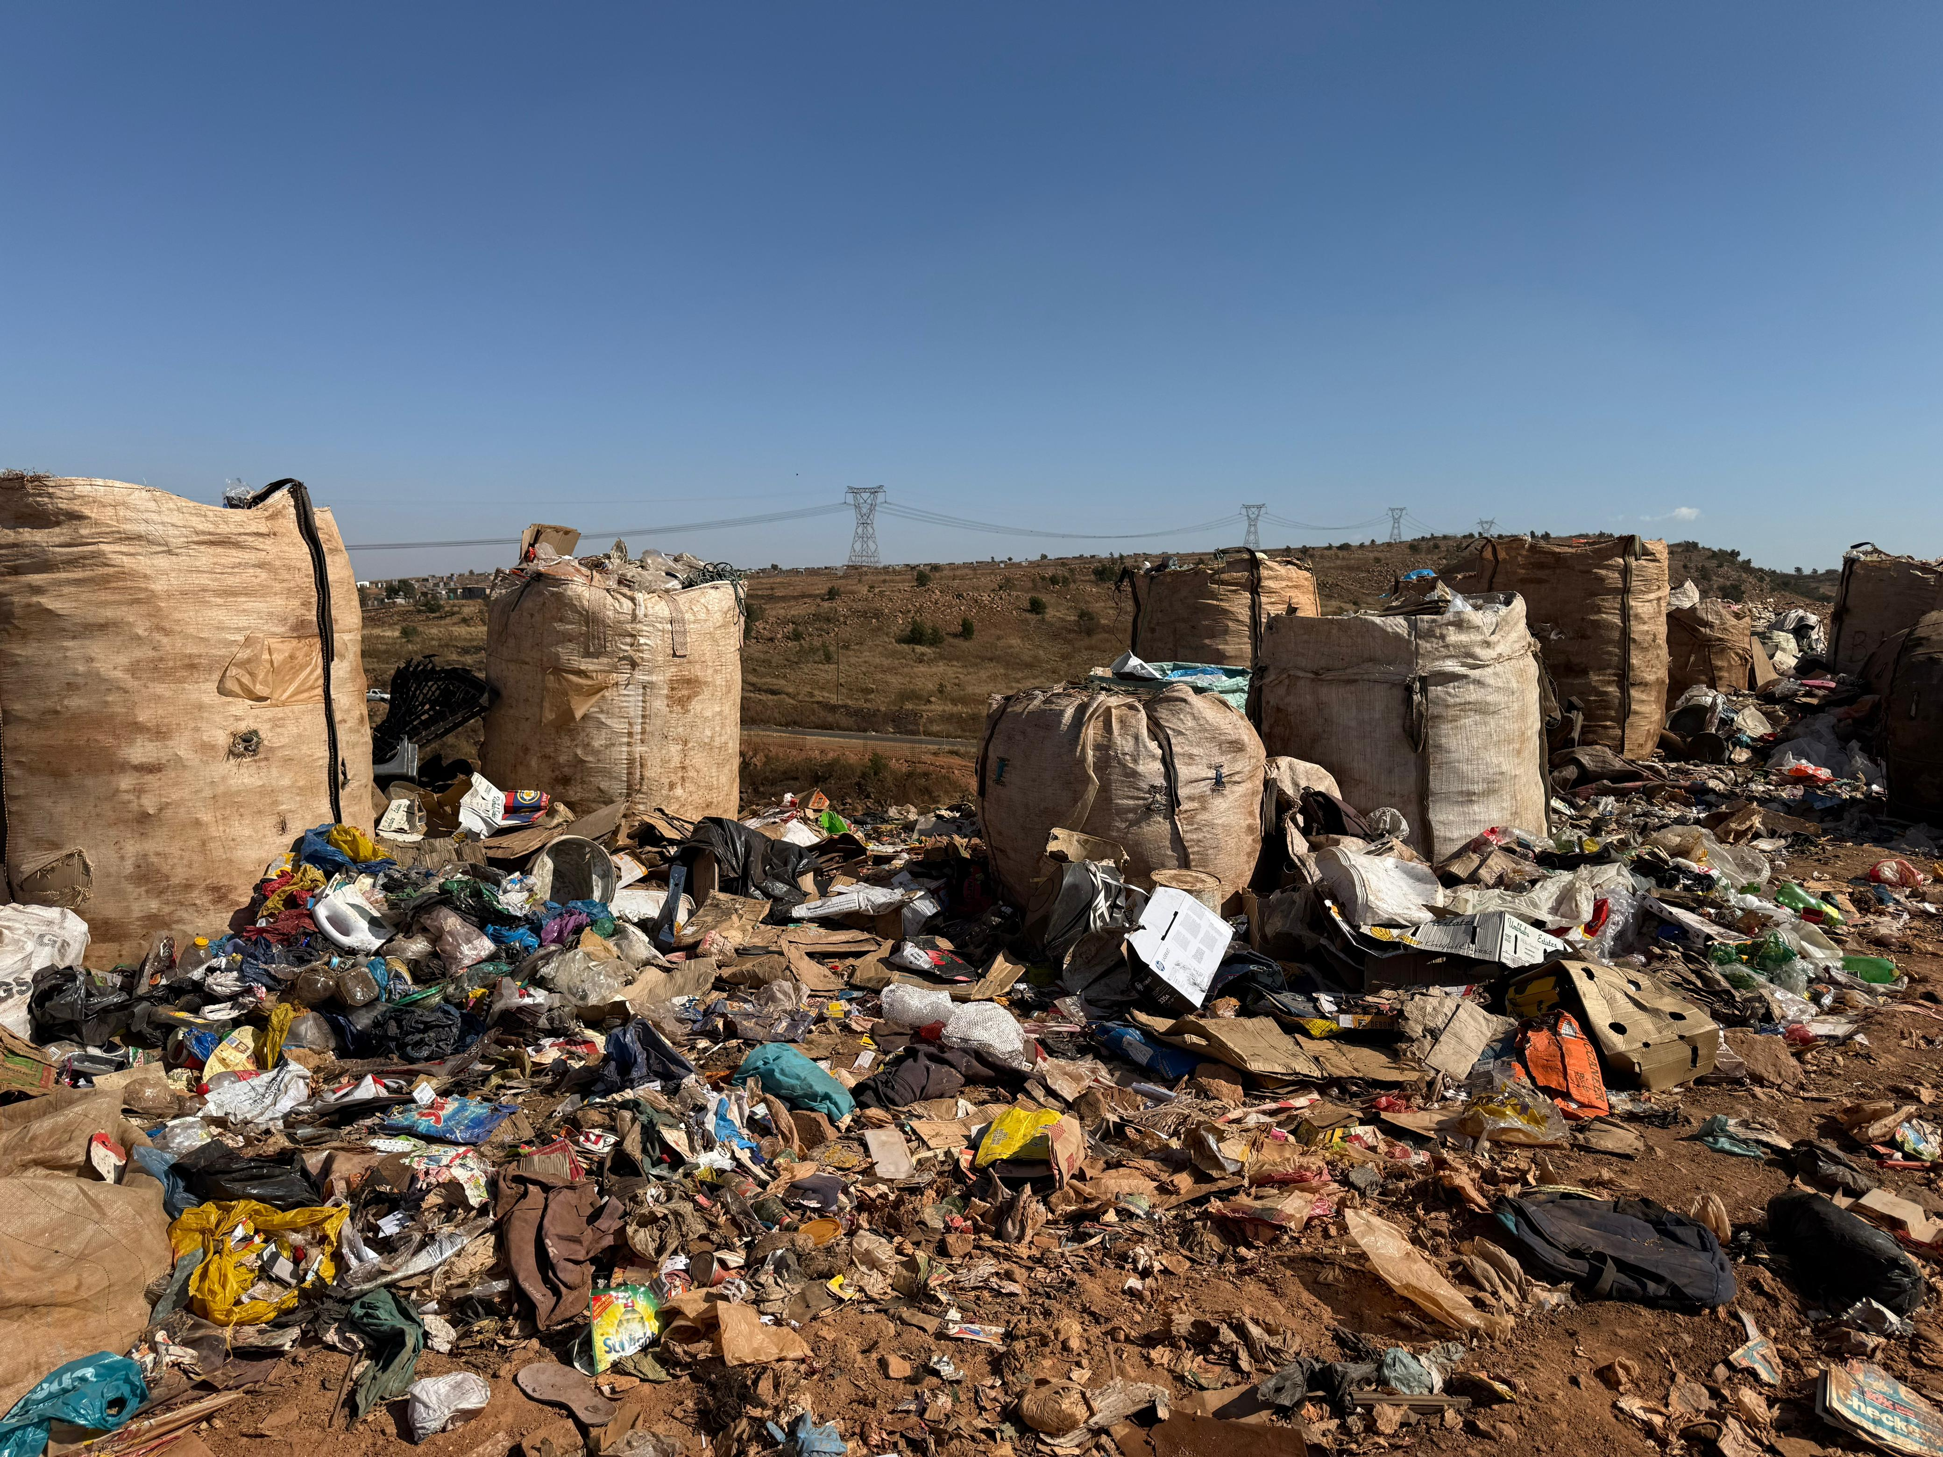

Slide 16
The new face of City of Joburg

Slide 17
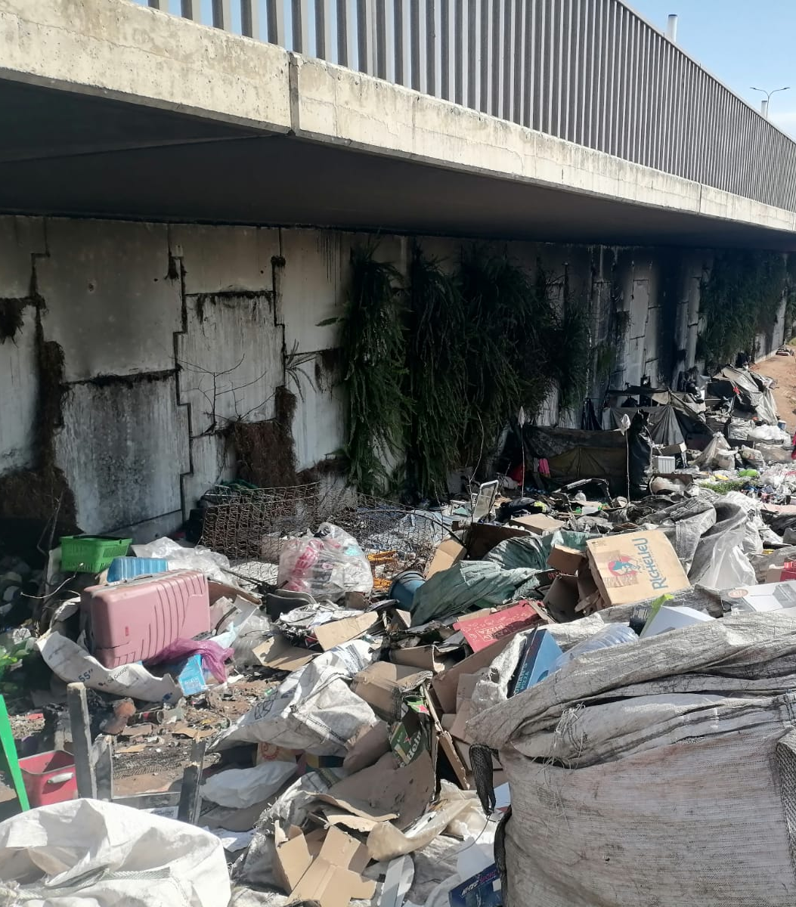
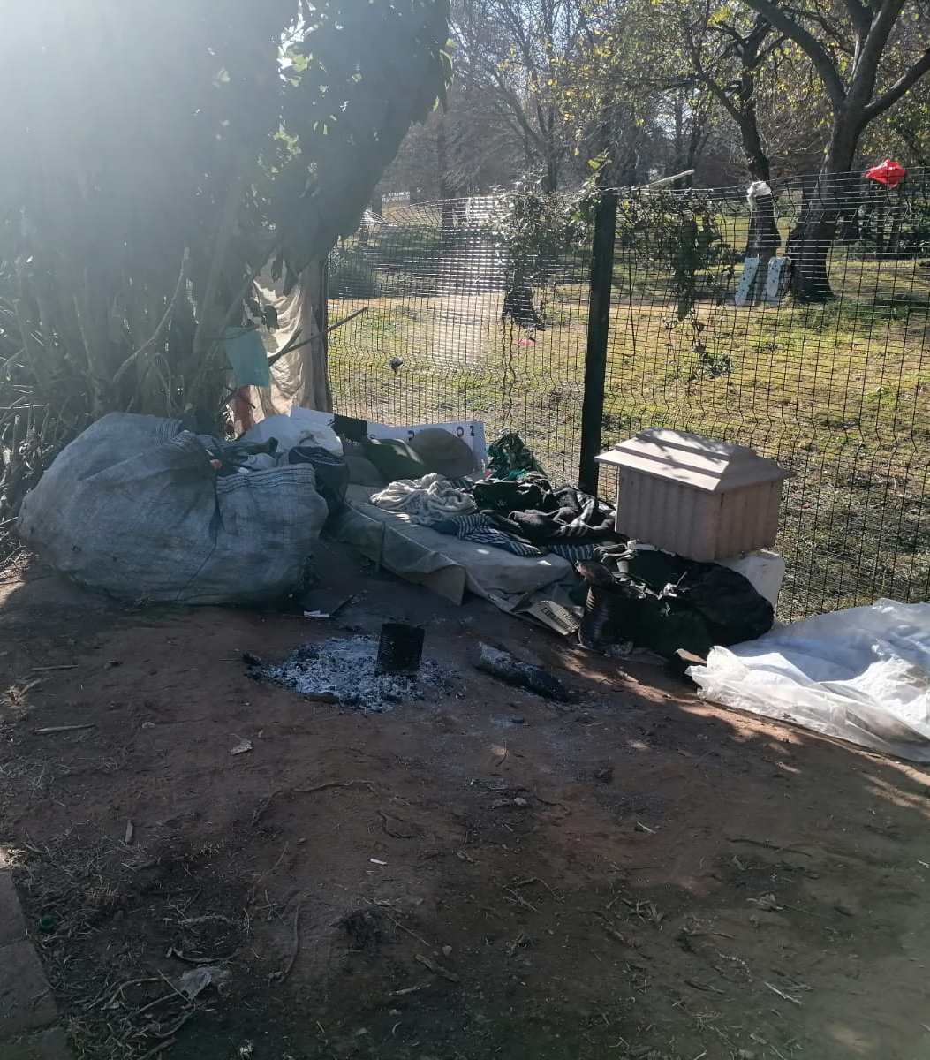
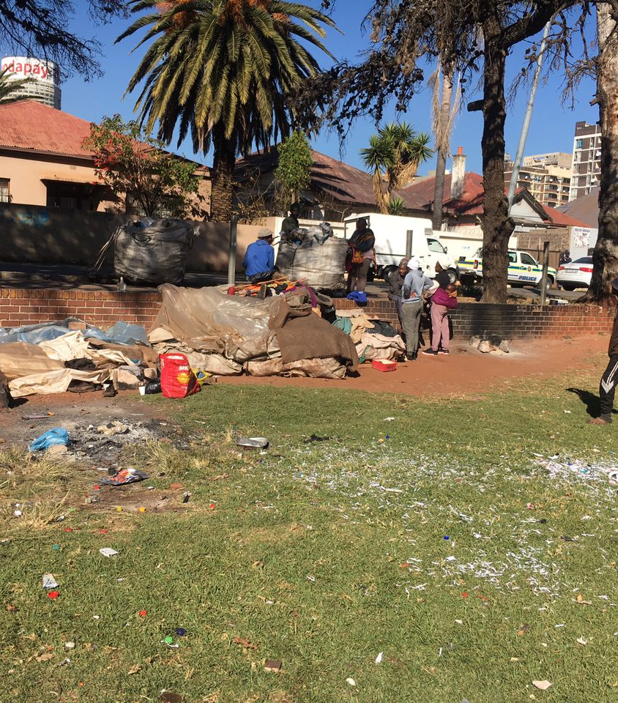
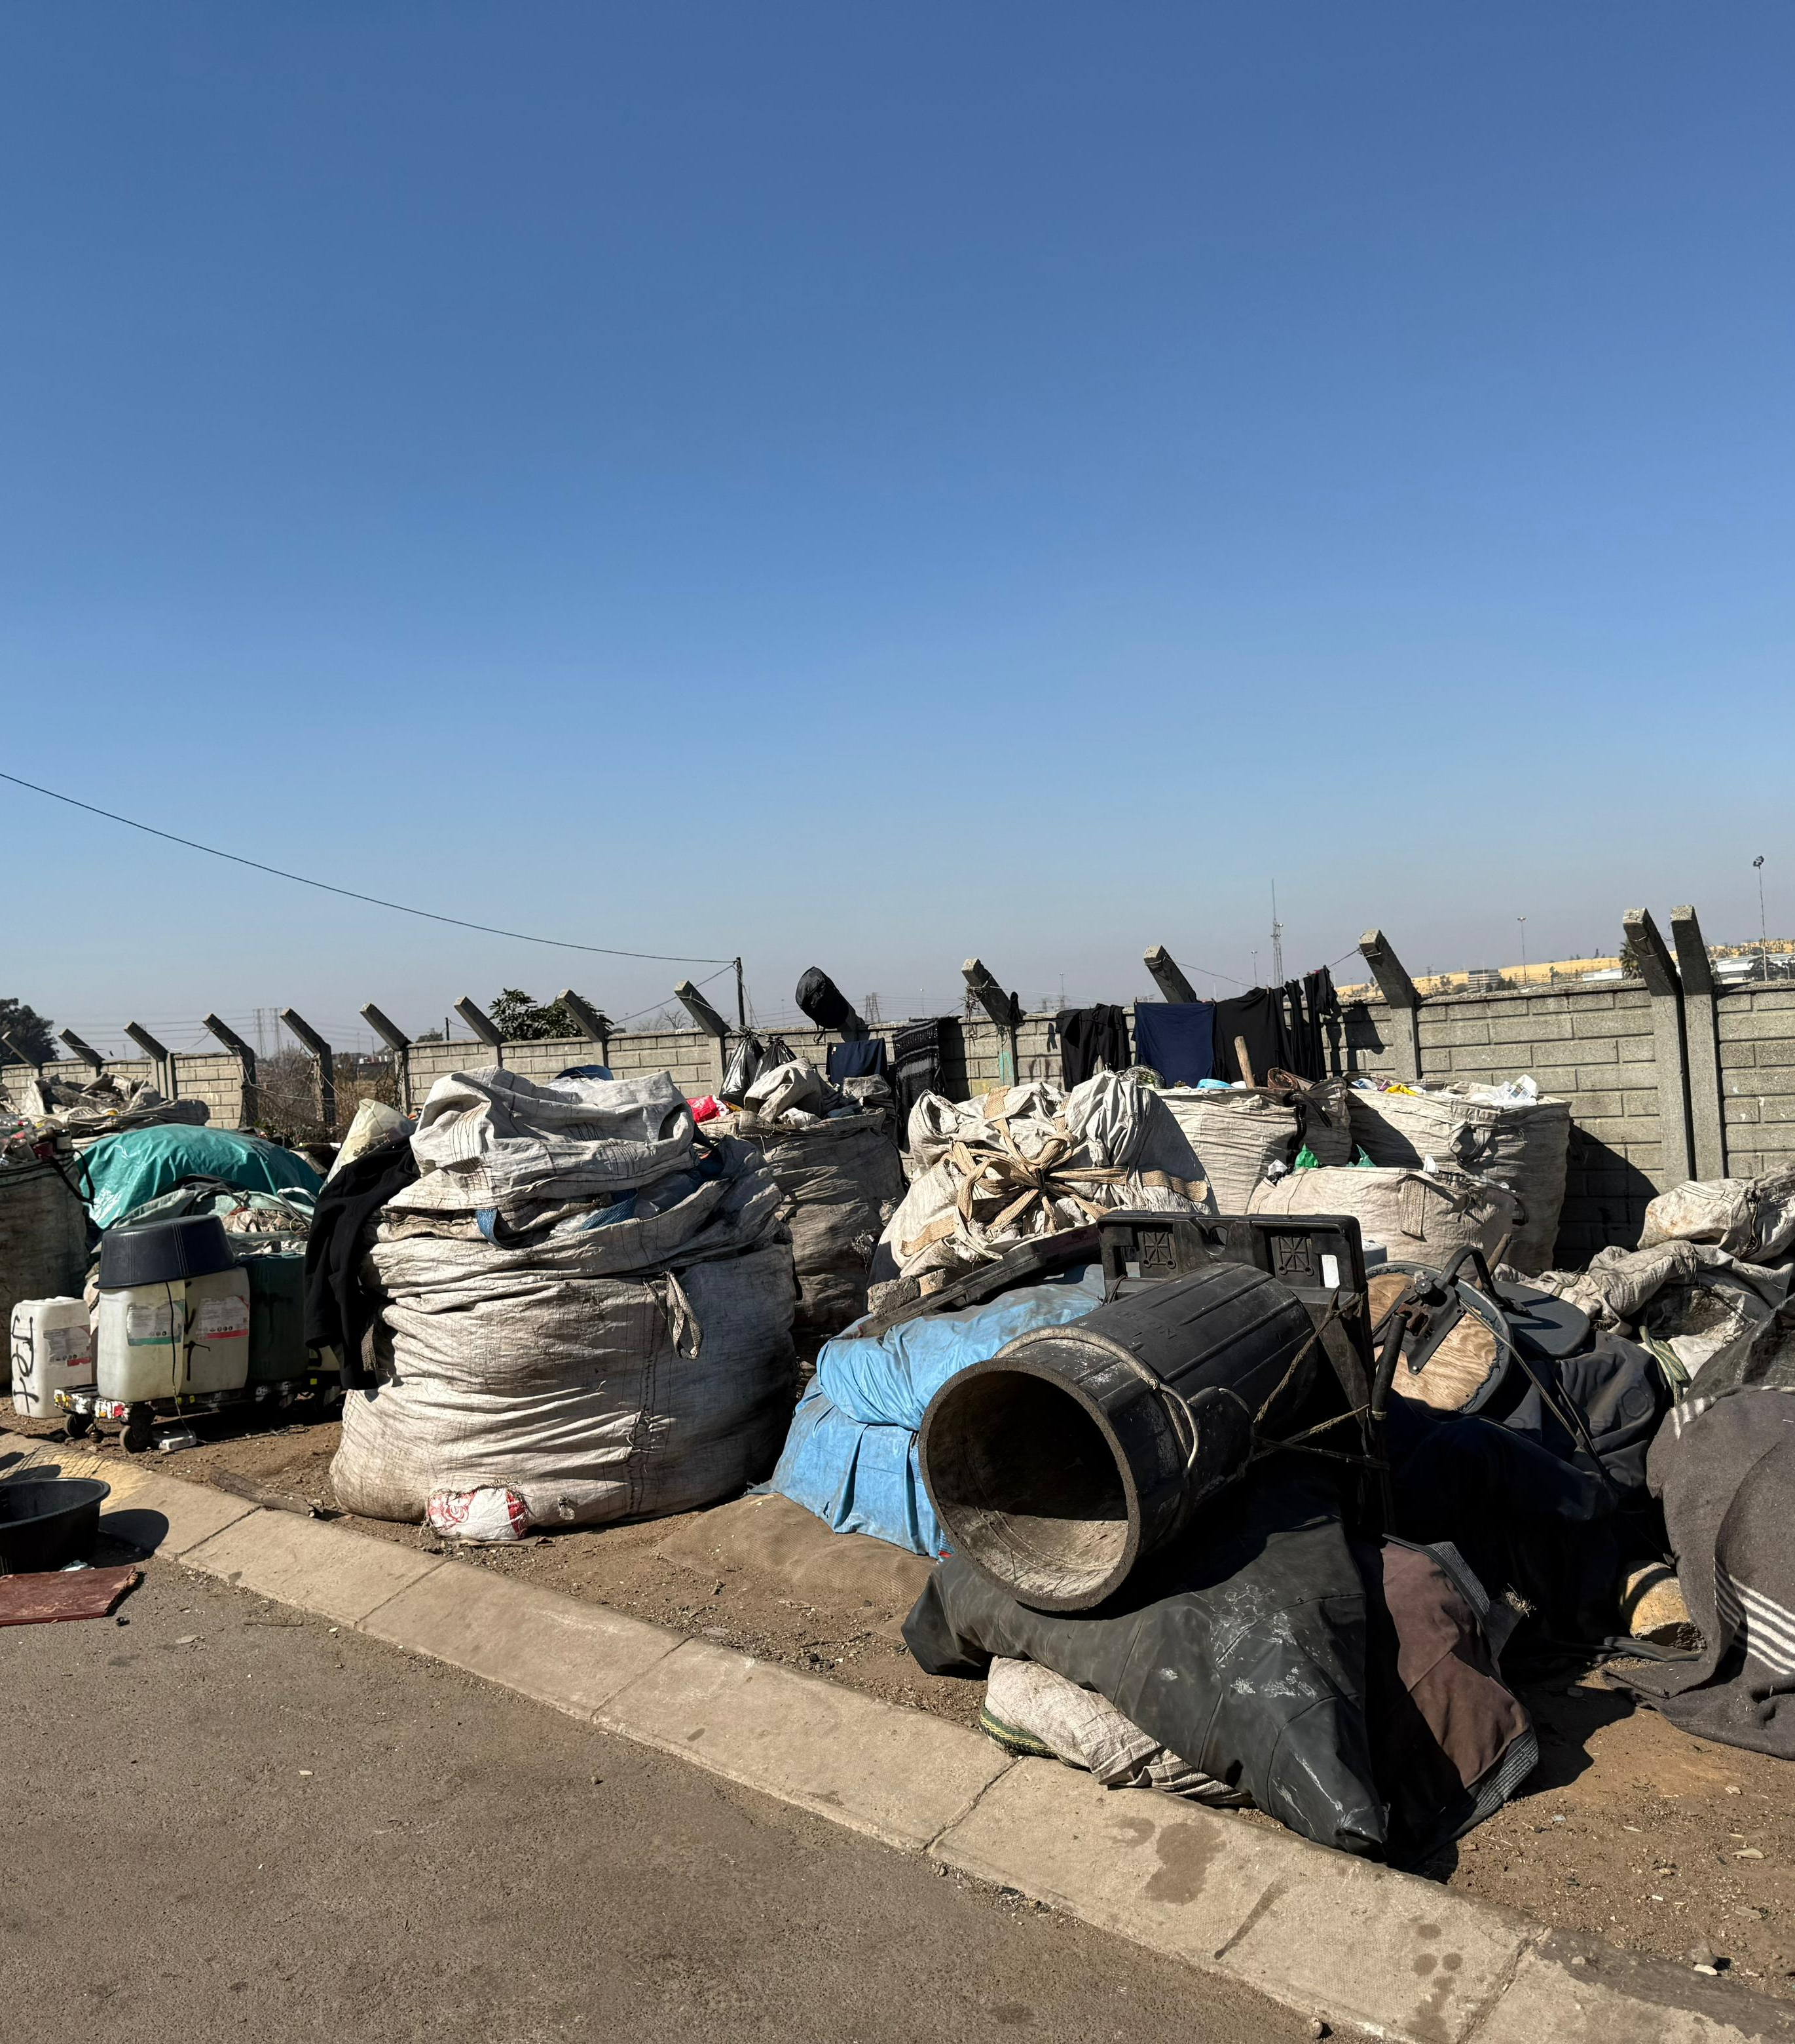
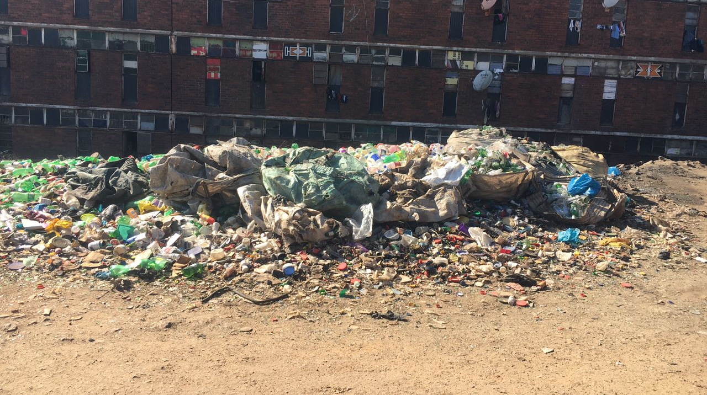
Emerging face of Joburg

Slide 18
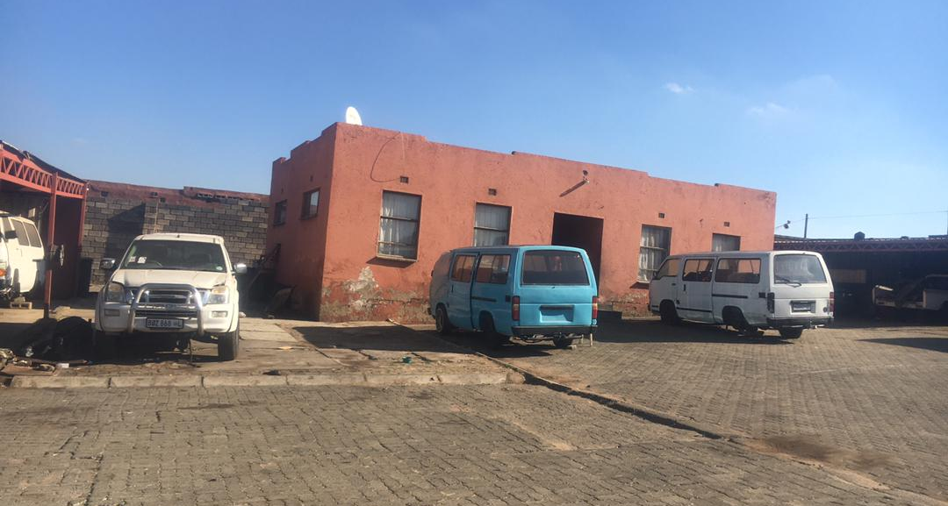
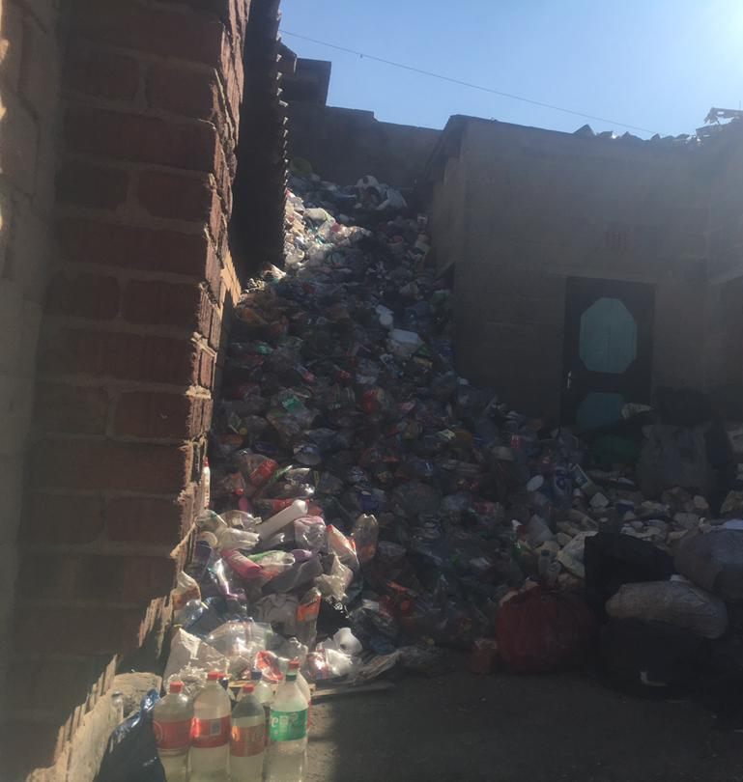
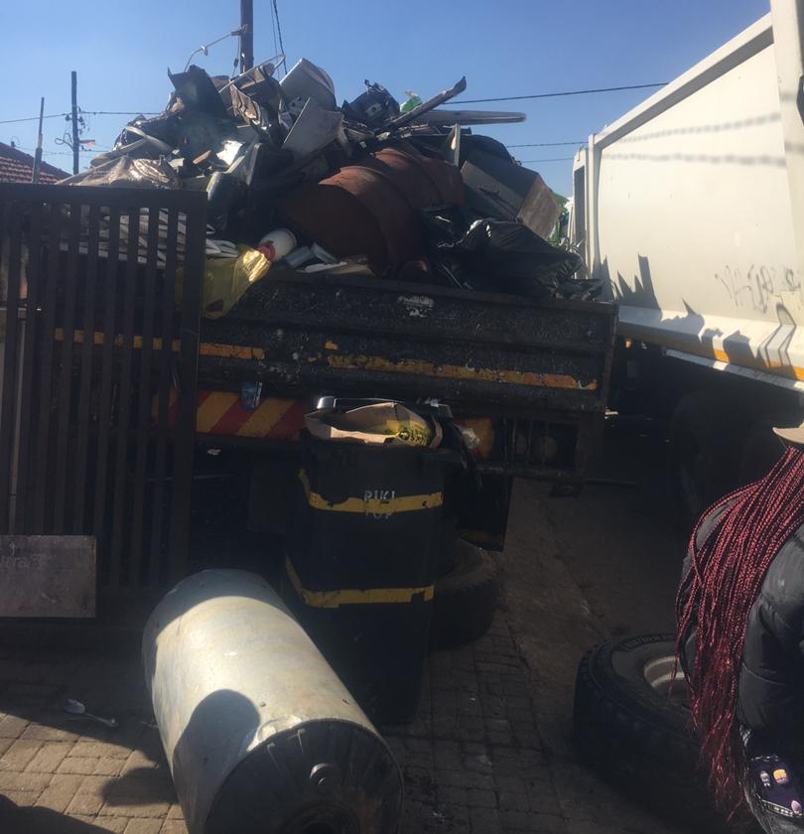
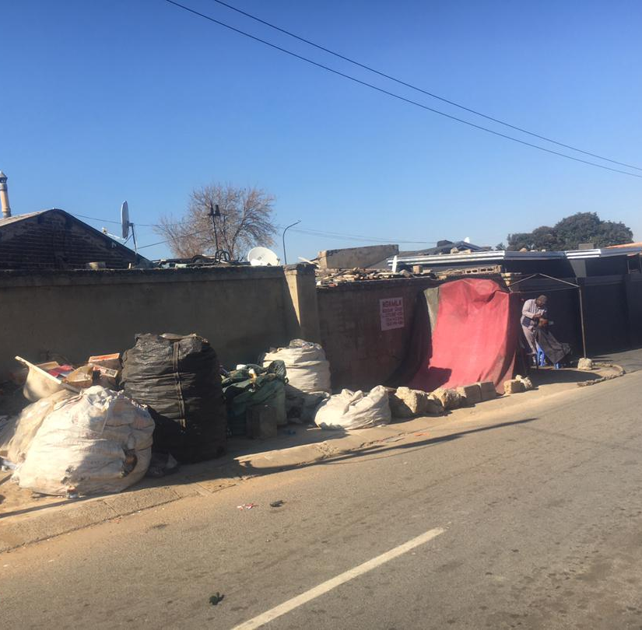
Emerging face of Joburg

Slide 19
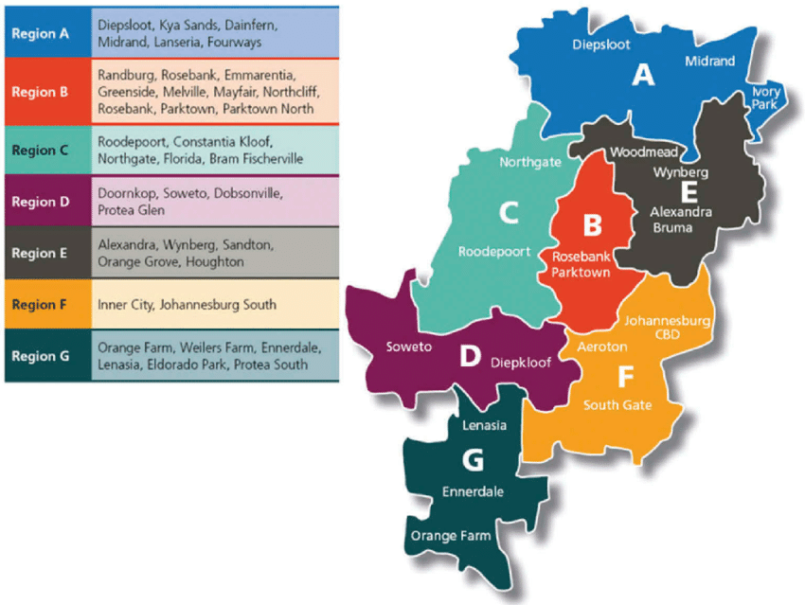
City of Joburg

Slide 20
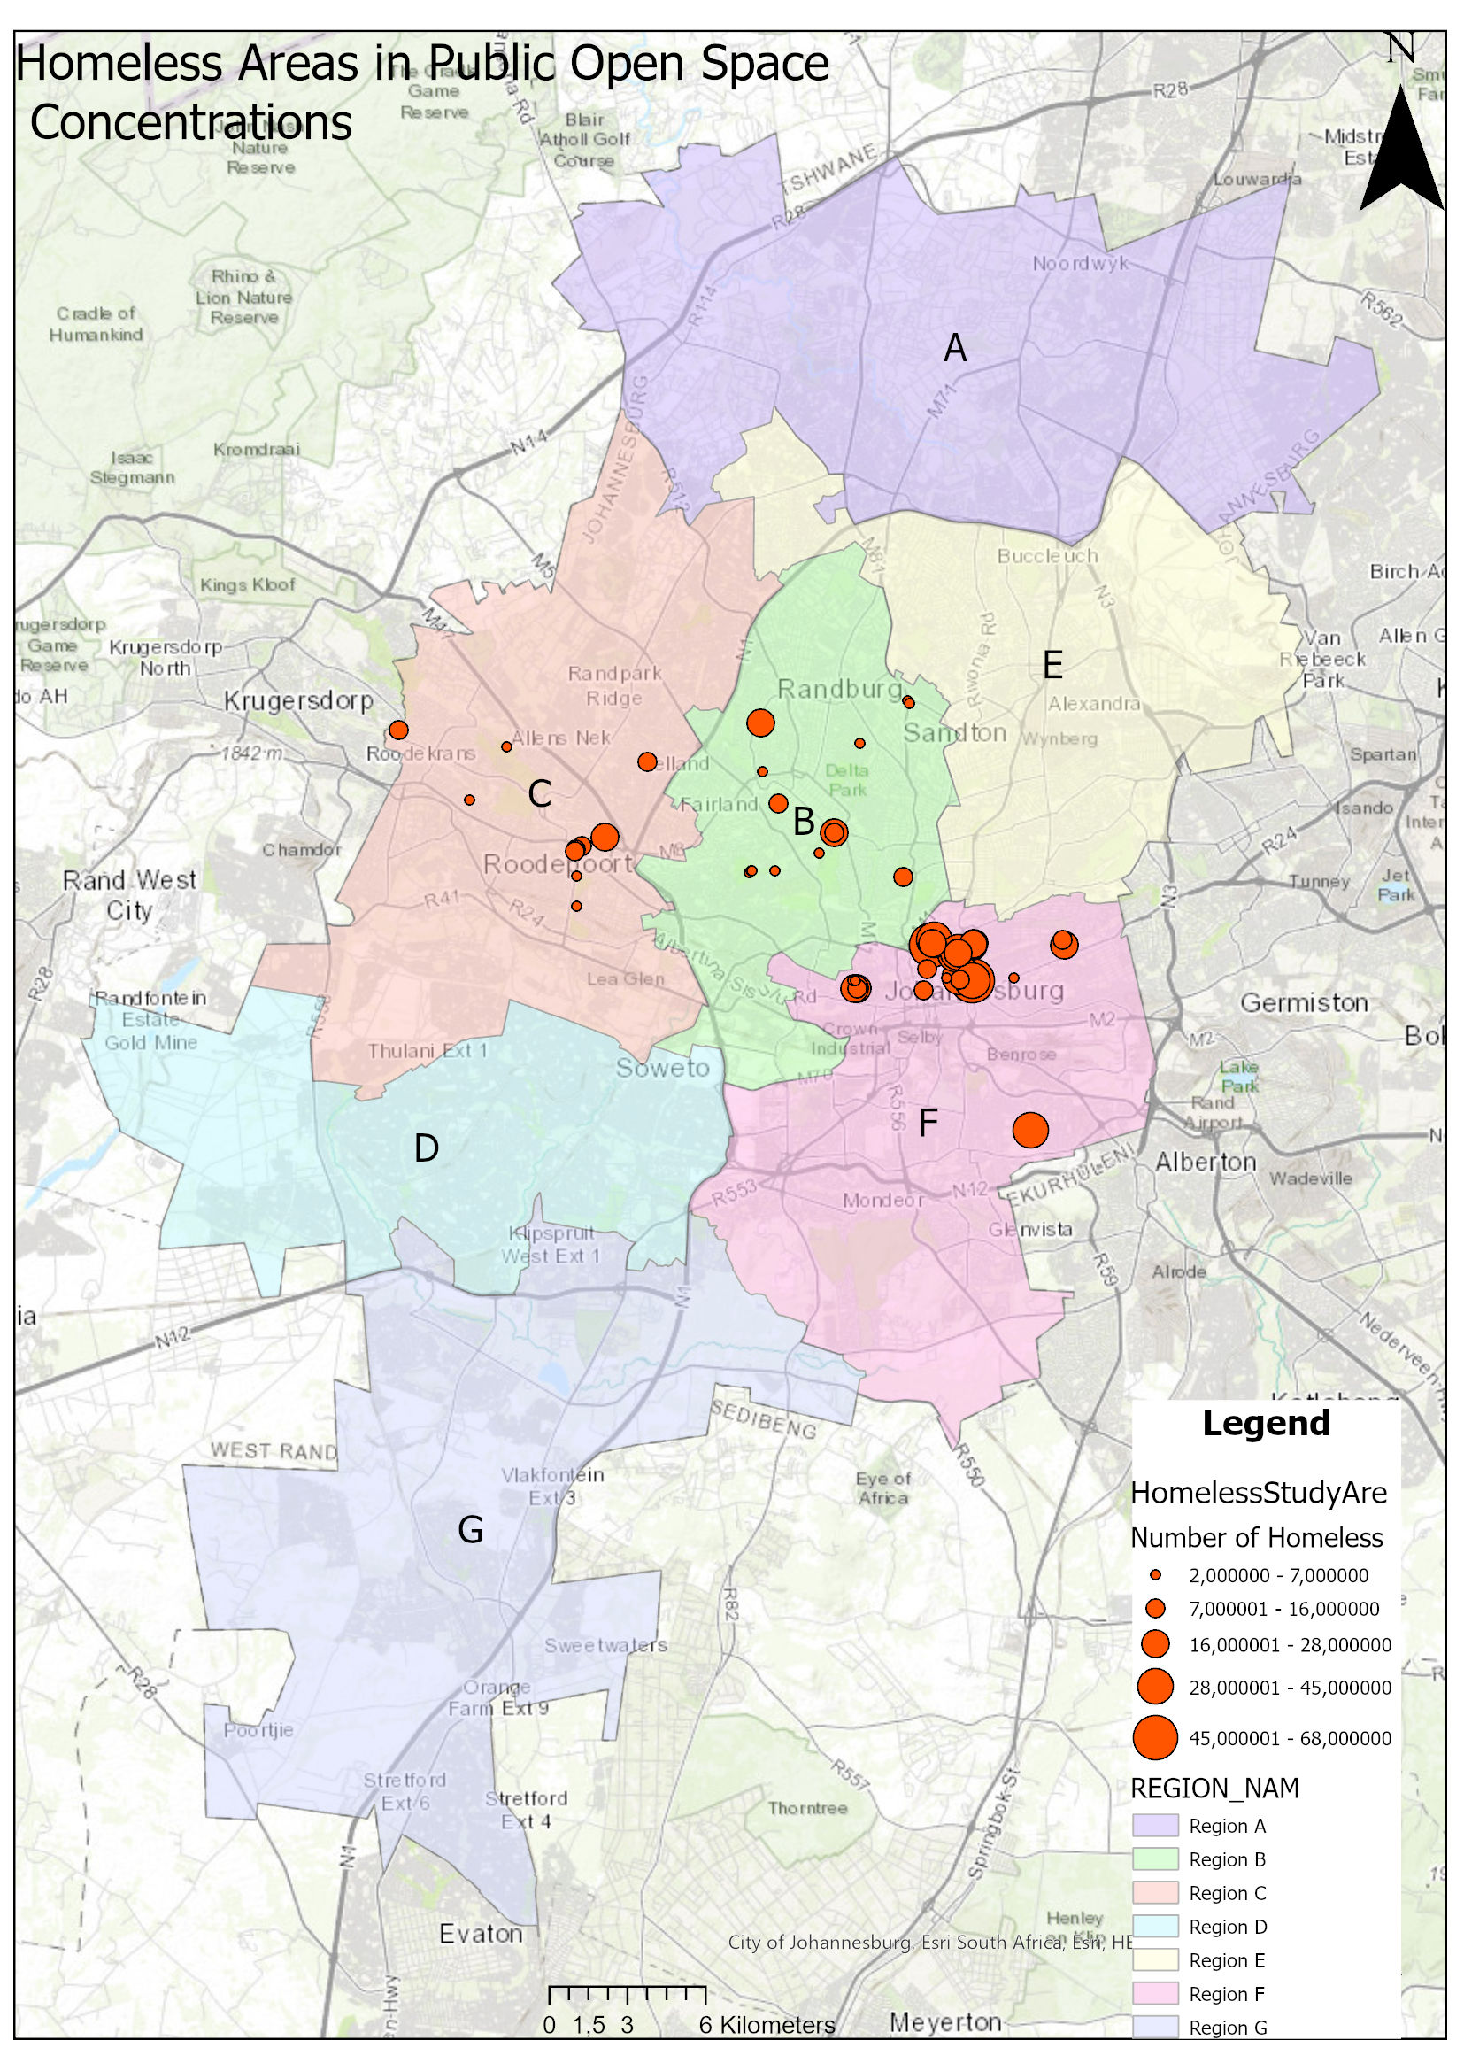
Survey Areas of Homelessness
The study was conducted from Region A-G in the City of Joburg. The 1193 public open spaces were surveyed, and 54 public open spaces are impacted by homelessness.

Slide 21
Method Used for Data Collection
Field data collection tool: Kobo Collect used to collect data in the field. Data was collected using two questionnaires these were:
Homeless Study – Homeless Individual Collection: This questionnaire is for individuals willing to speak to the data collector to obtain more background demographic information on the homeless individual. This questionnaire is completely voluntary, and no homeless individual was obliged to participate.
Homeless Study – Area Collection: The aim of this questionnaire is to identify areas where homelessness is found in public open spaces and parks. The identification of these attributes was done through collaboration and discussion amongst the authors as based on experience in similar studies done before on homelessness.
GIS Data processing: The exported field data collected with Kobo is excel spreadsheets. This is then imported into ESRI ArcPro from where the coordinate field in the captured data is used to create an XY points layer which can then be exported as a point spatial feature for analysis and map development.

Slide 22
Study Areas
REGION | No of functional Spaces in Region | No of Functional spaces with Homeless people | No of Homeless people in functional space per region
REGION A | 80 | 0 | 0
REGION B | 179 | 13 | 125
REGION C | 161 | 9 | 80
REGION D | 137 | 0 | 0
REGION E | 115 | 5 | 45
REGION F | 223 | 16 | 603
REGION G | 104 | 0 | 0
CEMETERIES | 40 | 1 | 40
CONSERVATION | 154 | 10 | 189
Grand Total | 1193 | 54 | 1044

Slide 23
Number of Homelessness in Public Open Spaces

Slide 25
Data Collection Analysis
132 Homeless people were interviewed ( Questioners)

Slide 26
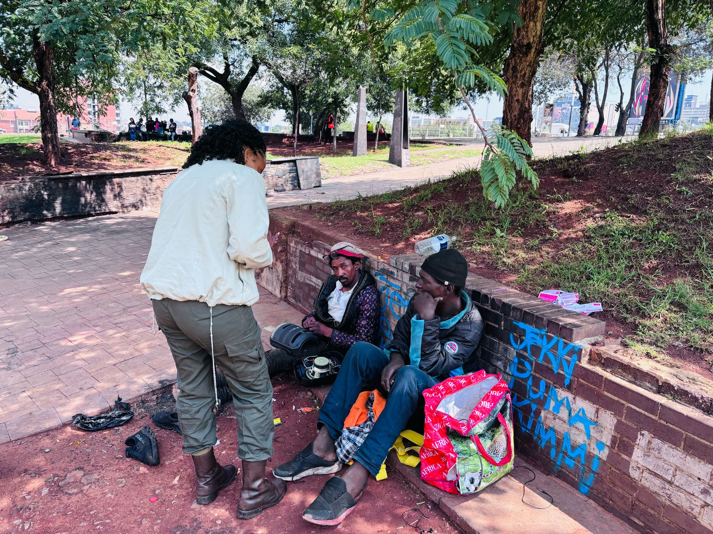
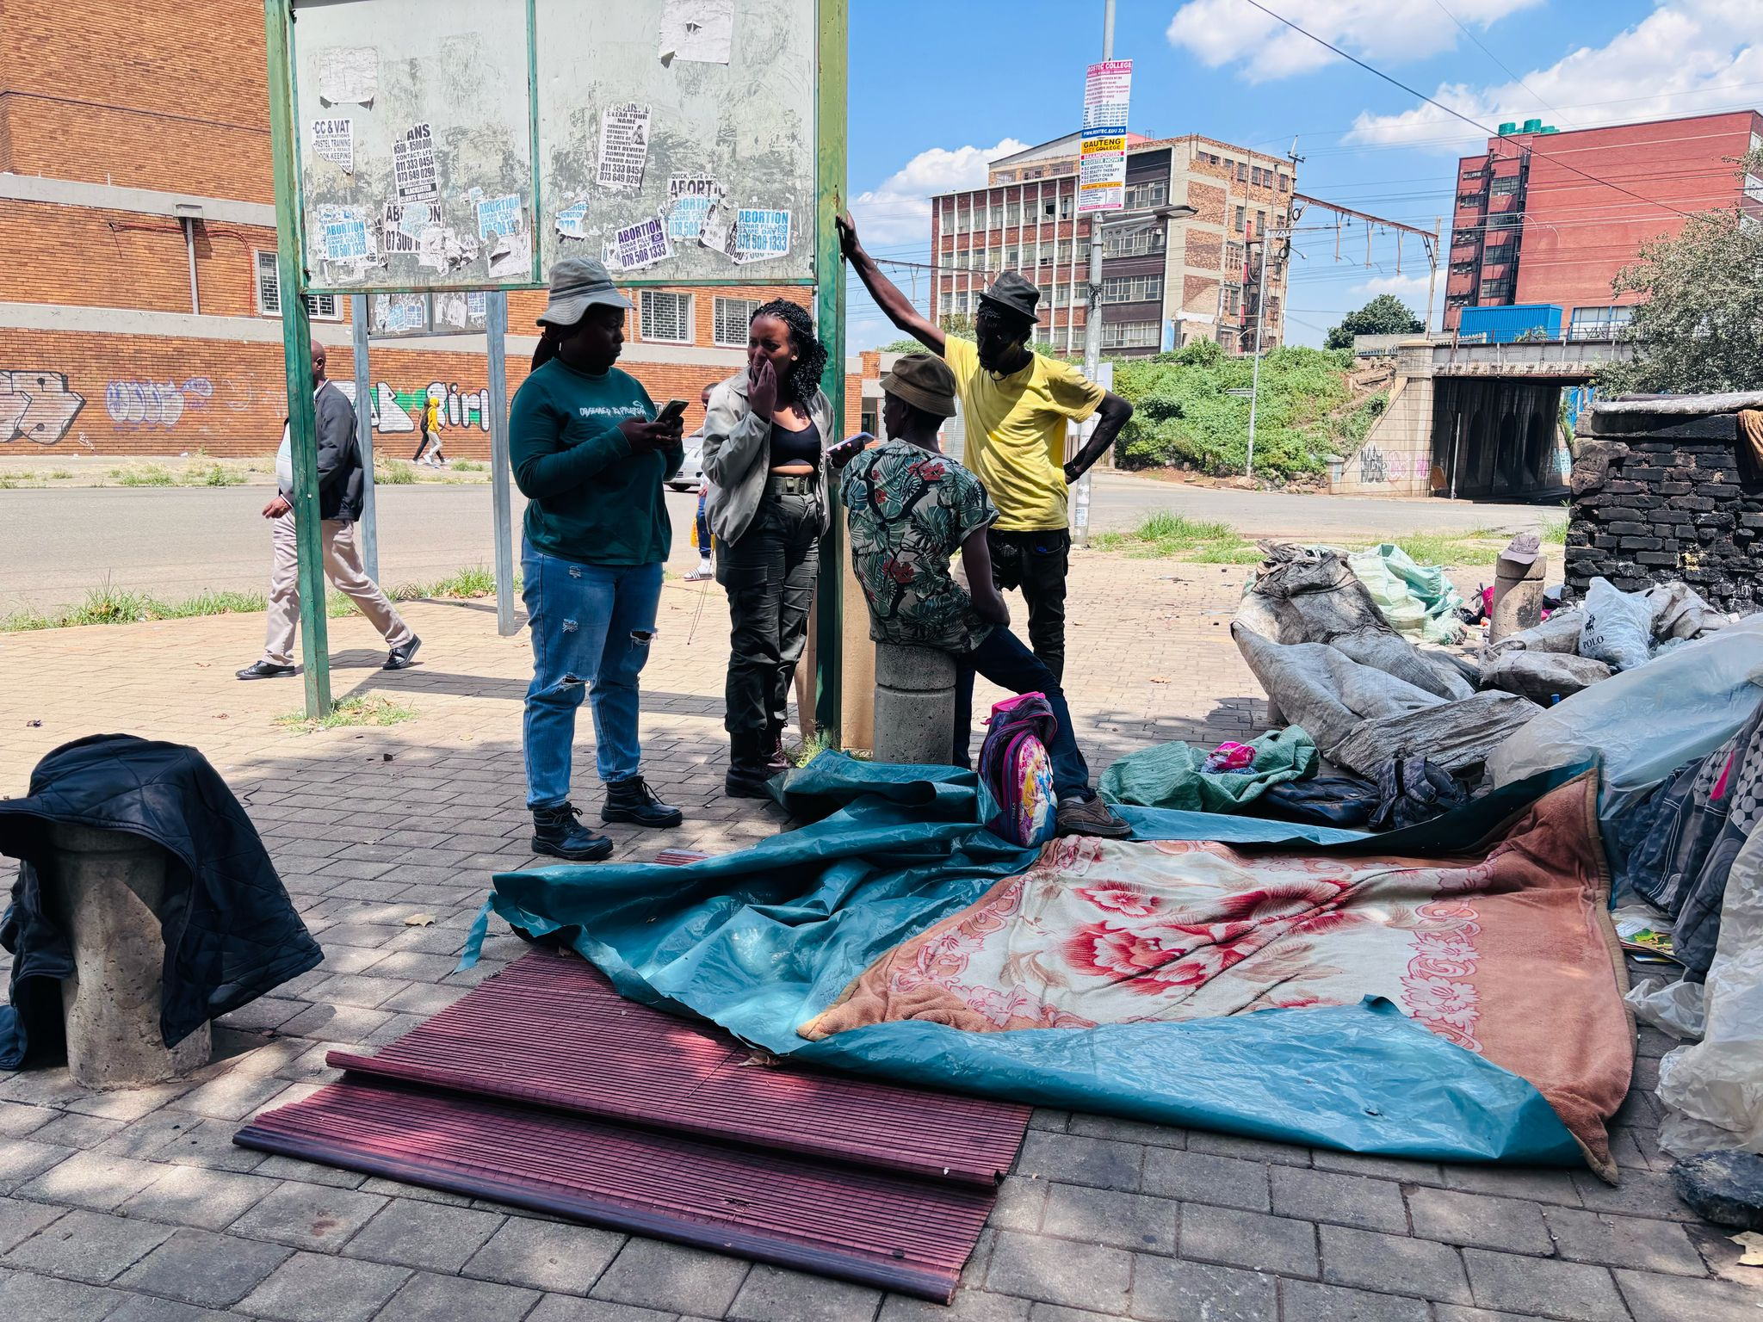

Slide 27
Data Collection
Which province are you from, if you from South Africa?
Which country are you from?
How long have you been living here?
How long have you been homeless?
Are you on drugs? If yes which one?
Would you like to go to a shelter?
Do you have any chronic Disease?
Why stay in cemeteries?

Slide 28
ETHNICITY

Slide 29
GENDER

Slide 30
AGE GROUP

Slide 31
AREA OF PREFERENCE

Slide 32
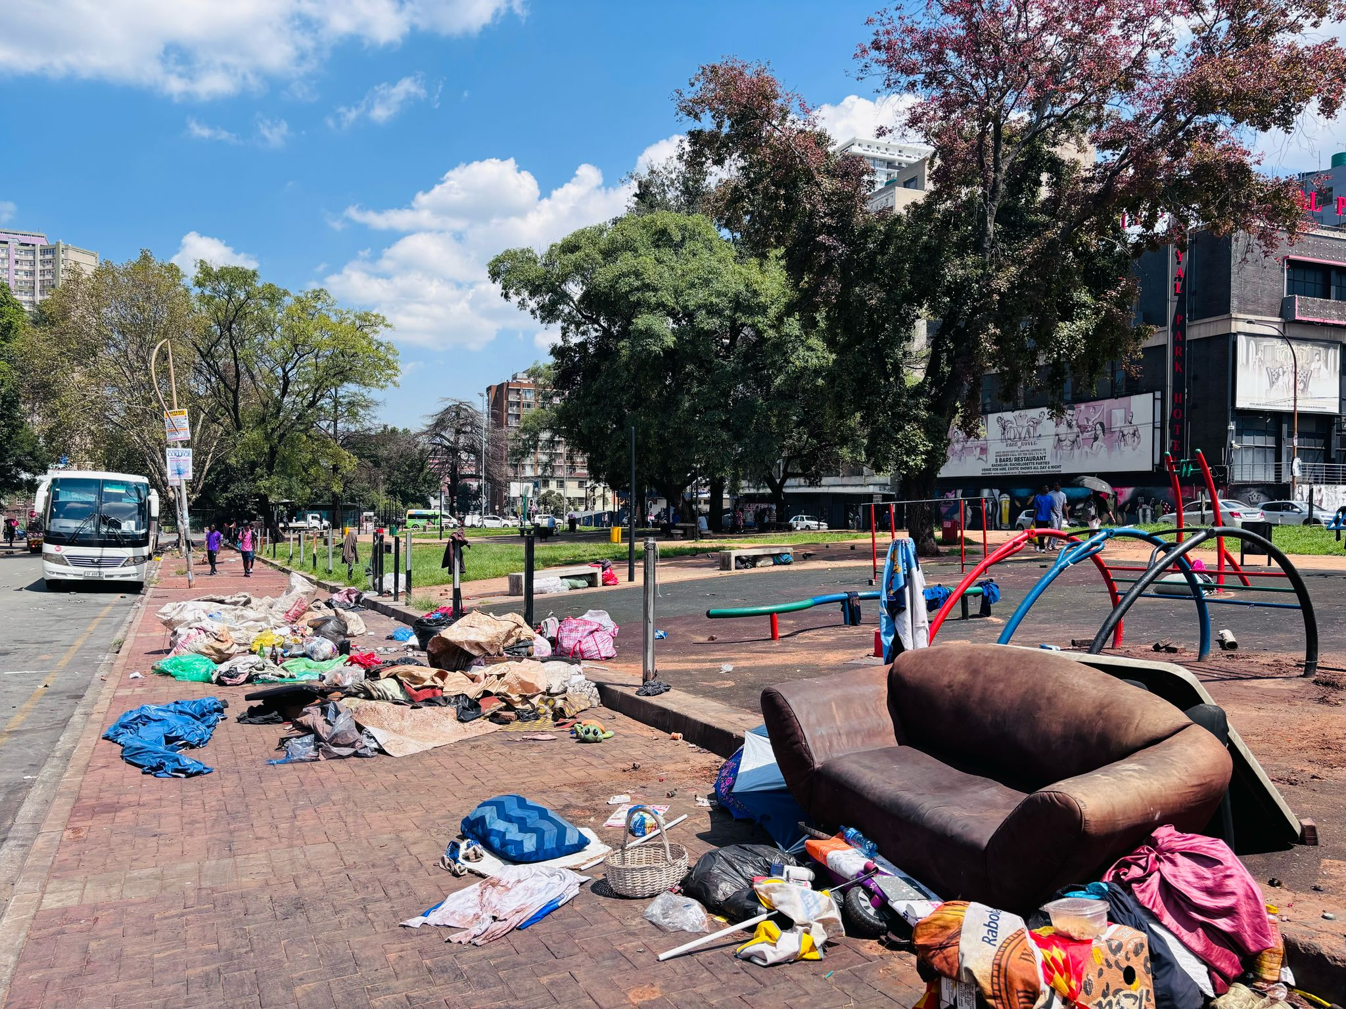

Slide 33
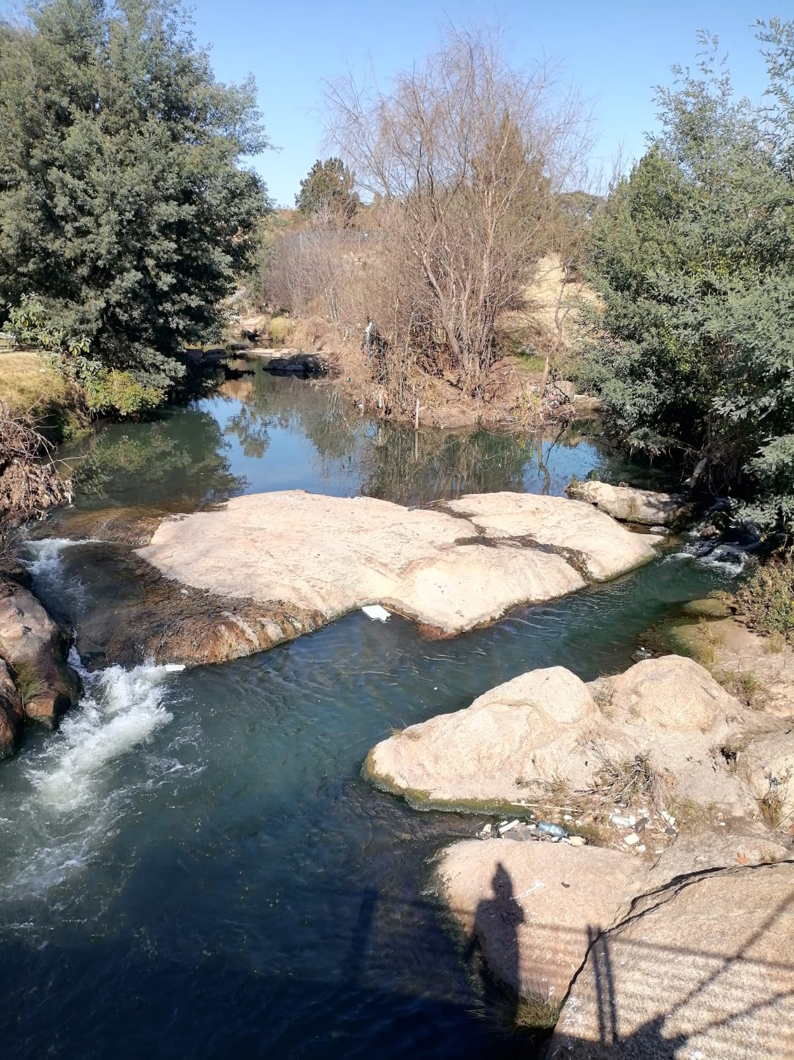
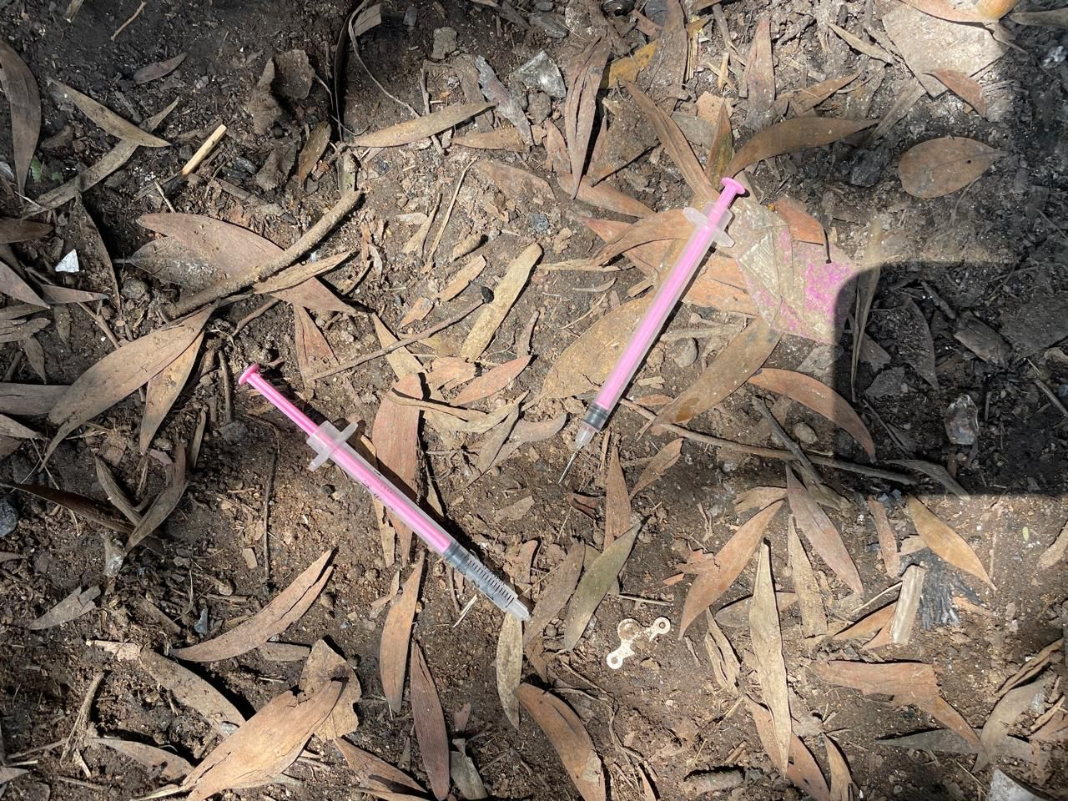

Slide 34
IMPACT OF HOMELESSNESS IN CEMETERIES

Slide 35
IMPACT OF HOMELESSNESS IN CEMETERIES
There are 42 Cemeteries in the City of Johannesburg
5 FLAGSHIP CEMETERIES
6 PASSIVE ACTIVE CEMETERIES
31 PASSIVE CEMETERIES

Slide 36
THERE ARE 2 HIGHLY IMPACTED CEMETERIES BY HOMELESSNESS

Slide 37
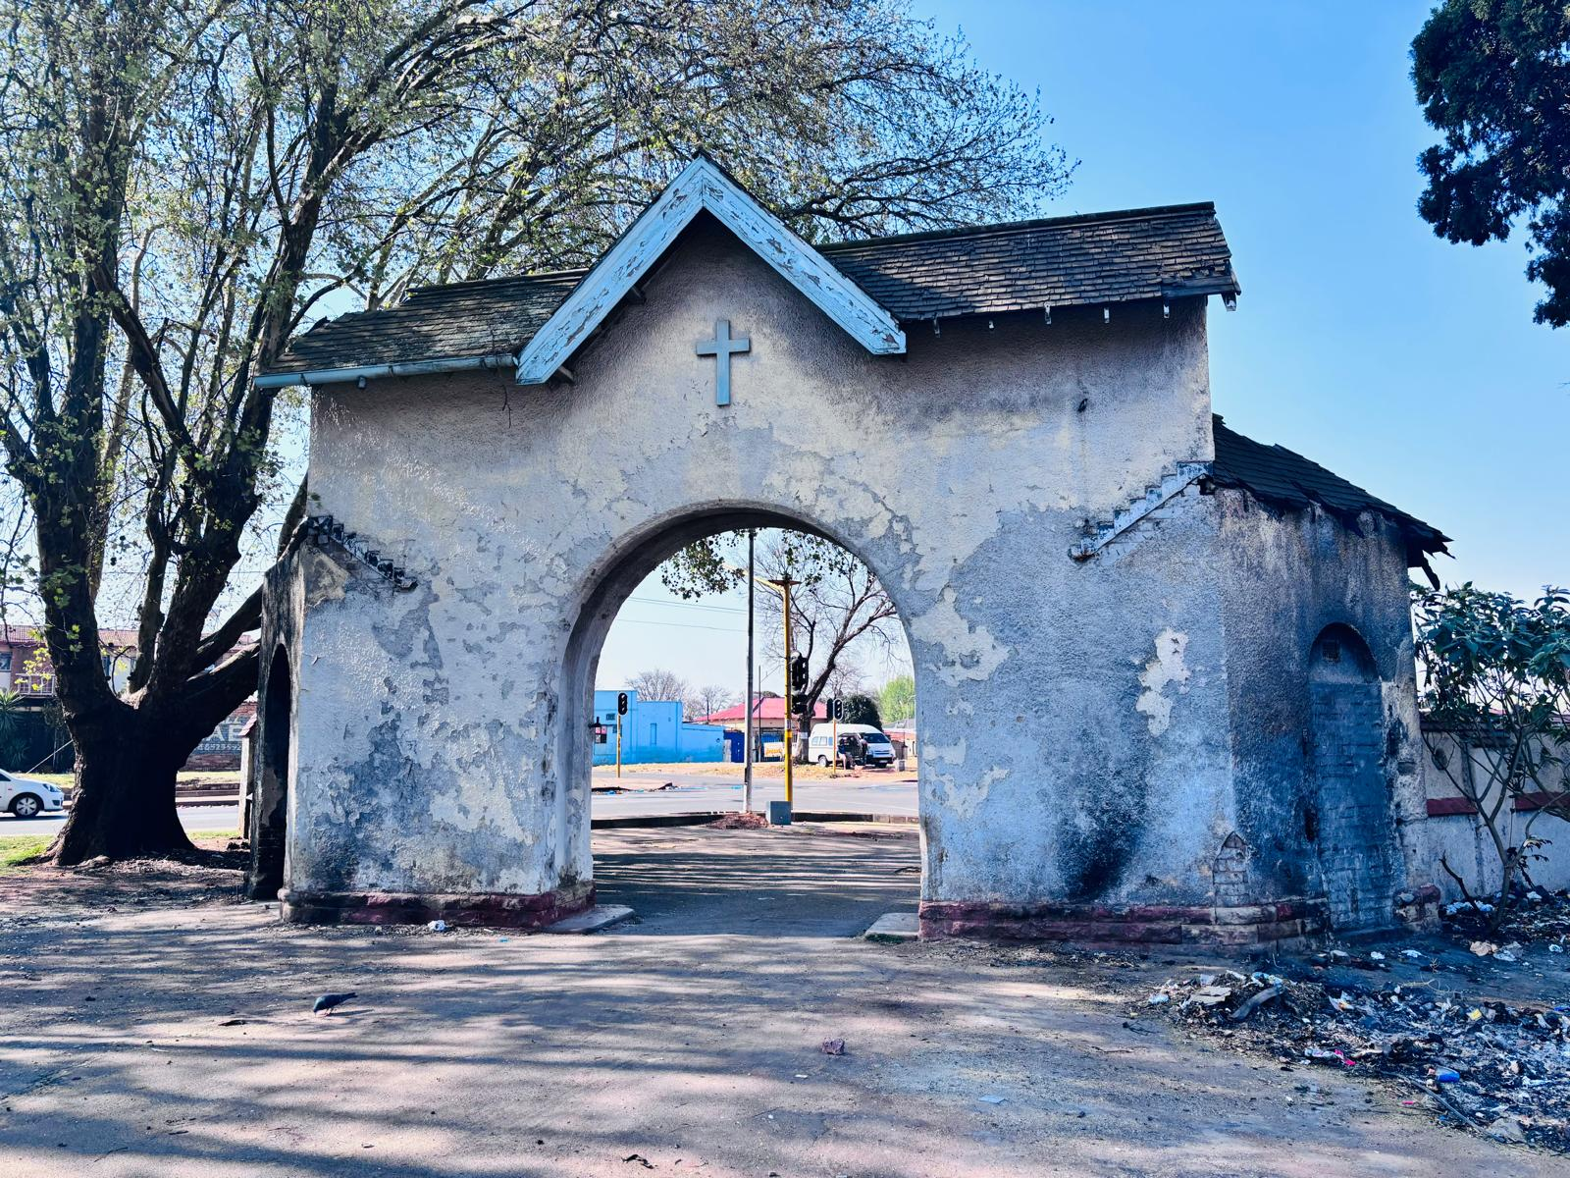
THE BRIXTON CEMETERY

Slide 38
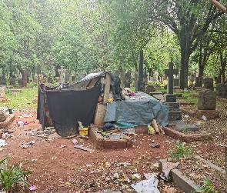
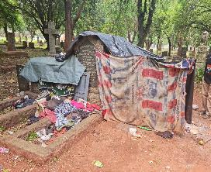

Slide 39
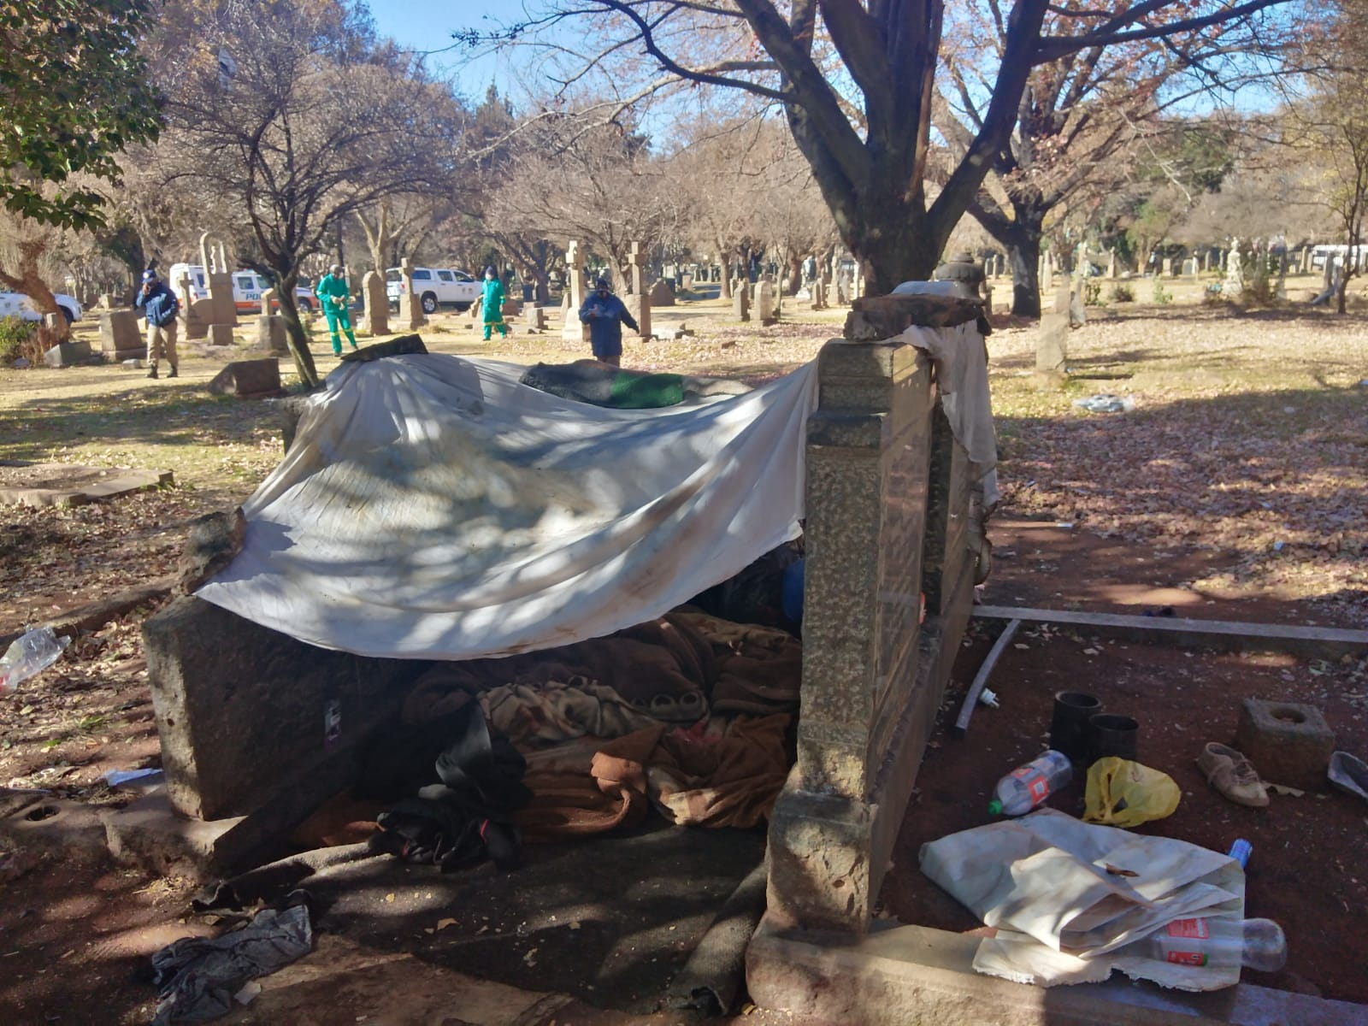
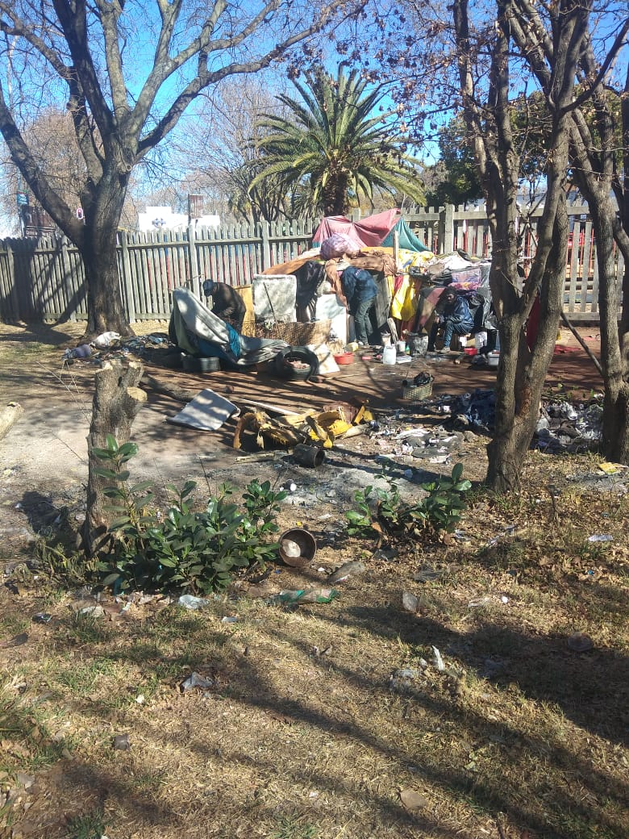

Slide 40
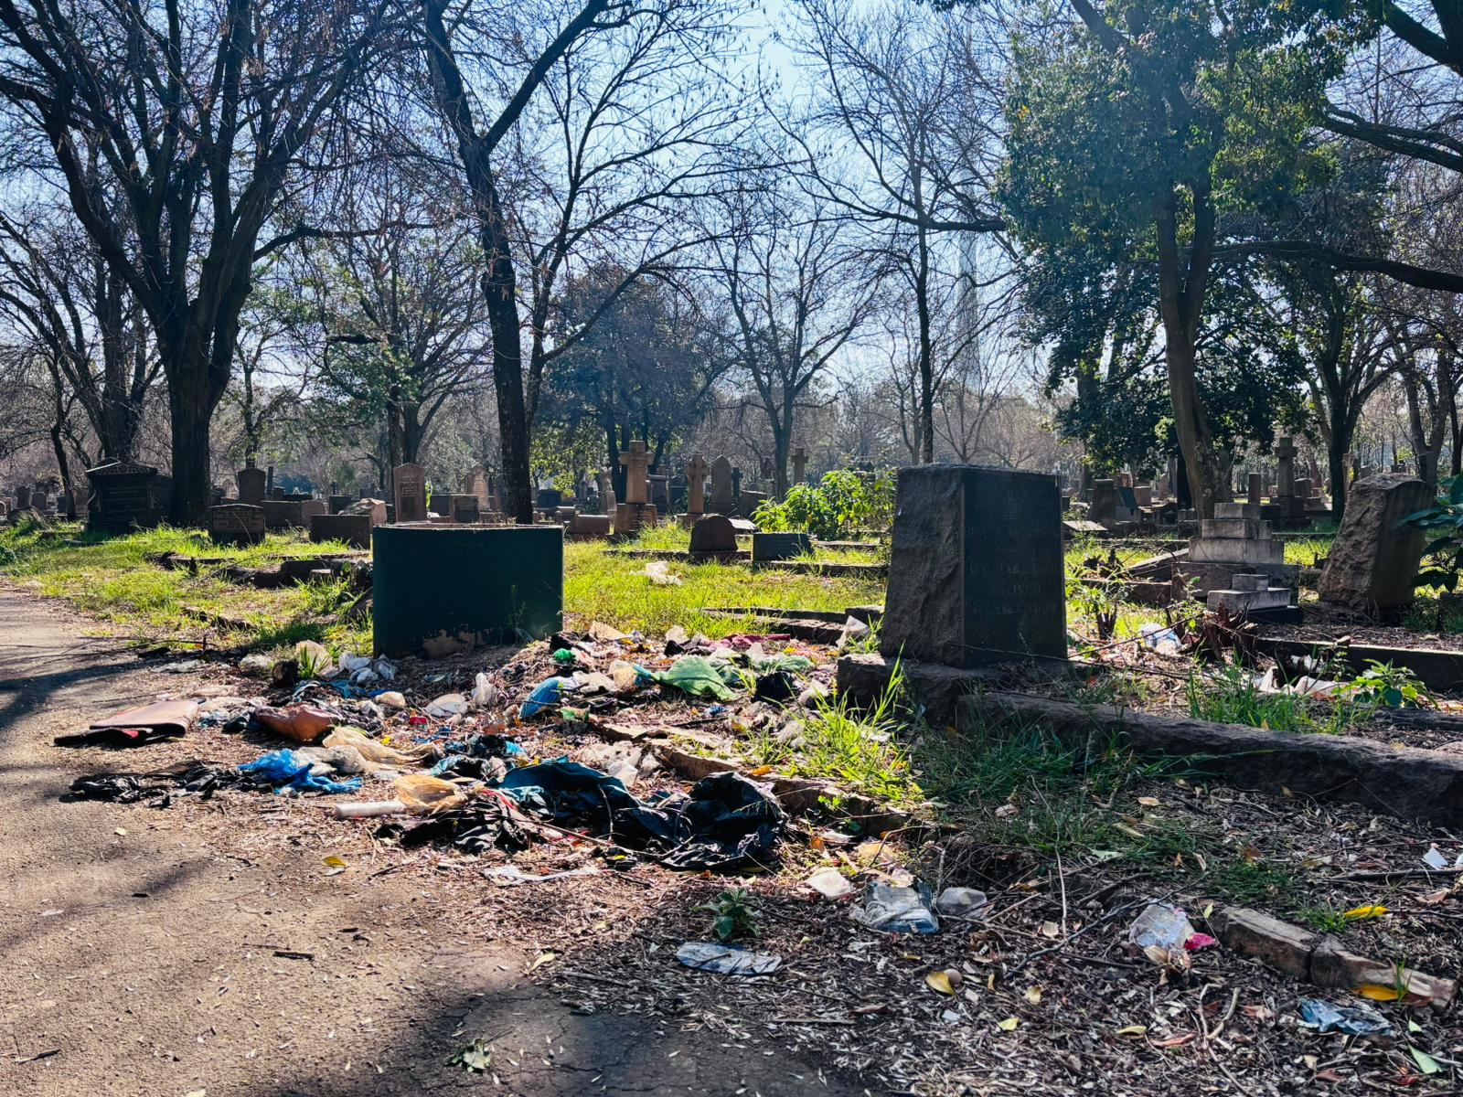
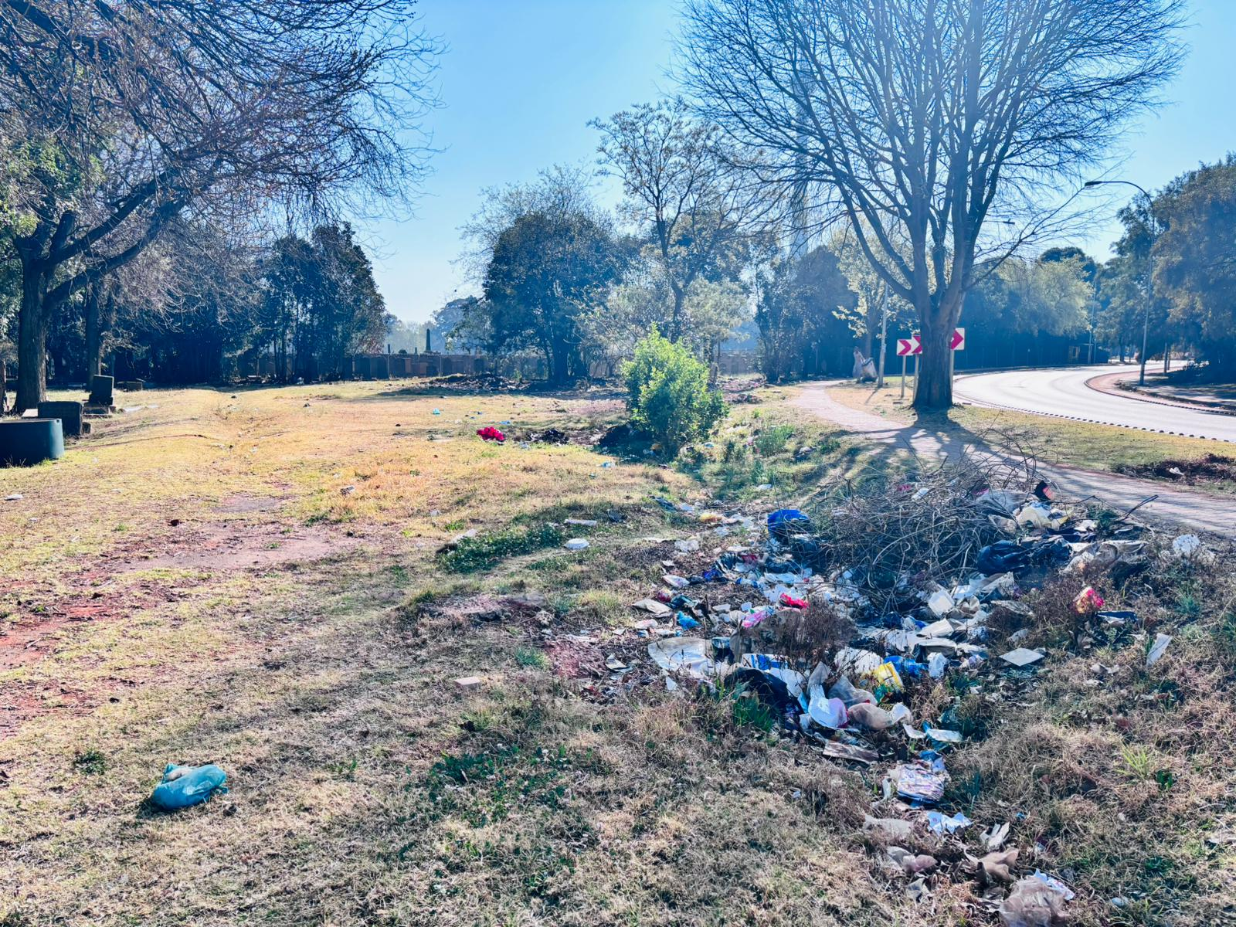

Slide 41
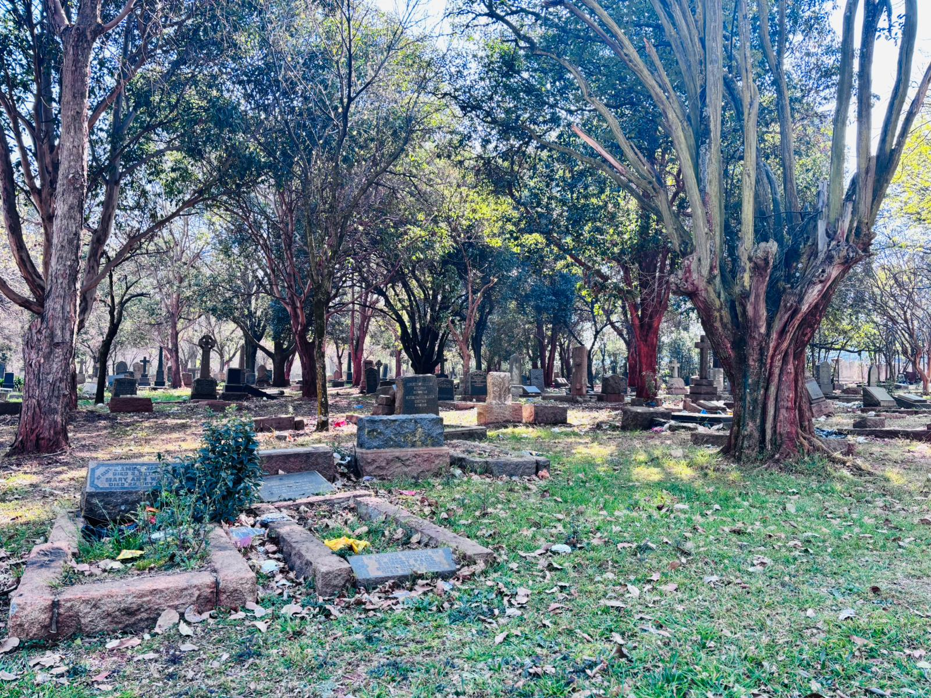

Slide 42
IMPACT OF HOMELESSNESS IN CEMETERIES
The cemetery look untidy as the homeless people does recycling inside the cemetery.
The fence is stolen and there s no longer proper access gate.
The homelessness crate unsafe cemeteries. Communities don’t feel safer to visit cemeteries.

Slide 43
IMPACT OF HOMELESSNESS IN CEMETERIES
The Johannesburg City Parks and Zoo has deploy security guards in some of the cemeteries.
The Green fencing project
No enough budget to have more security guards in our facilities.

Slide 44
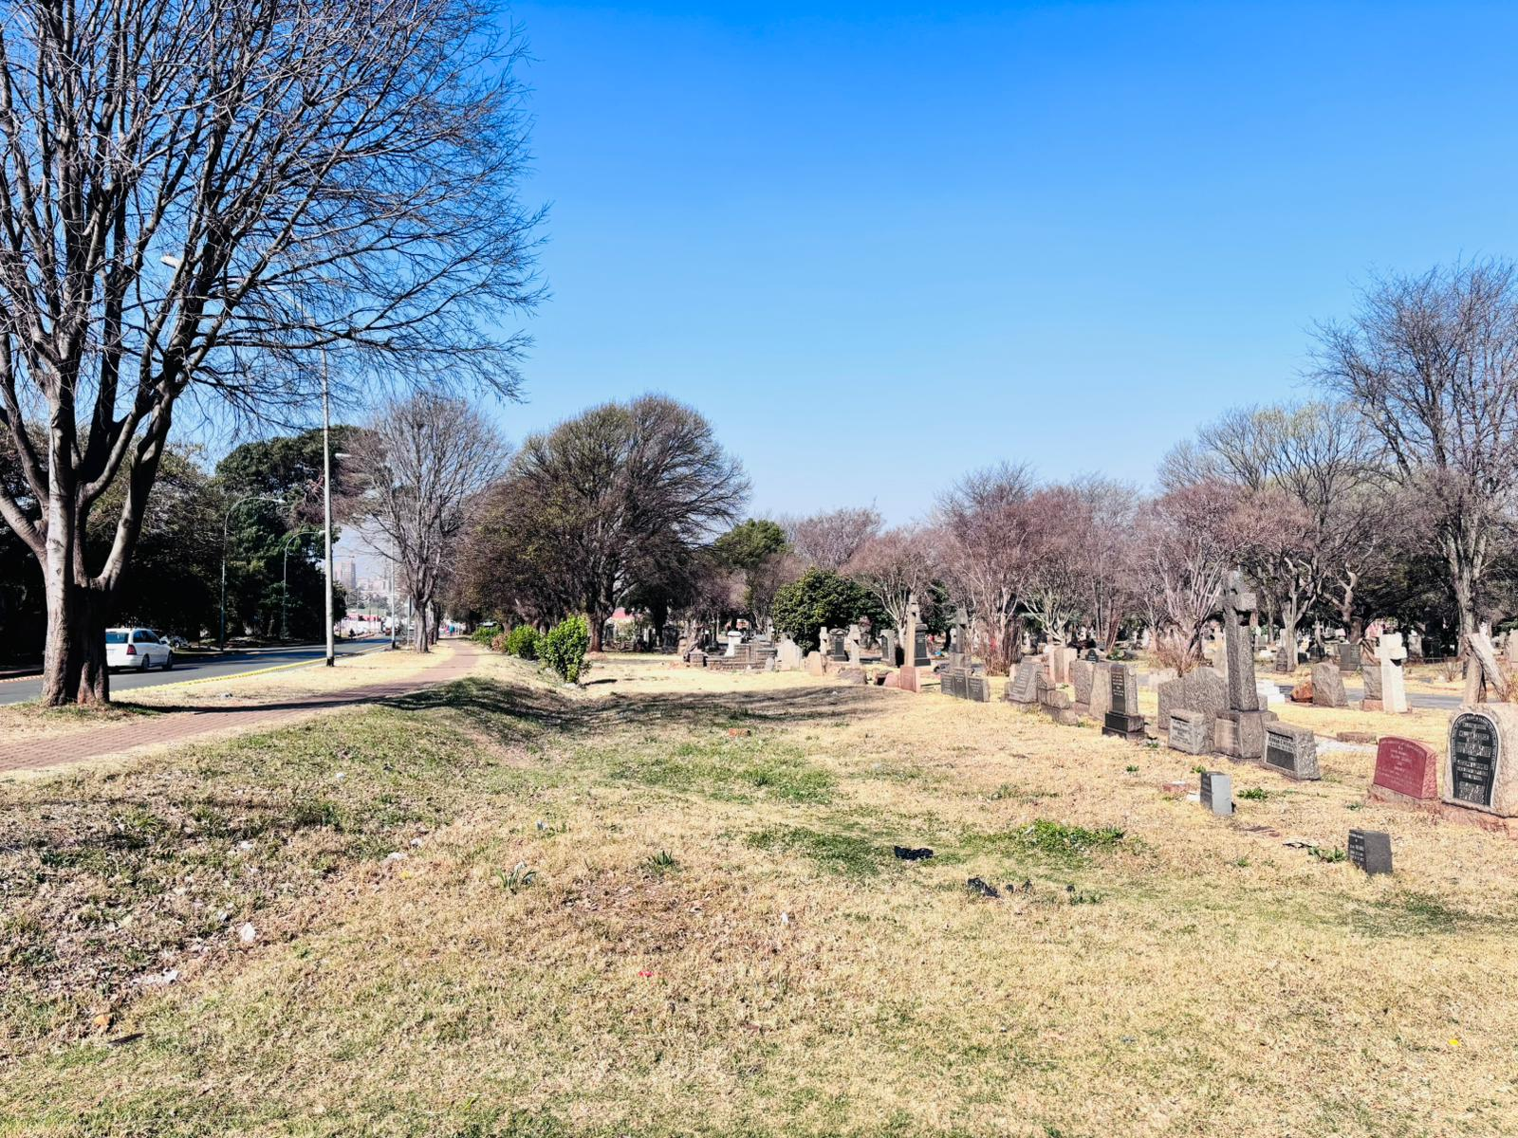
Green Fencing (Trees stolen)

Slide 45
RECOMMENDATIONS
Removal of homeless people to the shelters.
Huge clean up program at the cemetery.
Fixing of the fence line and repainting of the building
Community ownership of the cemetery (FRIENDS OF CEMETERIES)
Create this cemetery as a tourism destiny
Bylaw enforcement (Very aggressive bylaws)

Slide 46
THE BRAAMFONTEIN CEMETERY HAS BEEN RECLAIMED
CLEAN FROM HOMELESSESS AND MAINTENANCE DUE TO THE INTERVENTION

Slide 47
IF WE DON’T SAFEGUARD OF PUBLIC OPEN SPACES AND CEMETERIES

Slide 48
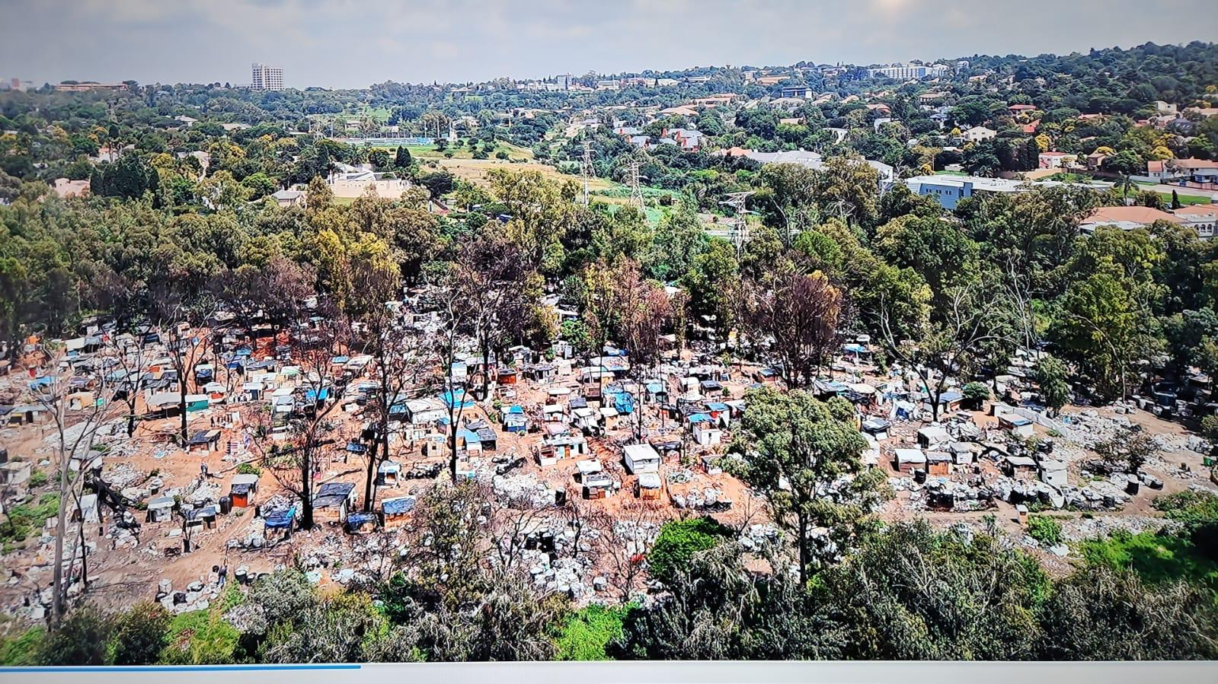
This is not the City of Joburg we want
CONCLUSION

Slide 49


Slide 50
Thank You / Ndo Livhuwa.

